Slide 1
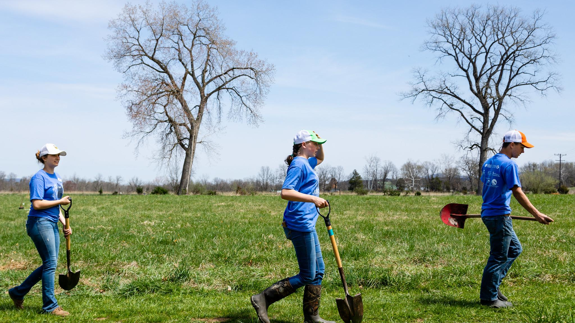
A Local Government Guide to the Chesapeake Bay
Module 7: Building the Workforce of Today and Tomorrow
Notes:
Photo by W. Parson/Chesapeake Bay Program

Slide 2
Content Developed By
A Local Government Guide to the Chesapeake Bay
Visit Us

Slide 3
Table of Contents
1
Purpose
What You’ll Learn
Green Collar Workforce
Diversity As An Asset
Education
Existing Programs
What You Can Do
To Learn More
Glossary
2
3
4
5
6
7
8
9
*Please refer to individual slide notes for data references and information sources.
Module 7: Building the Workforce of Today and Tomorrow
Notes:
Photo by Kylie Hauck

Slide 4
A Guide For Local Governments
As a local leader, your decisions set the course for your community. Your actions determine the health and vitality of your jurisdiction, as well as that of your local waterways and the Chesapeake Bay. You can achieve win-win outcomes by prioritizing local economic development, infrastructure resiliency, public health, and education while also protecting your environment.
This module is one in a series created by the Chesapeake Bay Program to support decision making by local officials. We encourage you to examine the full suite of modules:
How Your Watershed Works
Foundations of Clean Water
Healthy Water for the Economy
The Benefits of Trees
Preserving Local Character and Landscapes
Protecting Your Infrastructure Through Stormwater Resiliency
Building the Workforce of Today and Tomorrow
Protecting Your Community from Water Extremes
Understanding and Supporting Your Agricultural Allies
Keys to Community Buy-In for the Environment
Your Health and the Environment
To help local government representatives better understand how the information in the modules aligns with their priorities, look for these icons:
Economic Development
Public Health & Safety
Infrastructure Maintenance & Finance
Education
Building the Workforce of Today and Tomorrow
Purpose

Slide 5
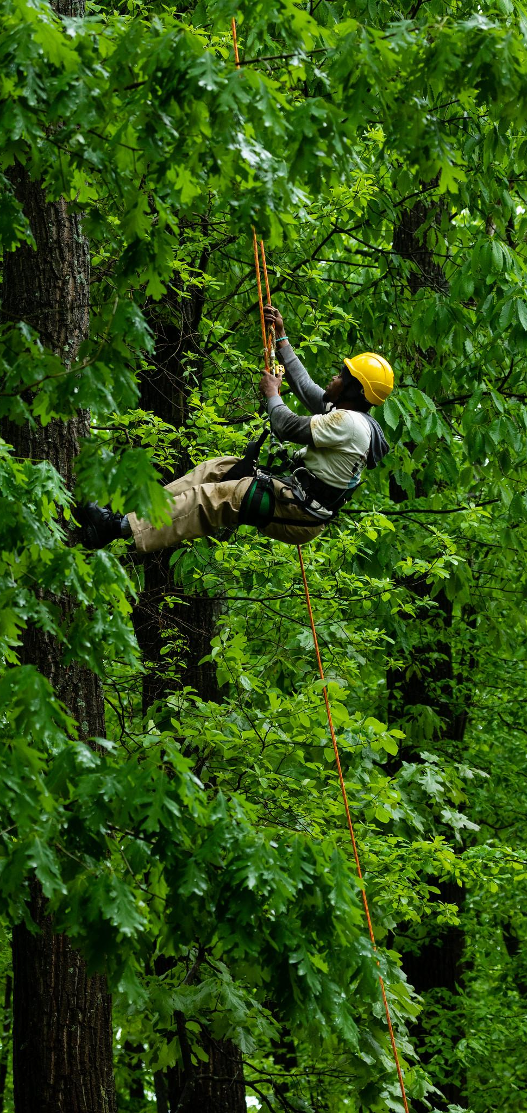
Workforce Connections
Jobs are a top priority for communities everywhere. The jobs of the 20th century, including those in agriculture, manufacturing, and mining, have dwindled and given rise to new fields, including what are referred to as green jobs.
With a growth in the construction and installation of stormwater management and green infrastructure projects, it is imperative to have workers trained in operations and maintenance to ensure these systems continue to function properly over time. Public lands and recreational areas require a workforce for their upkeep and to cater to tourists, who will need amenities, such as lodging and food, when they visit your community.
By developing our capacity to train and support green jobs, we can prepare our communities to thrive in the face of coming challenges.
Building the Workforce of Today and Tomorrow
Purpose
Notes:
References:
I. D. Wyatt and D. E. Hecker, Occupational Changes During the 20th Century: https://www.bls.gov/mlr/2006/03/art3full.pdf
Photo by W. Parson/Chesapeake Bay Program

Slide 6
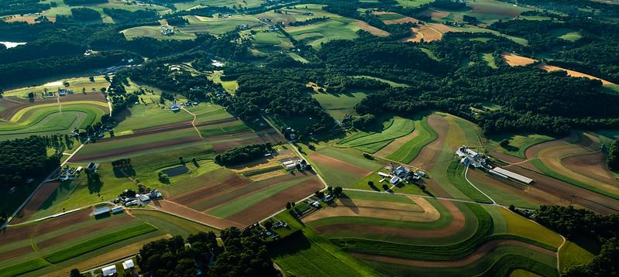
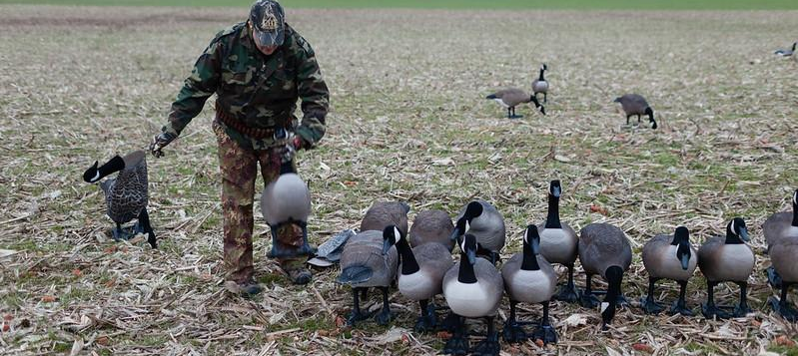
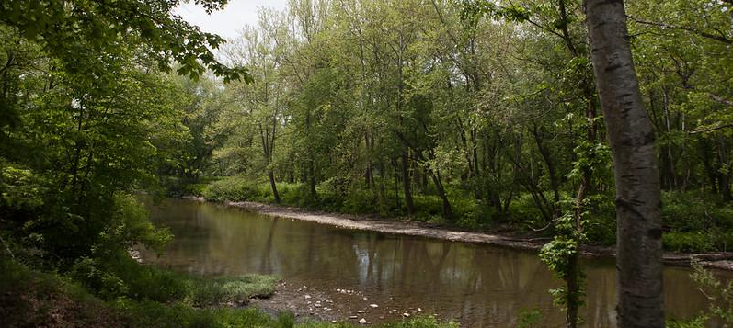
What You’ll Learn
What is the “green economy” and how could it help my community?
How do I attract and retain skilled workers, new residents, and businesses?
What are the benefits of a diverse workforce?
Building the Workforce of Today and Tomorrow
What You’ll Learn
Notes:
Photos by W. Parson and S. Droter (Chesapeake Bay Program)

Slide 7
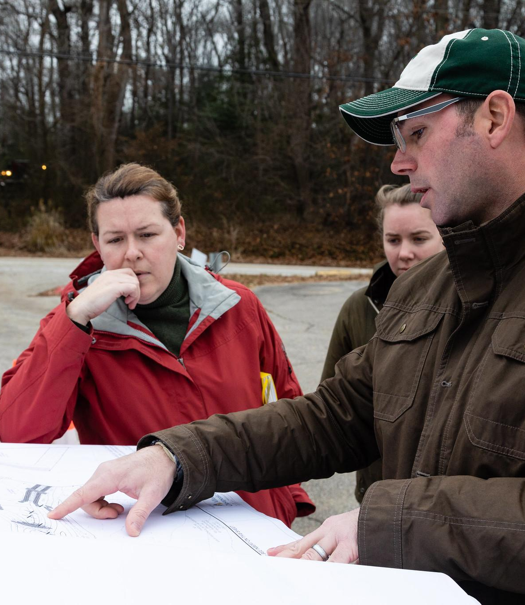
Green Collar Workforce
The green economy in the US is estimated to be worth $1.3 trillion annually, employing nearly 9.5 million workers.
Notes:
Reference:
L. Georgeson and M. Maslin 2019, https://www.nature.com/articles/s41599-019-0329-3#auth-1
Photo by W. Parson/Chesapeake Bay Program

Slide 8
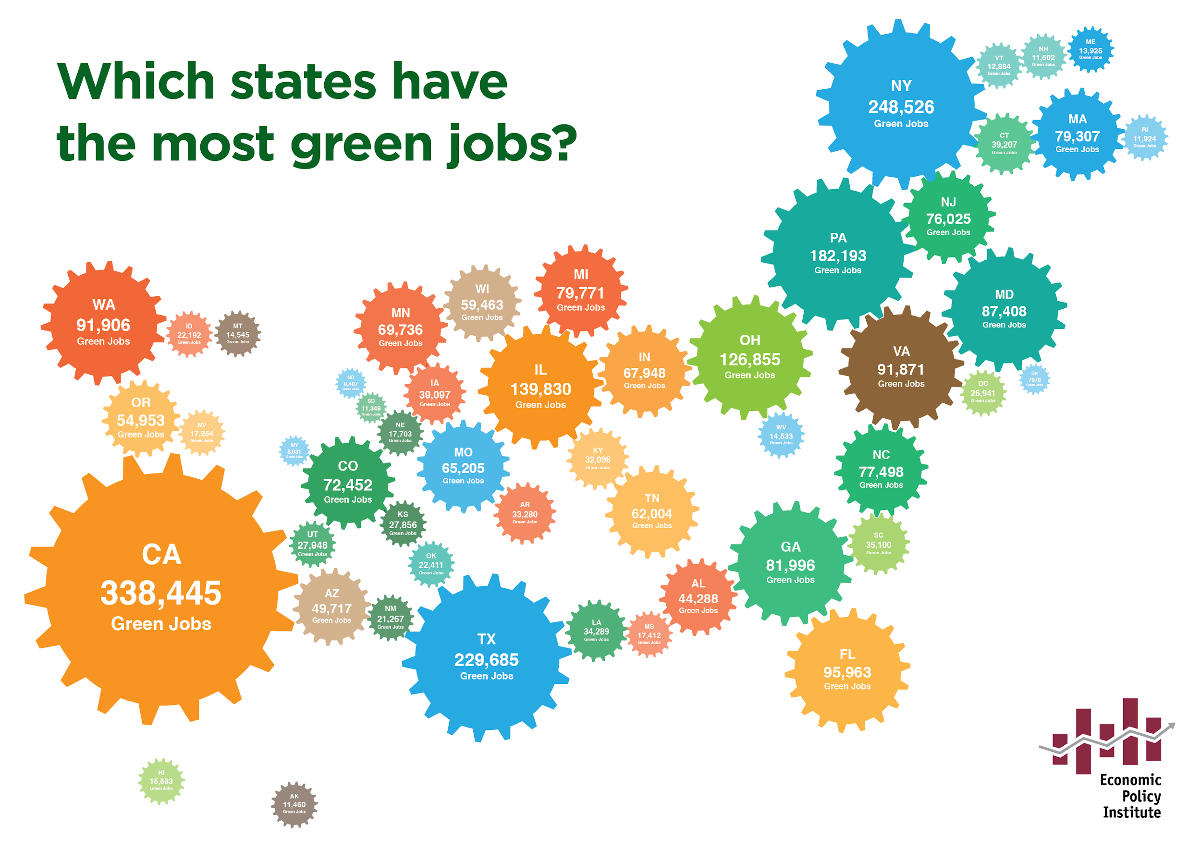
What’s Green Collar?
The Bureau of Labor Statistics defines green jobs as those in businesses that benefit the environment or jobs in which workers’ duties involve making their establishment’s production processes more environmentally friendly.
In 2012, four of the ten states with the most green jobs were in the Chesapeake Bay watershed.
CA
NY
TX
PA
IL
OH
FL
WA
VA
MD
Building the Workforce of Today and Tomorrow
Green Collar Workforce
Notes:
References:
E. Pollack 2012, https://www.epi.org/publication/bp349-assessing-the-green-economy/

Slide 9
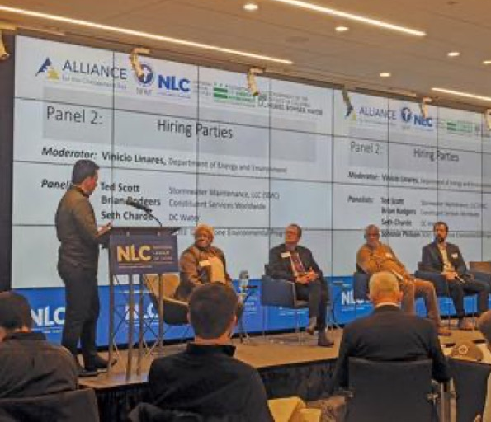
Why Green Jobs Matter
Community leaders must address many priorities, including economic development, education, human health and safety, and more, usually with limited staff and budgets. Investing in green workforce development is one way to address multiple local concerns.
Case study: Washington, DC
The District is connecting its environmental goals, like cleaner energy and improved stormwater management, with career opportunities for residents by prioritizing a green workforce.
Maintenance of the 1200+ green infrastructure installations in DC’s public spaces will take a new, skilled workforce. Training programs for underemployed and unemployed residents, like the Solar for All program, are providing economic mobility while meeting the District’s need for green workers.
Department of Energy & Environment director Tommy Wells emphasized the importance of the training programs “to help meet Mayor Bowser’s water quality, habitat restoration and clean energy targets, while also attracting top talent and cultivating the next generation of environmental leaders.”
Building the Workforce of Today and Tomorrow
Green Collar Workforce
Notes:
References:
E. Pollack 2012, https://www.epi.org/publication/bp349-assessing-the-green-economy/
Photo from the Bay Journal: https://www.bayjournal.com/columns/stewards_corner/elevating-the-green-workforce-in-a-changing-landscape/article_ae0ddb5a-ec67-11ea-8495-939ff7d76970.html

Slide 10
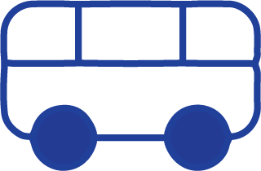
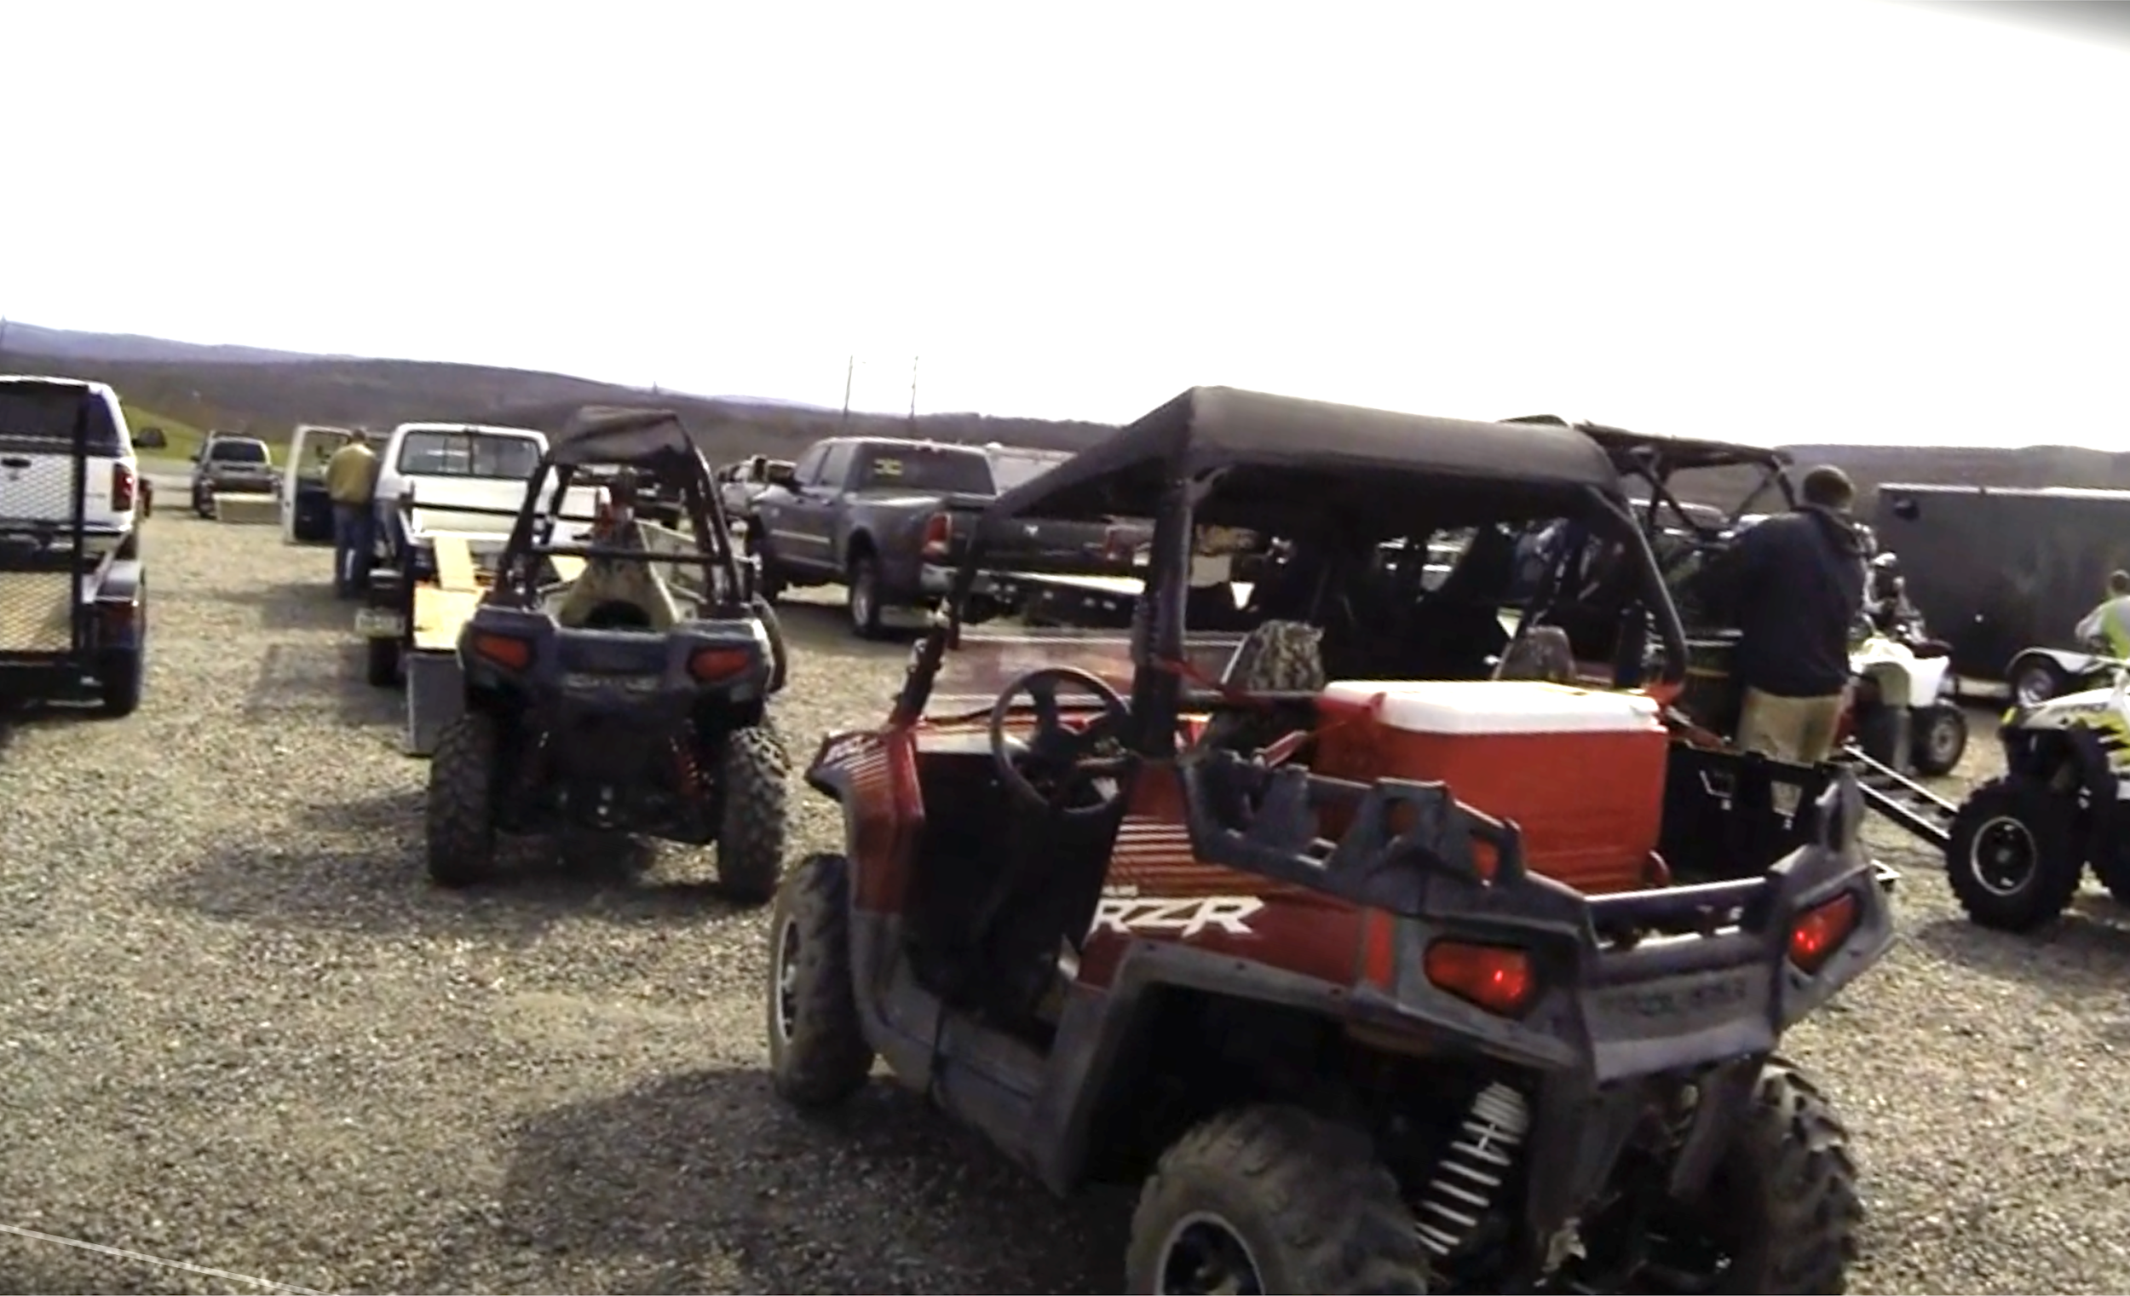
Outdoor Recreation
Nationally, there are approximately 7.6 million jobs in the outdoor recreation economy. Outdoor recreation provides a wide array of jobs across skills and sectors. Examples include:
park rangers
bus drivers
local shop owners
fishing guides
environmental educators
park maintenance
Case study: Coal Township, PA
Anthracite Outdoor Adventure Area is located on 7,000 acres of reclaimed coal mines that were vacant for decades. The outdoor recreation center sees tens of thousands of visitors per year, bringing patrons to nearby restaurants, gas stations, and hotels.
Mine reclamation creates jobs in areas with limited opportunities. These projects typically hire construction contractors who were often former mine operators and who in turn employ former miners and other local workers in depressed coalfield communities.
Building the Workforce of Today and Tomorrow
Green Collar Workforce
Notes:
References:
Outdoor Recreation Economy, https://outdoorindustry.org/wp-content/uploads/2017/04/OIA_RecEconomy_FINAL_Single.pdf
https://www.eenews.net/stories/1060044504
https://www.dailyitem.com/news/local_news/developer-describes-hotel-proposal-in-shamokin/article_ed22dec5-31bd-5ea4-be75-6a5621201879.html
http://files.dep.state.pa.us/Mining/Abandoned%20Mine%20Reclamation/AbandonedMinePortalFiles/SMCRA_Funded_AML_Program_FAQ.pdf
Photo from https://www.aoaatrails.com/news/aoaa-in-the-news

Slide 11
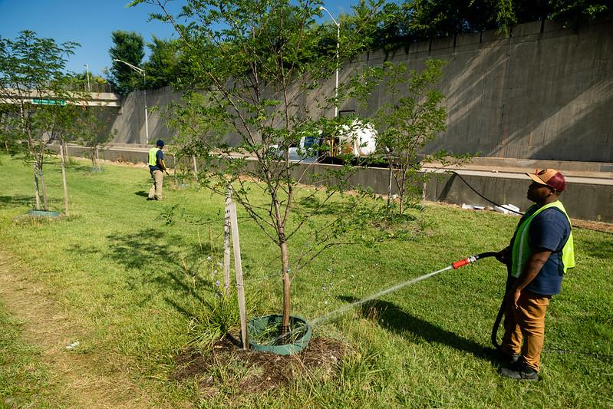
Green Infrastructure and Maintenance
Green infrastructure, or systems that use natural processes to manage stormwater, requires many skills to implement and maintain. They include landscape architects, tree trimmers, engineers, pipelayers, groundskeepers, pavers, hydrologists, and excavation machine operators.
Your community’s rain gardens, bioswales, and tree buffers need inspection and maintenance to ensure that they are operating properly and still contributing benefits to your community. By contracting with local businesses and workforce development programs, you benefit your community. Verification, inspection, and mapping of best management practices can also bridge the workload gaps during the slow seasons, like summer and winter.
“I have seen many planting projects fail due to lack of maintenance…”
Craig Highfield, Chesapeake Forests
“Planting the tree is the easiest part. Getting the tree to survive the first 5 years is the hardest part.” Lamonte Garber, Stroud Water Research Center
Building the Workforce of Today and Tomorrow
Green Collar Workforce
Notes:
References:
Exploring the Green Infrastructure Workforce, https://jfforg-prod-new.s3.amazonaws.com/media/documents/NatureWORKS-Issue-Brief-032317_v3.pdf
Photo by W. Parson/Chesapeake Bay Program

Slide 12
Green Buildings
Green construction is the practice using processes that are environmentally responsible and resource efficient when erecting buildings. There are national sustainability certifications, like the Leadership in Energy and Environmental Design (LEED) sustainability rating. The U.S. General Services Administration requires all Federal new construction and major renovation projects to meet LEED Gold standards. Many private developers pursue LEED certification to advertise their green credentials to the public.
Earning a LEED certified, Silver, Gold, or Platinum status requires workers with knowledge of energy and water efficiency, green landscaping, and low-impact materials. These workers include architects, engineers, urban planners, construction laborers, electricians, plumbers, roofers, and more.
Building the Workforce of Today and Tomorrow
Green Collar Workforce
Notes:
References:
https://www.bls.gov/green/construction/
Photo by J. Valente/Chesapeake Bay Program

Slide 13
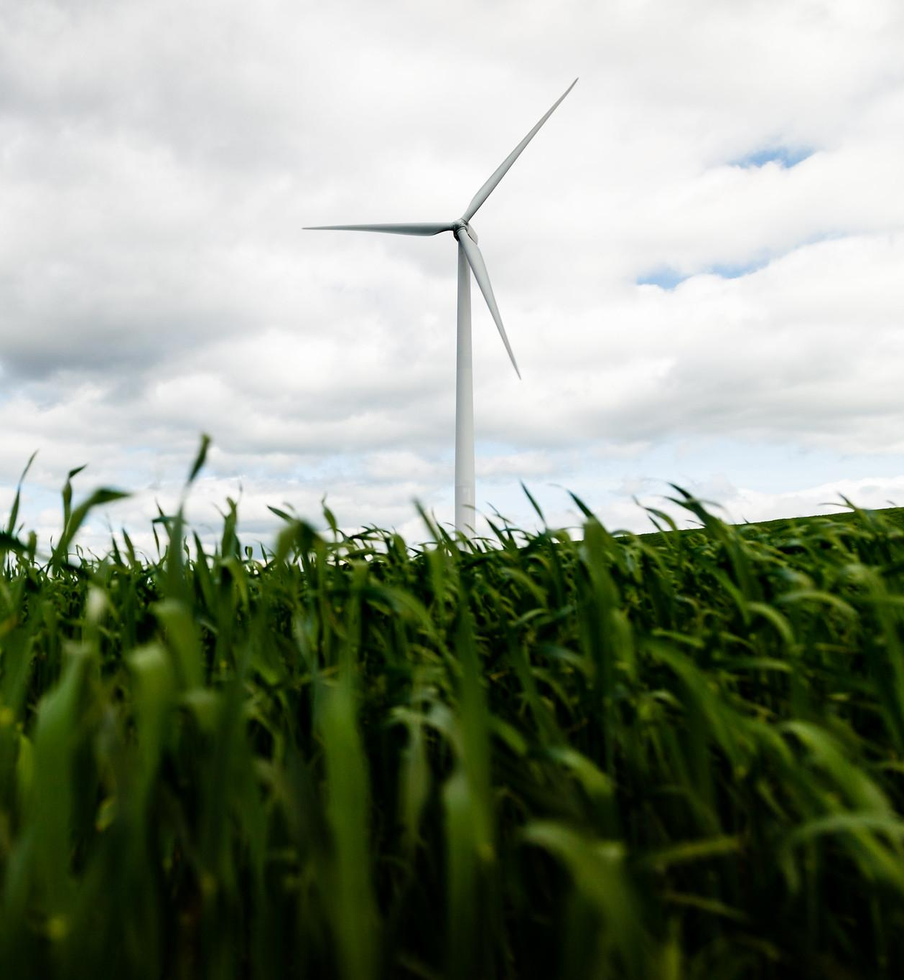
Clean Energy
In the United States, clean energy jobs outnumbered total fossil fuel employment by more than 3 to 1 in 2019. Clean energy is thriving worldwide but is also a large employer within the Chesapeake Bay watershed states. NY, PA, VA, and MD were in the top 15 states with the highest number of clean energy jobs, including in the sectors of renewable energy, grids and storage, energy efficiency, clean fuels, and clean vehicles. MD and DE were both in the top five states with the highest number of clean energy jobs per capita.
The wind turbine pictured here is one of 50 wind turbines spread over 3 “farms” in Madison County (NY).
Building the Workforce of Today and Tomorrow
Green Collar Workforce
Notes:
https://e2.org/wp-content/uploads/2020/04/E2-Clean-Jobs-America-2020.pdf
Photo by W. Parson/Chesapeake Bay Program

Slide 14
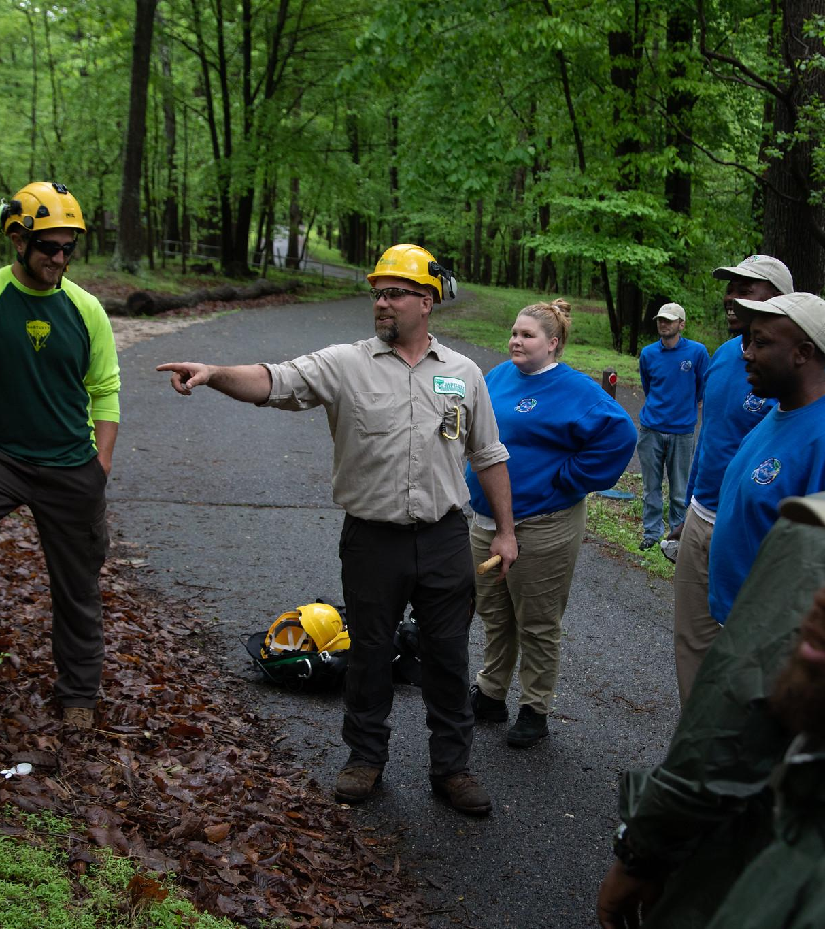
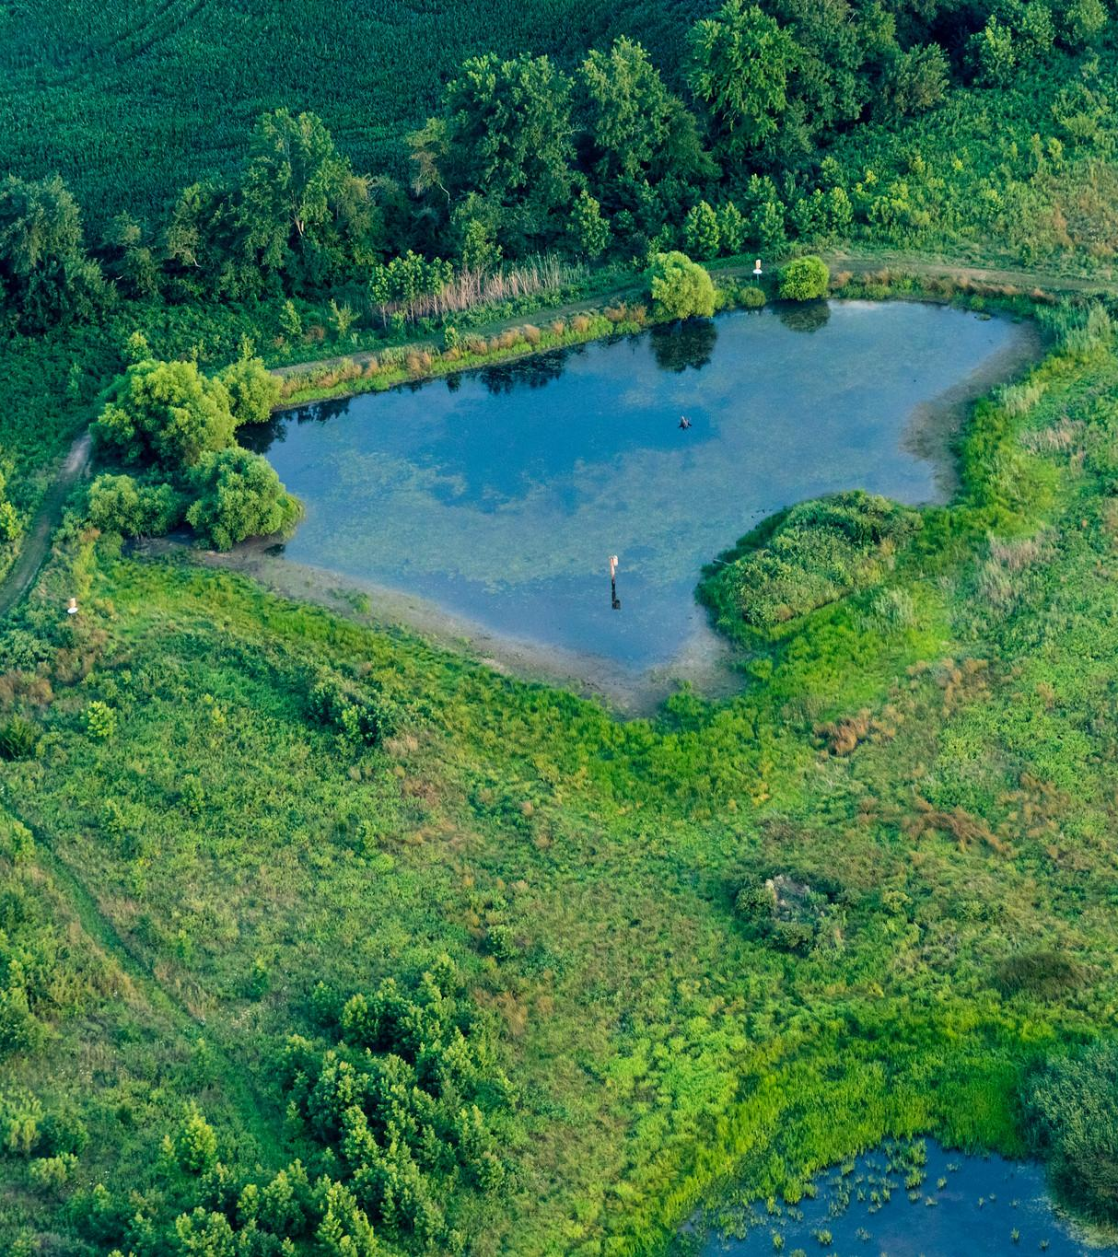
Diversity as an Asset
Let’s look at how a diverse and inclusive workforce makes a
community stronger.
Notes:
Photo from the Chesapeake Bay Program

Slide 15
Benefits of Diversity
A diverse workforce has a broad base of talents and perspectives. This base allows organizations to thrive in key areas: innovation, adaptability, and connection.
A diverse group of workers might have heterogenous ideas because of their varying experiences, allowing the group to “think outside of the box”.
Similarly, varied experiences help fuel creative solutions to problems, allowing flexibility in the face of disruption.
Lastly, a multicultural workforce is better able to serve a multicultural community, due to an understanding of language, culture, and shared experiences.
Building the Workforce of Today and Tomorrow
Diversity
Notes:
References:
A. Saxena 2014, https://www.sciencedirect.com/science/article/pii/S2212567114001786

Slide 16
Environmental Justice
Environmental justice is the fair treatment and meaningful involvement of all people regardless of race, color, national origin, or income, with respect to the development, implementation, and enforcement of environmental laws, regulations, and policies.
Increasing diversity and inclusion within environmental organizations and agencies in the watershed is one step towards addressing environmental justice concerns and increasing meaningful involvement of underrepresented communities. Reflecting your community’s diversity within your organization or agency includes perspectives that represent the community’s experiences. Since environmental stressors tend to affect underrepresented and underserved communities first and hardest, including their voices is vital to achieving justice.
Building the Workforce of Today and Tomorrow
Diversity
Notes:
Photo by C. Johnstone/Chesapeake Bay Program

Slide 17
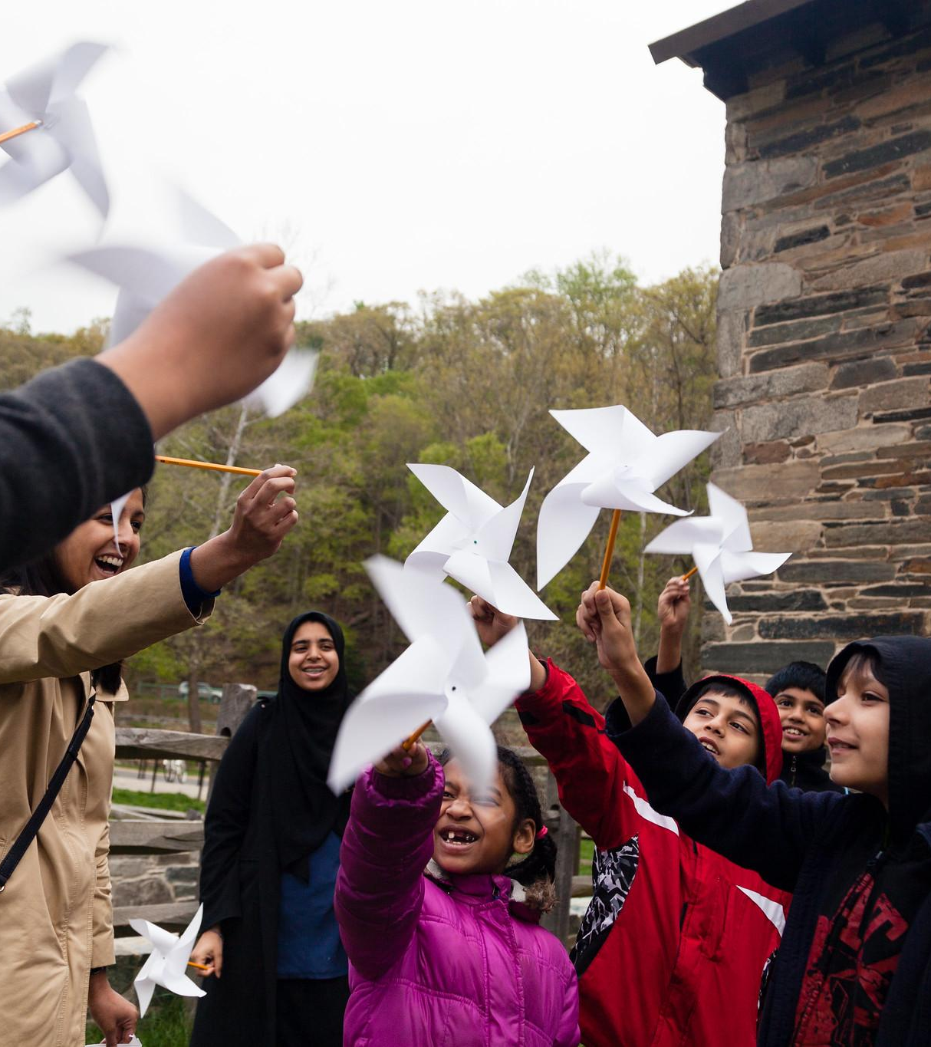
Education
K-12 education and targeted training programs are essential in developing a workforce tied to the green economy.
Notes:
Photo by W. Parson/Chesapeake Bay Program

Slide 18
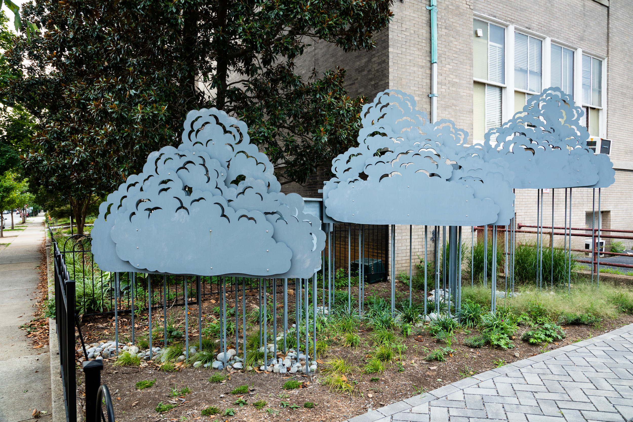
K-12 Education
Enhancing formal and informal education about the watershed builds a foundation for greater understanding and improved stewardship, and capacity to produce future scientists, managers, and members of a dynamic and innovative workforce. Investments in education are a proven economic development tool because they attract development, new residents, businesses and top earners.
Case study: Richmond, VA
“Taking a School by Storm” is a schoolyard retrofit project at Binford Middle School. It reduces stormwater runoff using several methods, including a rain garden with a collaboratively-designed rain harvesting sculpture. Through this hands-on project, students were exposed to the career paths of architect, land use planner, hydrologist, and more.
The project was funded with $200,000 awarded by the by National Fish and Wildlife Foundation through the EPA’s Small Watershed Grants Program.
Building the Workforce of Today and Tomorrow
Education
Notes:
https://research.upjohn.org/cgi/viewcontent.cgi?article=1028&context=presentations

Slide 19
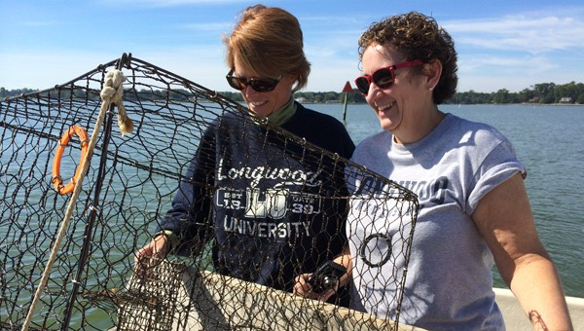
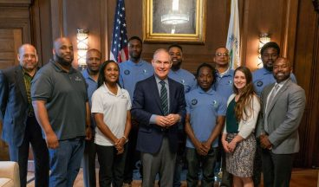
Job Training
Rather than creating new jobs, sometimes reimagining and expanding the current workforce’s skillsets are paths to the workforce of the future.
Case study: Watermen Tours
Programs in Maryland and Virginia have trained commercial fishers (or watermen) to lead on-water tours using their own vessels and expertise. These tourism opportunities bring new visitors to communities who often book lodging, eat in restaurants, and shop at local businesses. The watermen guides show tourists first-hand why a clean, restored Chesapeake Bay is necessary for healthy, abundant local seafood. The Watermen Heritage Tourism Program in Virginia also helps watermen supplement their fishing incomes while sharing their knowledge with others.
Case study: Baltimore, MD
Through the Brownfields Job Training Program, EPA provides environmental cleanup and safety training to residents of brownfields-impacted communities who are seeking new skills and opportunities.
Civic Works in Baltimore, MD, has used Brownfields Job Training Grant funds to train 80+ people with a 90% employment rate on graduation due to education and the network of alumni and employers that the program has built.
Building the Workforce of Today and Tomorrow
Education
Notes:
References:
https://www.epa.gov/sites/production/files/2015-09/documents/ss_bcgc_baltimore_md.pdf
Photos from Green Fin Studio (top) and http://civicworks.com/epa-selects-civic-works-for-200000-job-training-grant/ (bottom)

Slide 20
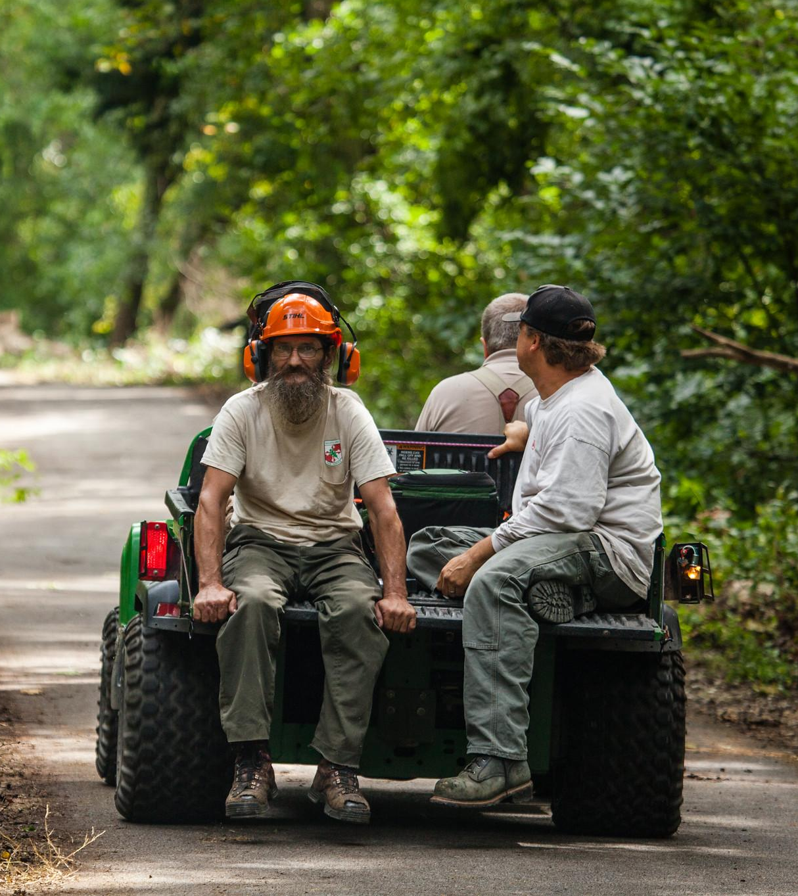
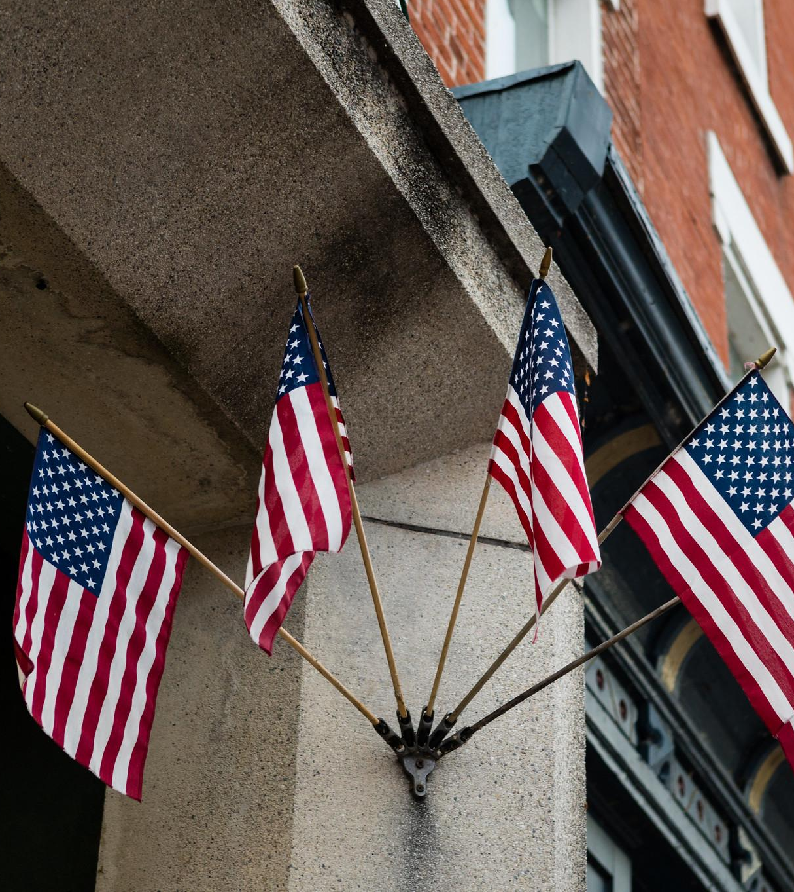
Existing Programs
Let’s discuss some programs currently operating around the watershed as examples of what you could do in your community.
Notes:
Photo by L. Boorhem-Stephenson/Chesapeake Bay Program

Slide 21
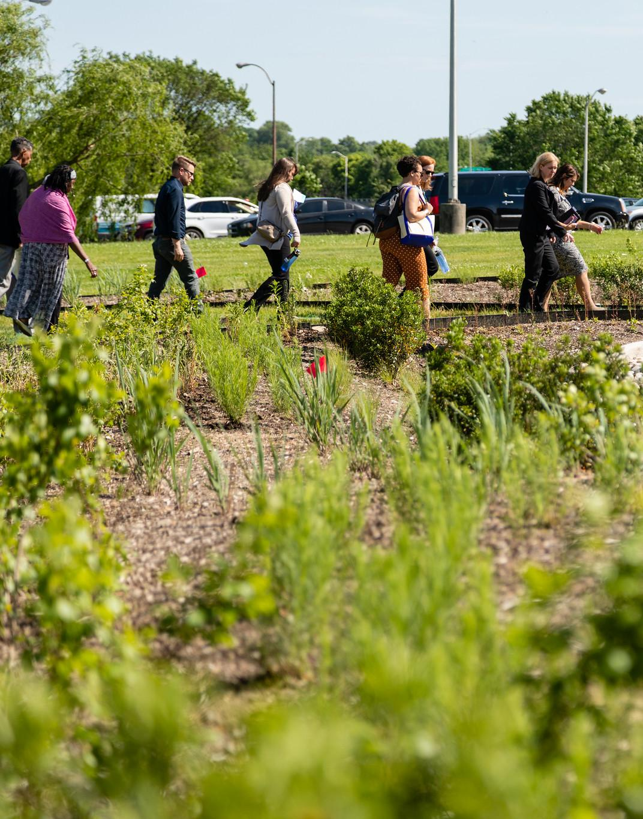
Chesapeake Bay Landscape Professional Certification Program
The CBLP is a voluntary certification program for professionals in the watershed who design, install, and maintain sustainable landscapes. The credential training and examination are based on a core set of standards in sustainable landscaping, emphasizing stormwater retrofit best practices and conservation landscaping with native plants. There are two levels of training aimed at landscape professionals, an Associate program for the youth workforce, and two new certificate programs for stormwater management practices maintenance and riparian buffers.
Over 650 professionals have been certified since the program began in 2016.
Building the Workforce of Today and Tomorrow
Existing Programs
Notes:
Photo by W. Parson/Chesapeake Bay Program

Slide 22
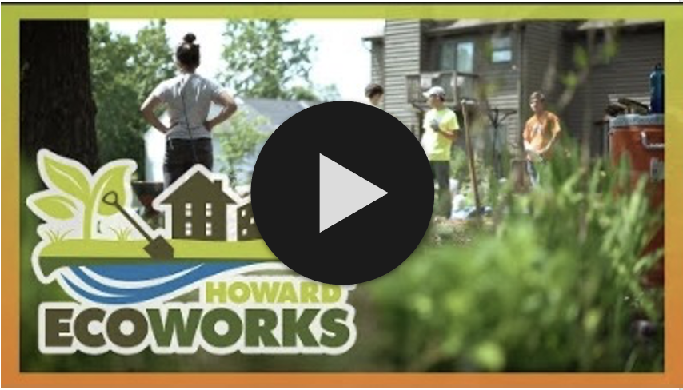
Howard EcoWorks
Howard EcoWorks provides three programs in Maryland that train individuals on the construction and maintenance of green infrastructure while simultaneously helping the county to meet water quality goals. Each of the programs focuses on a different target audience.
Restoring the Environment and Developing Youth (READY): a summer workforce program for young adults ages 16-25. This program teaches high school students and young adults about the environment, increases stewardship, and gives them valuable work experience in a green collar job.
UpLift: a 9–10-month adult workforce development program targeting under-served populations for entry-level jobs. There are no prerequisites, and the curriculum includes the CBLP-Associates certificate.
Seeds of Change: a workforce development program offered at the Howard County’s Corrections Department that develops inmate skills and knowledge to maintain a native plant nursery. The program is six weeks in length with no prerequisites and participants receive a Landscape of Life certificate.
Learn more by watching the video on the right or visiting their website: https://www.howardecoworks.org
Building the Workforce of Today and Tomorrow
Existing Programs

Slide 23
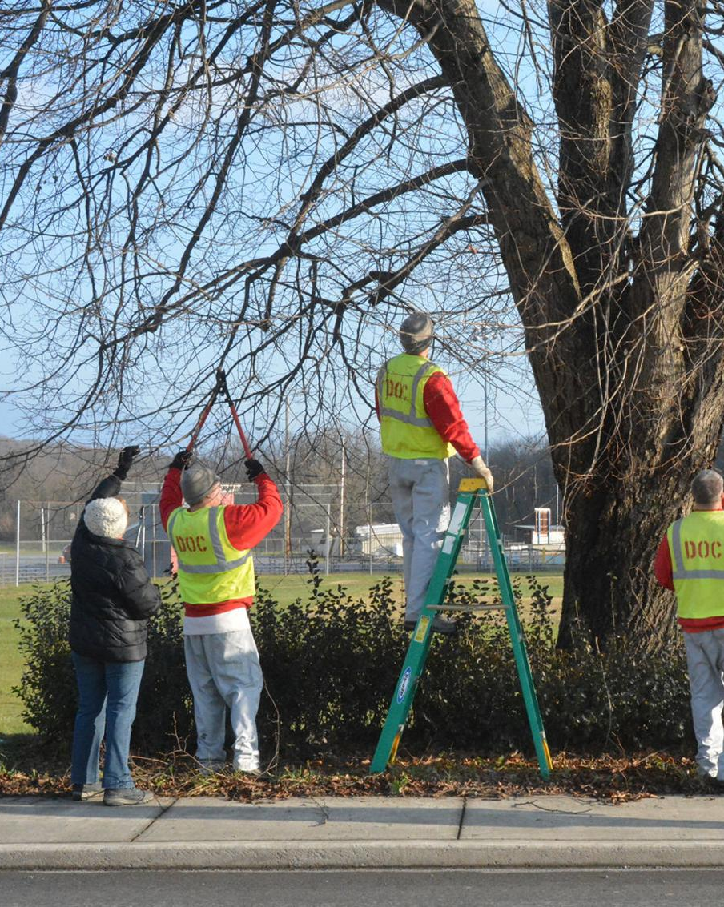
Workforce Training for Incarcerated Individuals
Pennsylvania’s Correctional Conservation Collaborative is a multi-agency partnership that supports a workforce development program in forestry/arboriculture and riparian buffers for inmates nearing release. The targeted job sectors include tree service in the riparian and forest sectors. The focus area was identified, in part, based on the riparian buffer projects planned in the region with multiple job types: tree climber/arborist, utility line clearer, tree nursery worker, and riparian forest buffer technician. There are no educational or work experience pre-requisites. The program presents an opportunity for participants to take Pesticide Applicators Certification courses and become a Tree Worker Climber Specialist.
Building the Workforce of Today and Tomorrow
Existing Programs
Notes:
Photo by R. Berdar/https://www.huntingdondailynews.com/news/local/sci-tree-tenders-help-beautify-huntingdon-streets/article_1d8d8bbf-8702-5e0c-9e48-ba042d666a88.html

Slide 24
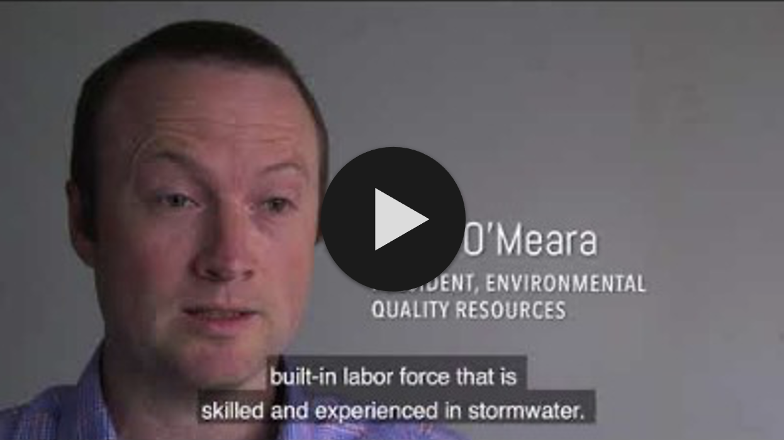
Clean Water Certificate (CWC) Training Program
The program trains workers to fill entry-level jobs in the stormwater industry. The certificate program is a foundation for additional credentials and helps the existing workforce expand their career path or responsibilities. The program also aims to increase opportunities for individuals in low-income communities and under- or unemployed individuals to secure a living wage job leading to financial stability.
Hear from a perspective employer above and learn more here.
The program operates on a contractual or fee for service model where the CWC training is integrated with existing programs that provide life skills and support services to participants. It serves as a pathway for local businesses to hire trained and ready workers following successful completion of the program.
Building the Workforce of Today and Tomorrow
Existing Programs

Slide 25
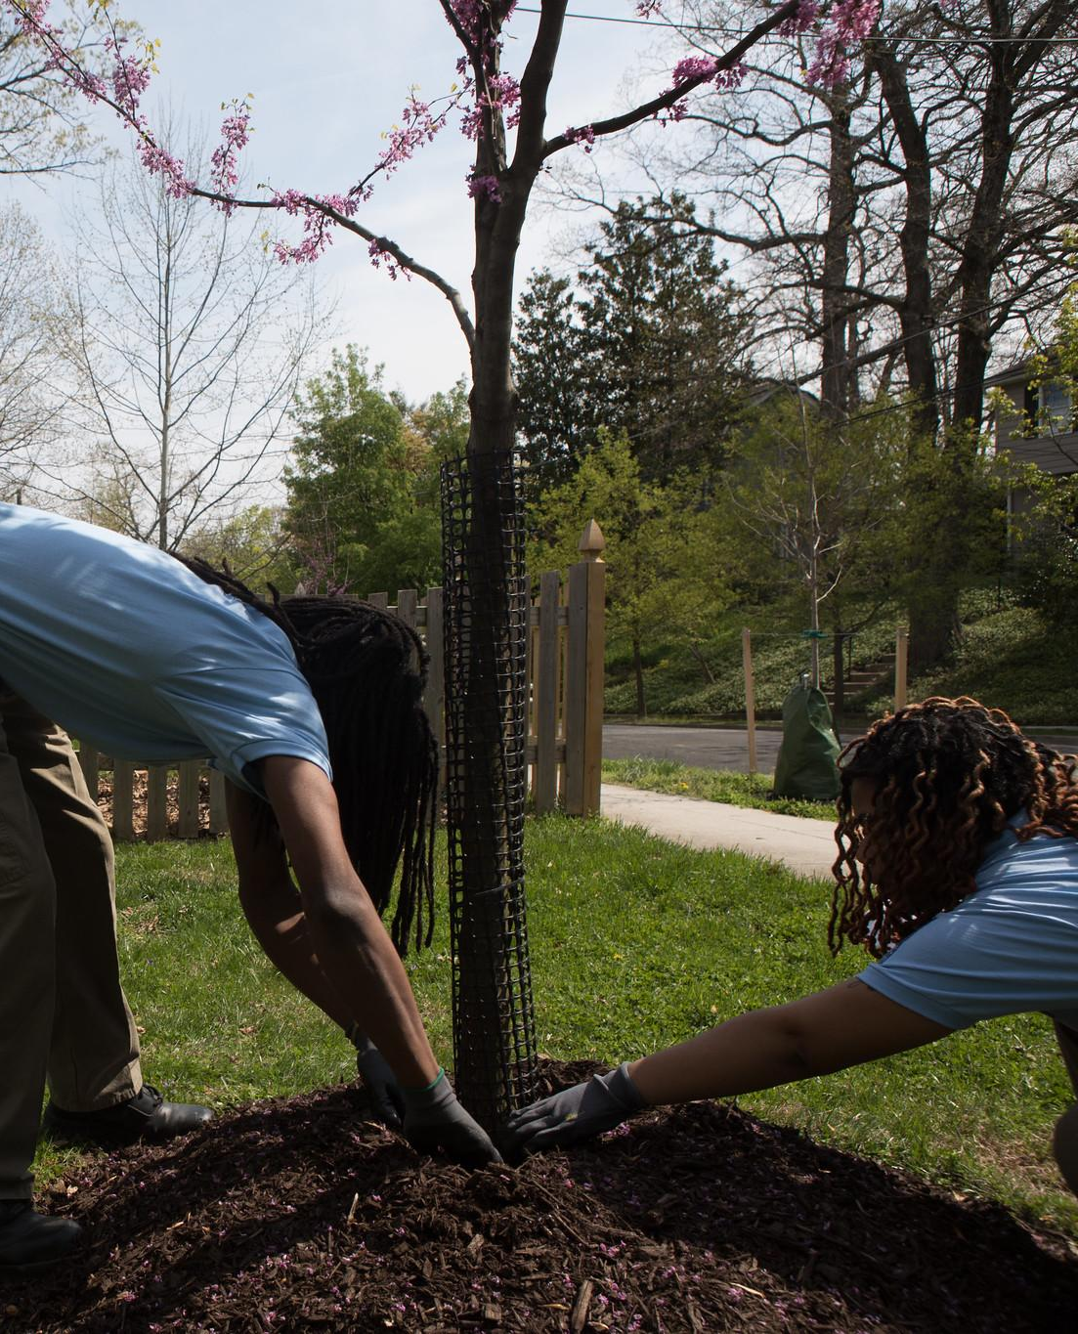
River Corps
The River Corps program is funded through the DC DOEE and implemented through a local Conservation Corps Program, Latin American Youth Center (LAYC). LAYC offers job training in green infrastructure and conservation to residents of Montgomery County, MD and the District of Columbia. The programs provide field experience and classroom instruction, and may include job readiness training, certifications, and career development opportunities. Over five months, young adults ages 18-24 monitor streams, remove invasive plants, maintain bioretention cells, conduct RiverSmart Homes inspections, and more. River Corps seeks to build the next generation of environmental stewards.
Building the Workforce of Today and Tomorrow
Existing Programs
Notes:
Photo by W. Parson/Chesapeake Bay Program

Slide 26
Solar Installation Training
During the summer of 2019, Bridging the Gap in Virginia held their first solar installation training program in the Union Hill community of Buckingham County, VA. The 40-hour week of training was led by master trainer Sean White, who shared his expertise in solar knowledge with program participants. The training week brought together members of the community, contractors, and formerly incarcerated individuals to engage with renewable energy firsthand. This program seeks to provide opportunities for individuals seeking to be competitive candidates in the renewable energy job market.
Building the Workforce of Today and Tomorrow
Existing Programs
Notes:
Photo by Bridging the Gap in Virginia (top), Vivint Solar (bottom)

Slide 27
What You Can Do
Create hands-on learning opportunities for installation and maintenance of best practices that address local needs, such as flooding and beautification.
Prioritize contracting with local workforce development programs for green infrastructure installation/maintenance, especially those that work with previously incarcerated, veteran, and other disadvantaged populations.
Require the hiring of trained and certified contractors to install and maintain publicly-funded green infrastructure.
Invest in your future workforce by funding STEM education, with a particular focus on under-resourced communities.

Slide 28
To Learn More
Alliance for the Chesapeake Bay’s Workforce Development Programs
Learn about the Correctional Conservation Collaborative, Ready Green Jobs Training Project, and RiverSmart Stormwater Contractor Training programs
Maryland Climate Leadership Academy
Advances the capacity of state and local government agencies, infrastructure organizations and businesses to develop and implement sound climate change initiatives to ensure current and future public health, security, and economic prosperity
EPA’s Environmental Workforce Development and Job Training Grants
Find information about EPA’s workforce development grants, including resources like FAQs
EPA’s Making Water a Career of Choice
Explore water workforce case studies from across the country (including one in PA and one in VA)

Slide 29
Glossary
Stormwater Runoff
Precipitation that does not evaporate or soak into the ground but instead flows over the land and into the nearest waterway
Green Jobs
Jobs in businesses that produce goods or provide services that benefit the environment or conserve natural resources and jobs in which workers' duties involve making their establishment's production processes more environmentally friendly or use fewer natural resources
Green Infrastructure
Nature-based solutions that use soil and vegetation to help slow the flow of runoff and manage rainwater where it falls
Green Construction
The practice of erecting buildings and using processes that are environmentally responsible and resource efficient
Clean Energy
Energy that comes from renewable, zero emission sources that do not pollute the atmosphere when used
Environmental Justice
The fair treatment and meaningful involvement of all people regardless of race, color, national origin, or income, with respect to the development, implementation, and enforcement of environmental laws, regulations, and policies
Brownfields
A property, the expansion, redevelopment, or reuse of which may be complicated by the presence or potential presence of a hazardous substance, pollutant, or contaminant

