Slide 1
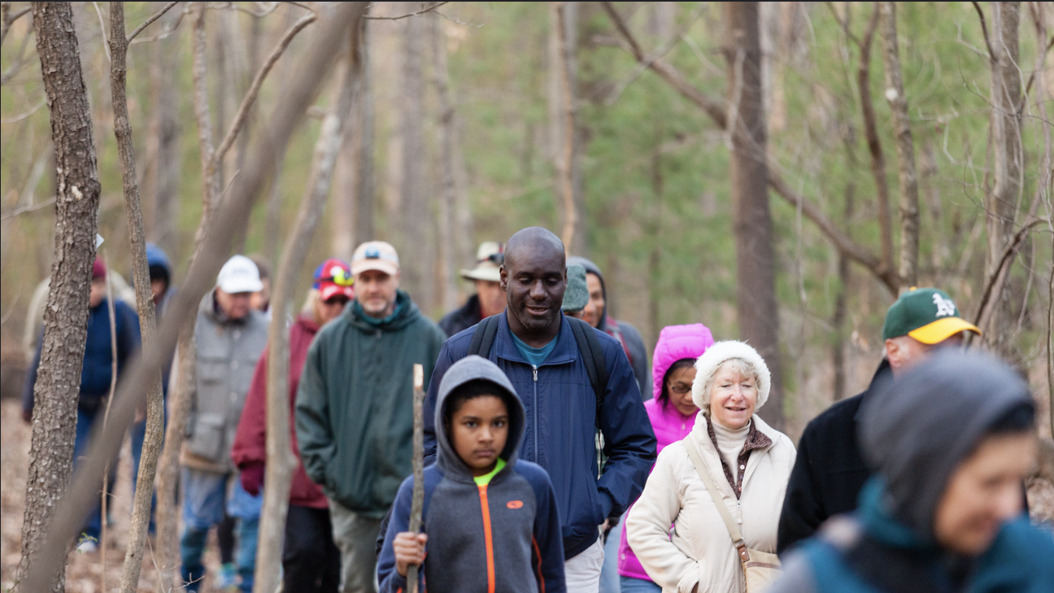
A Local Government Guide to the Chesapeake Bay
Module 10: Keys to Building Community Buy-In for the Environment
Notes:
Photo by W. Parson/Chesapeake Bay Program

Slide 2
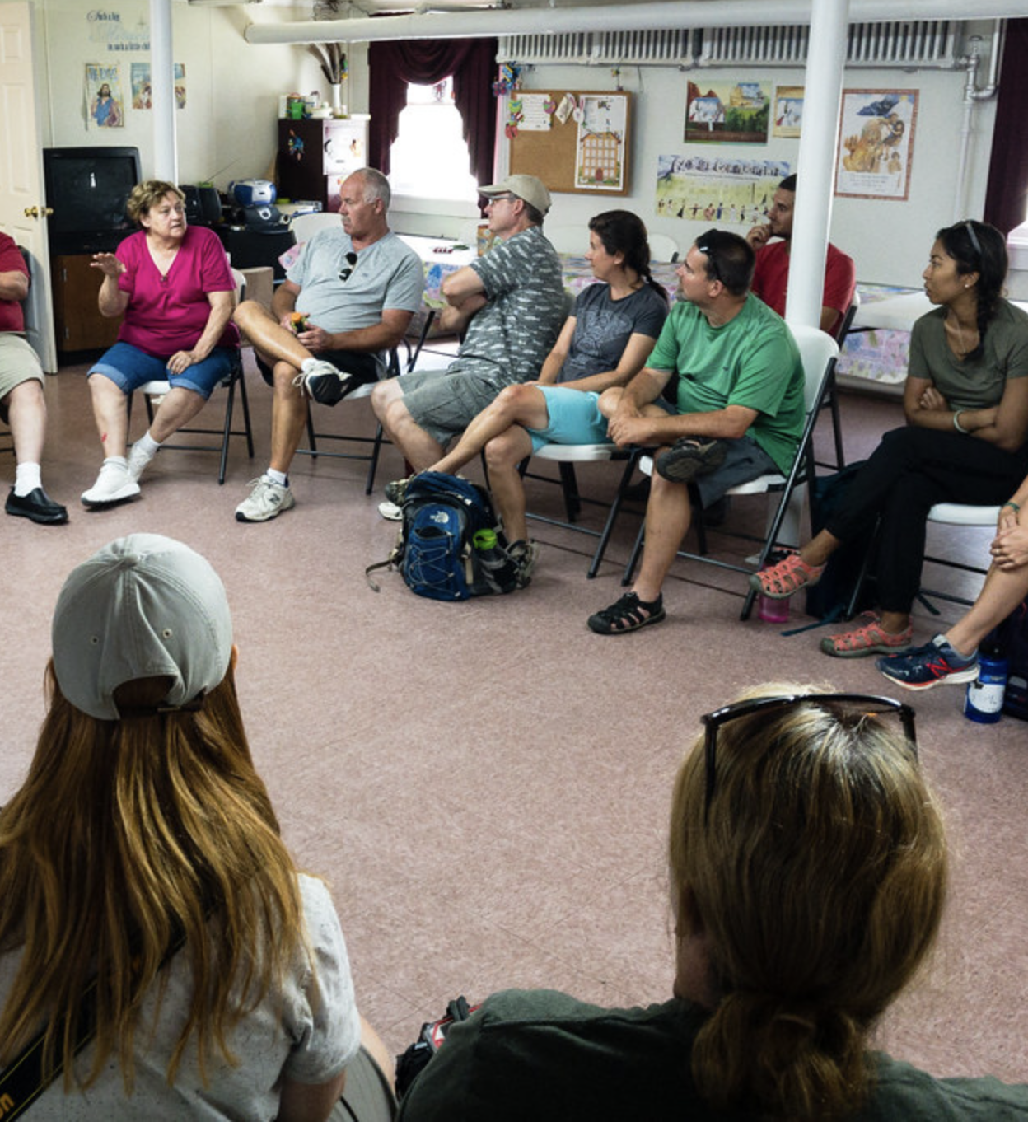
Table of Contents
1
Purpose
What You’ll Learn
Benefits of Engaging
When and Who
Best Practices
What You Can Do
To Learn More
Glossary
2
3
4
5
6
7
8
*Please refer to individual slide notes for data references and information sources.
Module 10: Keys to Community Engagement on Sustainability
Notes:
Photo by W. Parson/Chesapeake Bay Program

Slide 3




A Guide For Local Governments
To help local government representatives better understand how the information in the modules aligns with their priorities, look for these icons:
As a local leader, your decisions set the course for your community. Your actions determine the health and vitality of your jurisdiction, as well as that of your local waterways and the Chesapeake Bay. You can achieve win-win outcomes by prioritizing local economic development, infrastructure resiliency, public health, and education while also protecting your environment.
This module is one in a series created by the Chesapeake Bay Program to support and inform decision making by local officials. We encourage you to examine the full suite of modules listed on the next slide.
Economic Development
Public Health & Safety
Infrastructure Maintenance & Finance
Education
Community Engagement
Purpose

Slide 4
A Guide For Local Governments
Available Local Government Modules
How Your Watershed Works
Foundations of Clean Water
Healthy Water for the Economy
Capitalizing on the Benefits of Trees
Preserving Local Character and Landscapes
Protecting Your Infrastructure Through Stormwater Resiliency
Building the Workforce of Today and Tomorrow
Preparing Your Community for Water Extremes
Understanding and Supporting Your Agricultural Allies
Keys to Community Buy-In for the Environment
Your Health and the Environment
Community Engagement
Purpose

Slide 5
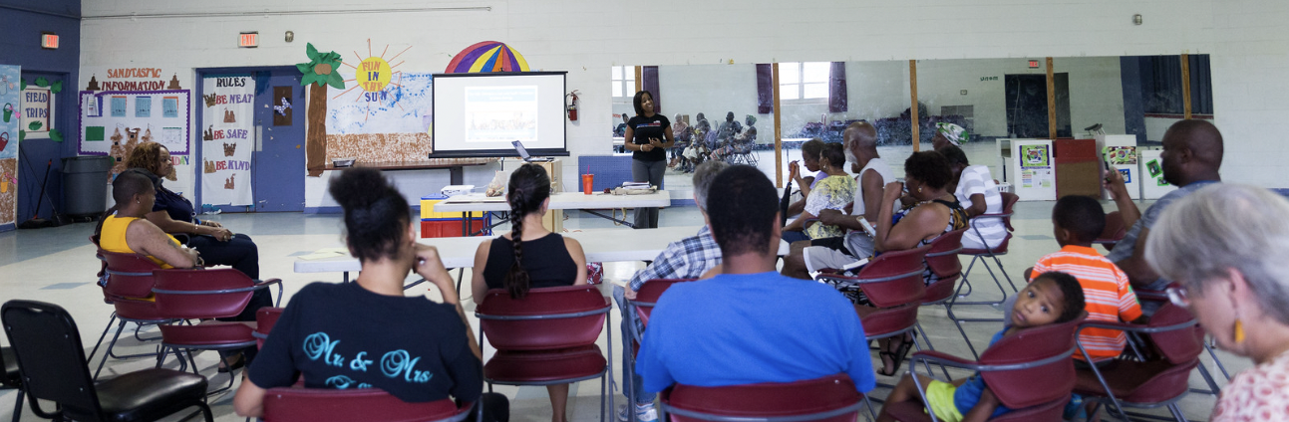
Laying Foundations
You already understand that community engagement is important as a local elected official. Public opinion and engagement plays a large role in what you do. But how do you build support on environmental issues like necessary clean water investments, spur behavior change, and get the most out of your efforts?
Community Engagement
Purpose
Notes:
Photo by Skyler Ballard/Chesapeake Bay Program

Slide 6
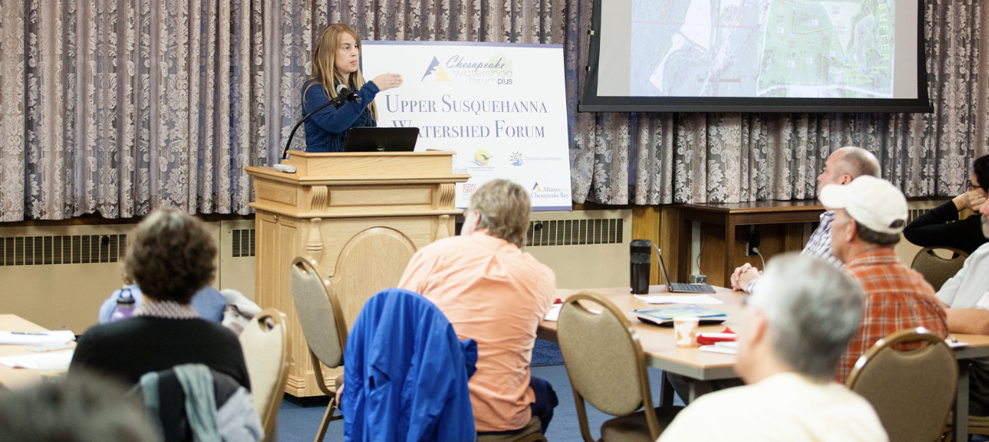
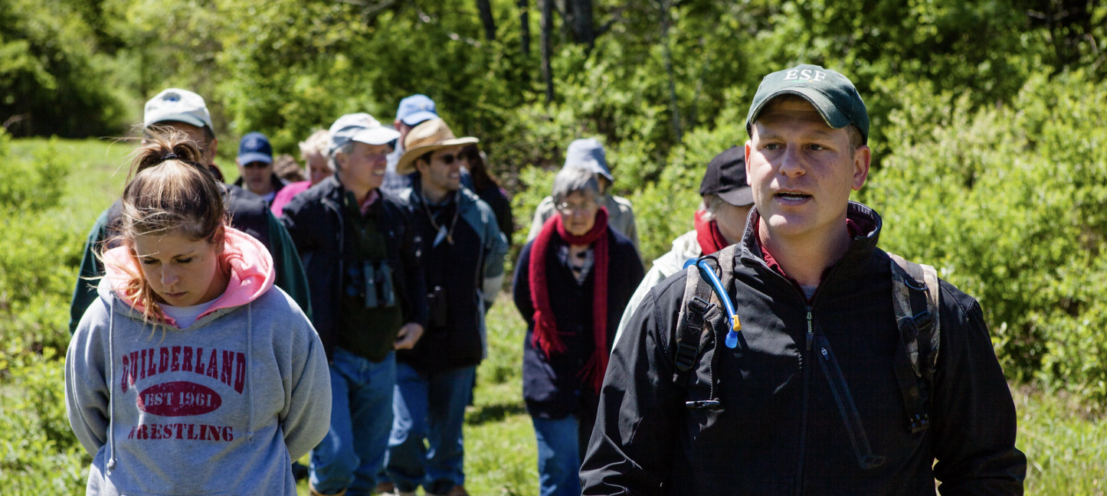
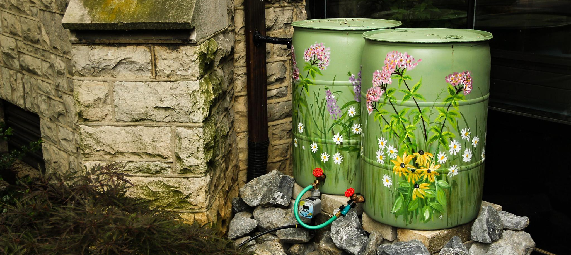
What You’ll Learn
What are the benefits of community engagement?
How can I maximize the impact of my engagement efforts?
How do I build support for clean water work?
Community Engagement
What You’ll Learn
Notes:
Photos by W. Parson and S. Droter/Chesapeake Bay Program

Slide 7
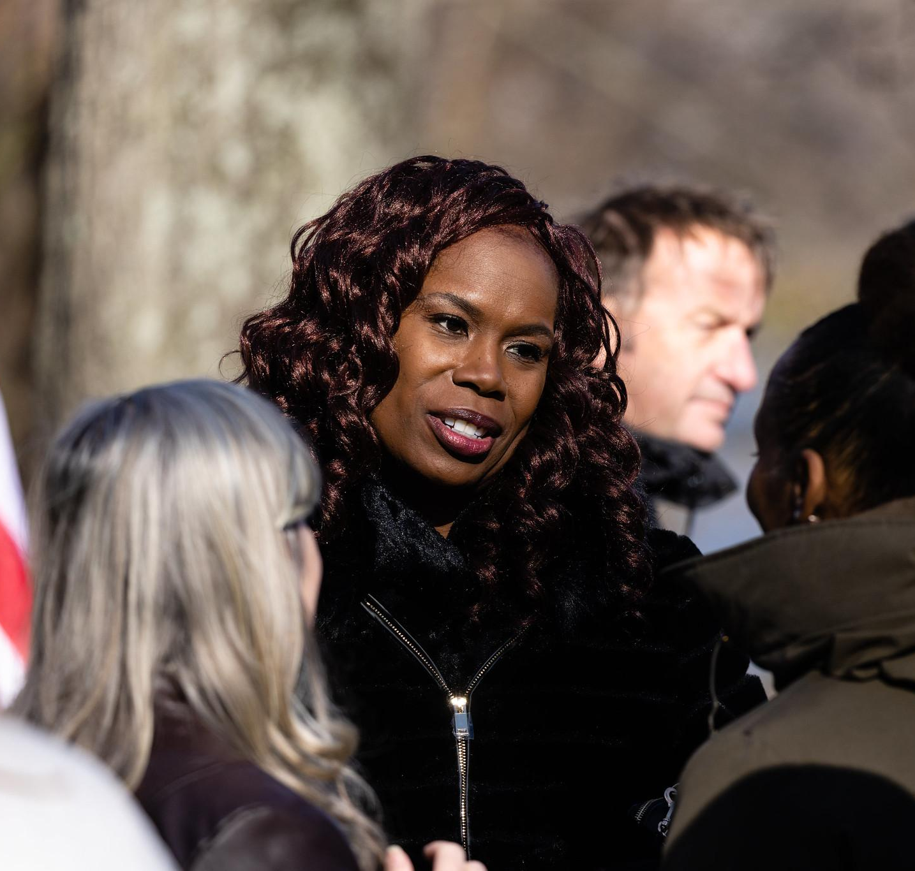
Benefits of Engaging
Engaging your community takes work. Is it really worth your time and effort? (Hint: yes!)
Photo of Dr. Boyd, Director of the Chesapeake Bay Program, engaging with people at the National Fish and Wildlife Foundation watershed restoration event at Truxtun Park in Annapolis, Maryland in 2022.
Notes:
Photo by W. Parson/Chesapeake Bay Program

Slide 8
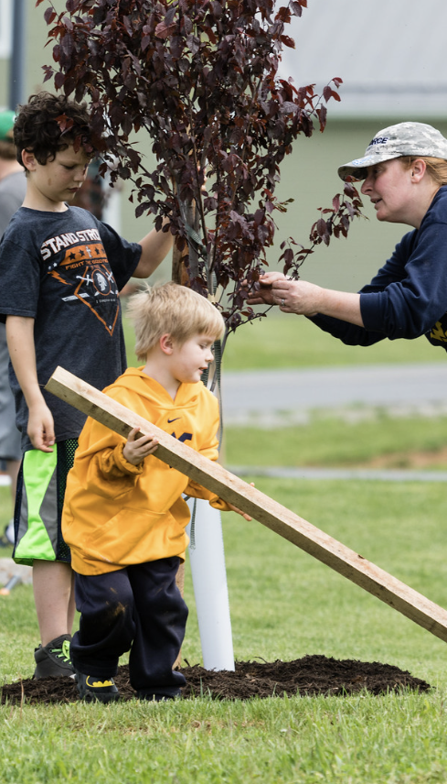
Return on Investment
How much time and money does your community spend on sustainability efforts like picking up trash, planting trees, or creating green infrastructure?
If your community is engaged in the effort from the beginning, they will feel ownership over the project and are more likely to volunteer and protect the effort. Having the community invested in the continuation of a sustainability effort increases the return on your investment and dissuades bad actors from vandalizing or otherwise harming new projects.
Local governments in the US spent
$146.6 billion
on protecting the environment in 2020.
Community Engagement
Benefits
Notes:
Photo by W. Parson/Chesapeake Bay Program
References:
2020 Annual Survey of State and Local Government Finances: https://www.census.gov/data/datasets/2020/econ/local/public-use-datasets.html

Slide 9
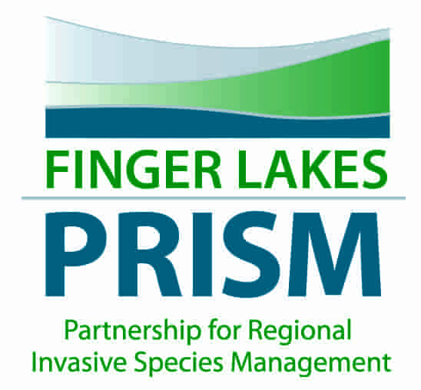
Capacity Building
More community involvement means more pooled resources from volunteers and
community partners.
Local government staff time is limited. Having community members volunteer or connecting with community partners that can mobilize their own networks can expand your geographical reach, access to equipment, and capacity. Community engagement helps you make connections, identify shared needs, and plan strategically to be as efficient as possible.
Case study: Finger Lakes, NY
The Finger Lakes Partnership for Regional Invasive Species Management (PRISM) includes government, academic, and nonprofit collaborators. The partnership recruits and trains volunteers to monitor, report, and remove invasive species that can damage crops and forests, cause stormwater drainage problems, and decrease recreation value and quality of life in their community.
The volunteers reduce the amount of time and energy that local government staff spend on tackling local invasive species.
Community Engagement
Benefits
Notes:
Photo source: https://monroecountyswcd.org/page-62.html

Slide 10
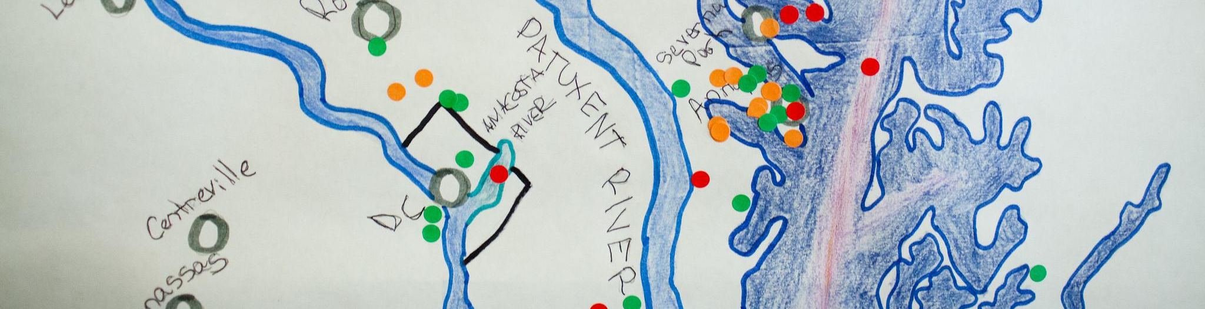
Building Trust
Good communication and community engagement increase trust in local government.
While local government has the highest level of trust compared to all branches of government, there is room for improvement. Engaging the community demonstrates that you’re interested in communicating openly with them, as well as making sure that they feel involved in the decisions made about their own backyard.
66%
of Americans polled in 2021 have high confidence in local government’s ability to handle problems, compared to 57% for state government and 39% for federal government.
Community Engagement
Benefits
Notes:
Photo by W. Parson/Chesapeake Bay Program
References:
https://news.gallup.com/poll/355124/americans-trust-government-remains-low.aspx

Slide 11

Understanding
Engaging with your community is centered on understanding the people that comprise it.
Part of that understanding is realizing that there are different sectors with different needs and motivations. Once you understand these needs and motivations, you can more effectively communicate with them.
Community Engagement
Benefits
Notes:
Photo by W. Parson/Chesapeake Bay Program
References:
https://news.gallup.com/poll/355124/americans-trust-government-remains-low.aspx

Slide 12
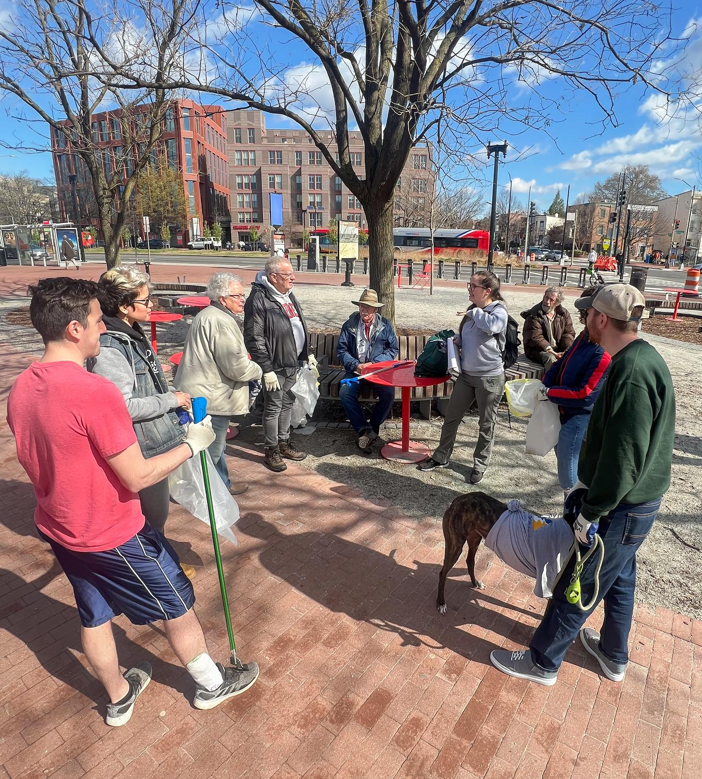
When and Who
Let’s look at the spectrum of involvement and how it can be put into practice.
Notes:
Photo by the Alliance for the Chesapeake Bay

Slide 13





The Spectrum of Involvement
INFORM
CONSULT
INVOLVE
COLLABORATE
EMPOWER
Provide information that assists in understanding the problem, potential opportunities, and/or solutions.
Gather public feedback on analysis, alternatives, and/or decisions.
Work with the public throughout the process, ensuring that concerns and desires are understood and considered.
Partner with the public in all aspects of the decision – including finding alternatives and selecting the preferred solution.
Foster democratic participation by fully placing decisions in the hands of the public.
GOAL
We will keep you informed.
We will listen to and acknowledge concerns and desires & follow up on how public input influenced decisions.
We will work with you to reflect your concerns and desires & follow up on how public input influenced decisions.
We will look to you for advice & incorporate your recommendations to the maximum extent possible.
We will implement what you decide.
MESSAGE
Community Engagement
When and Who
Notes:
References:
https://cdn.ymaws.com/www.iap2.org/resource/resmgr/pillars/Spectrum_8.5x11_Print.pdf

Slide 14



Desired Outcomes
Individual Actions
You may want your constituents to adopt or stop a behavior, like install a rain barrel or stop littering. Achieving this goal will likely take more outreach than simply providing information – it may take facilitation, strategy, incentives, and more.
Longevity
Engaging your community can help the ideas and projects that you support endure in your absence. You can empower your constituents to take ownership over efforts that are important to you and continue to champion them.
Transparency
Sometimes the goal of engagement is just to share information freely and be transparent about upcoming decisions that affect the community. By opening lines of communication, listening to concerns, and responding, you can increase trust in local government and prevent complaints later.
Community Engagement
When and Who

Slide 15

Framing Sustainability
Environmental issues are far from the daily concerns of your average constituent. How do you communicate why your community needs to do things like manage stormwater?
Frame environmental concerns through different values that your community holds, like recreation, economic benefit, health benefits, and benefits to the next generation.
Example talking points for stormwater:
    Properly managing stormwater prevents flooding and erosion, which can cause costly damage to property in our community.
    Trees and cleaner water increase recreational opportunities, like hiking, bird watching, hunting, swimming, and fishing.
    Properly managing stormwater means less well contamination, fewer mosquitoes and the diseases that they carry, and less pollution in our local waterways.
Community Engagement
When and Who

Slide 16





Navigating Pushback
Engage early. More and earlier public dialogue can help make responses less emotional.
Our communities are diverse in experiences and opinions – this can sometimes lead to conflict.
When your goal is to actively engage your community, you will likely have to navigate passionate, frustrated, scared, or confused constituents. To the right is a list of tips and tricks that you can use to respond to pushback or conflicts during engagement efforts.
Be empathetic. People’s feelings are real and feeling ignored will increase tension.
Establish civility. Make guidelines for effectively sharing views and concerns known in advance.
Listen with respect. Use attentive body language and acknowledge what you’re hearing.
Be transparent. Record notes, make information publicly available, and define how input will be used.
Identify values. Think and ask about the values underlying the opinions expressed.
=
Be fair. Allow everyone to speak. Trying to drown out other perspectives will increase frustration.
Community Engagement
When and Who

Slide 17

Best Practices
Having guidelines and examples to follow will make the engagement process easier.

Slide 18
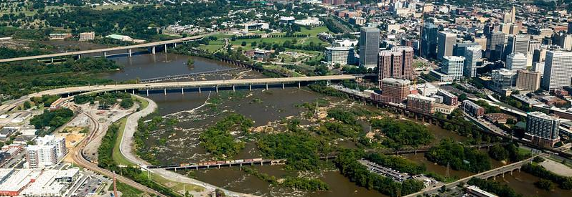
Understanding Needs and Perceptions
Case study: Richmond, VA
Oftentimes, we start communication and engagement efforts with our desired outcomes. This is understandable, but the first step of the engagement should be understanding the needs and perceptions of your community in order to create an effective plan for meeting your desired outcomes.
Approach engagement with a “listen and learn” attitude and an open mind.
Stakeholder interviews – Conduct online, phone, or in-person interviews to ask targeted questions.
Surveys – Online surveys are a cheap way to gather input, but keep barriers to participation in mind like computer access.
Roundtables – Bring key community members together to gather input. Keep barriers like childcare and transportation in mind.
The City of Richmond began RVAgreen 2050 in 2017. The overall goal is to achieve net zero greenhouse gas emissions by 2050 and help the community adapt to climate impacts, all while centering equity in the process. Early phases of the plan created space for community input, focusing on historically marginalized and underrepresented groups. They invited a group of residents who participated in Racial Equity & Environmental Justice Roundtables. These residents served as liaisons that advocated for the inclusion of voices, experiences, and needs of their community in the planning process.
Community Engagement
Best Practices
Notes:
Photo by W. Parson/Chesapeake Bay Program

Slide 19

Build Relationships
Case study: Prince George’s County, MD
Following on listening to your community, prioritize maintaining a relationship rather than one-time communication or “fixing” a problem. Support the work of community partners and collaborate to achieve mutual wins.
Build in value for your community partners – rewarding participation will make partners want to continue to engage and seek out new opportunities.
Rather than developing a transactional relationship, support your partners even when you are not asking for something in return.
Celebrate the wins of your partners – when you use your communication channels to share when your partners succeed, you strengthen the relationship and gain positive attention for everyone involved.
In 2016, Prince George’s County launched the Pet Waste Management Initiative, bringing together 40+ municipalities and 12+ homeowners/civic associations. Through the project, more than 200 pet waste stations were installed, an outreach video was produced, and municipalities received training on best practices for talking to residents about pet waste and stormwater.
Community Engagement
Best Practices
Notes:
References:
https://www.princegeorgescountymd.gov/3689/Scoop-That-Poop

Slide 20

Understanding Needs and Perceptions
Timing
Case study: Lancaster, PA
Don’t wait to inform your community until after a change has already been finalized. They will be more likely to feel frustrated and left out.
Engage your community before implementing changes and keep the public informed throughout the process.
If possible, engaging key stakeholders from the beginning and gathering feedback on potential options will give community members some decision-making power and provide them a sense of ownership over the proposed changes.
Inform key groups – if changes will strongly affect a particular group within your community, make an intentional effort to connect with them (i.e., local businesses in the case study to the right).
The City of Lancaster adopted a stormwater utility program to limit the quality and quantity of runoff. Prior to rolling out a fee structure, the City held dozens of public meetings and individual briefings. Among other topics, the City presented background information, projected costs of compliance, comparisons with other cities, and various fee options.
Another major part of the engagement effort was meeting with the top 80 businesses in town, the Lancaster City Consortium Group, to answer questions and address concerns.
Community Engagement
Best Practices
Notes:
Photo by W. Parson/Chesapeake Bay Program
References:
https://www.njfuture.org/wp-content/uploads/2019/04/Stormwater-Utility-Case-Study-Lancaster-PA.pdf

Slide 21
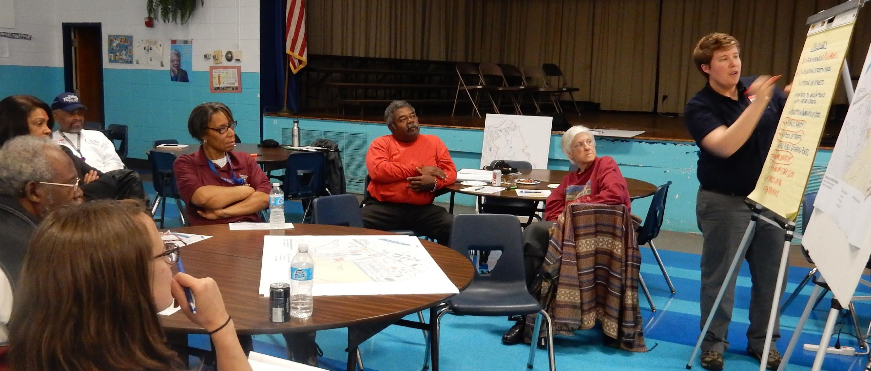
Understanding Needs and Perceptions
Diversity and Inclusion
Case study: Petersburg, VA
You want your engagement to mirror the diversity of your community. Actively recruit and prioritize marginalized voices.
Consider barriers to engagement, like language, work hours, transportation to in-person meetings, childcare, etc. To address these barriers, you may need to translate outreach materials, hold multiple meetings at different times and days of the week, and offer compensation for time, transportation or childcare costs.
Reach out to partners already operating in underserved communities or consider community block grant funding.
The Petersburg Walkable Watershed project started with a survey to identify community needs. They began holding public meetings in collaboration with the Robert E Lee Neighborhood Watch at the local school in the evenings. Input was collected and all presentations and draft strategies were made available online for public review. After each review session, the plan was updated to incorporate feedback and shared again. Engaging the residents already involved in the Neighborhood Watch brought diverse voices to both share their concerns and help develop solutions.
Community Engagement
Best Practices
Notes:
Photo from http://www.walkablewatershed.com/petersburg/
Reference:
http://www.walkablewatershed.com/petersburg/

Slide 22
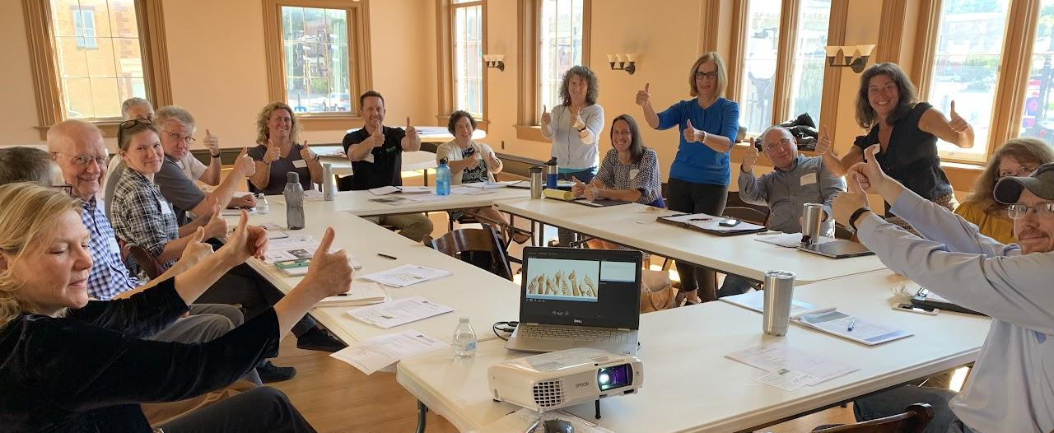
Understanding Needs and Perceptions
Manage Expectations
Case study: Safe Water Conservation Collaborative, WV
Be transparent in describing the desired outcomes of engagement, responsibilities, capacities and limitations, especially time and financial constraints.
Don’t solicit input if there’s no opportunity to influence the course of action, like if a decision is already made.
Establish “rules of engagement” and share them before engaging, especially for meetings or roundtables.
Create and share a tentative timeline of when decisions will be made or actions will be taken.
The Safe Water Conservation Collaborative brings together 25+ water utilities, land conservation organizations, and
community partners. Through their strategic plan, they establish a shared mission, vision, and goals as well as laying out a timeline for action through 2026. With this information publicly available, steering committee members and partners are clear on how the Collaborative operates. Together, the Collaborative has conserved 1,000+ acres of land that protect the drinking water for 37,500 residents.
Community Engagement
Best Practices
Notes:
Photo from safewatercollaborative.org
Reference:
https://www.safewatercollaborative.org/learn-more/accomplishments

Slide 23
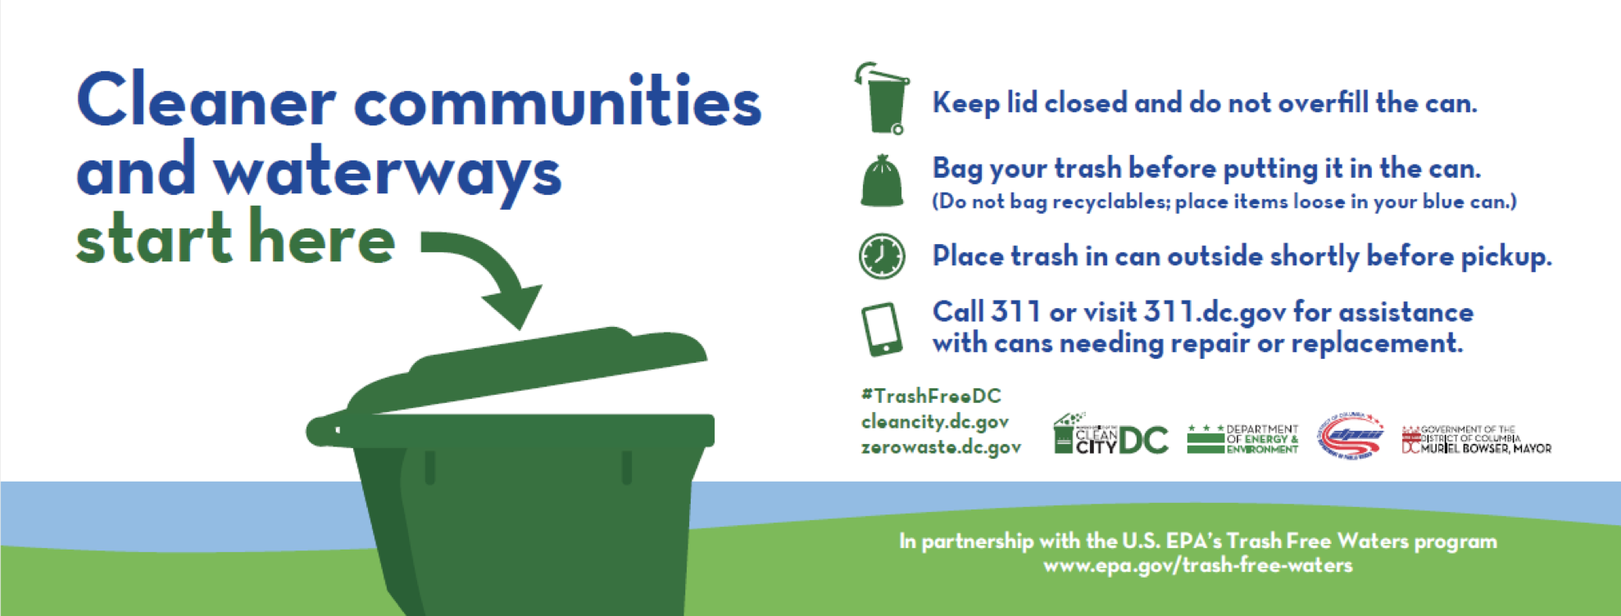
Understanding Needs and Perceptions
Reflect and Learn
Case study: Washington, D.C.
Community engagement doesn’t end after an event or campaign does. Evaluate how the engagement went and what could be improved in the future.
Begin the outreach effort with metrics of success in mind so that you can evaluate progress as you move forward.
Collect data related to what success for your specific engagement effort looks like. This takes resources but is necessary to know if you are meeting your goals.
Create an internal or external summary document with “lessons learned” after the project is complete.
In 2020, Washington, D.C. launched a campaign to educate communities about proper waste containment and encourage behavior change to reduce curbside trash leakage. Before beginning the campaign, the team conducted weekly monitoring that continued after distributing outreach materials to better assess the impact of the campaign. The pilot program also compared houses that received the outreach materials to houses that did not. Both metrics allowed the team to measure behavior change and success. Read the full summary report.
Community Engagement
Best Practices
Notes:
Reference:
https://www.epa.gov/system/files/documents/2022-05/Curbside%20Summary_Final_5.12.pdf

Slide 24



What You Can Do
Build authentic community connections. You want to build trust, but remember, it takes time! Have patience, be present, and continue to show up for your community.
Provide a neutral space to interact with community members. When your community feels like they can show up in a safe, welcoming environment it leads to more genuine interactions.
Discuss challenges and opportunities. By talking through the pros and cons it allows for different perspectives to be shared and to problem solve. It also gives insight into how difficult the decision-making process can sometimes be.
Notes:
Jennifer Starr: Build authentic community connections; provide a neutral place to interact with community members; Build trust (it takes time!); create opportunities to build relationships and discuss challenges and opportunities

Slide 25
To Learn More
Chesapeake Behavior Change
  Find and use tools, information, and survey data to understand how to gain community buy-in and engagement.
Chesapeake Bay Program: Beyond Environmental Benefits Database and Search Tool
  Discover specific case studies of how communities are taking the most action to reduce climate impacts by working together on local projects.
Chesapeake Bay Program: Find a Bay Organization
  Explore the map to discover how +600 different organizations are protecting natural resources and growing sustainable communities throughout the Bay Watershed region.
Chesapeake Bay Program: Help Protect the Bay
  View an expansive list of everyday actions constituents can take to help protect the Chesapeake Bay from damage. From reducing food waste to reducing greywater, this resource has it all.
Community Engagement, Environmental Justice, & Health (CEEJH)
  Find out more about how you can empower your community to be more engaged and inclusive through exploring research/publications, a Maryland-specific EJ-Screen PPGIS tool, education and training, and more.
Civic Ecology Lab’s Environment Education & Community Engagement Course
  Register for the 4-week online course to earn a certificate from Cornell University to support community collaboration on environmental issues.

Slide 26
To Learn More
ICLEI Local Governments for Sustainability
  Find out how to join a global group of +2500 local and regional governmental groups who are dedicated to developing urban sustainability through policy and local action.
Local Government Sustainability Guide: Encouraging Eco-Friendliness at the Local Level
  Discover best practices on how government officials can drive action on sustainability and support environmentally friendly policies.
Audubon Internal Sustainable Communities Program (SCP)
  Explore the SCP and take part in the certification program to learn about how you can transform your community into a sustainable space with consideration for the different priorities, needs, and issues facing your community.
American Water Works Association: A Water Utility Manager’s Guide to Community Stewardship
  View an expansive guide to successful community engagement, how to develop a plan and put in into action, and an expansive list of case studies, resources, and tools, this resource has it all.

Slide 27
Images and Graphics
The Spectrum of Involvement
Graphics by Green Fin Studio
Desired Outcomes
Graphics by Green Fin Studio
Navigating Pushback
Graphics by Green Fin Studio
Best Practices
  Photo by Envato Elements
Understanding Needs and Perceptions
Photo by W. Parson/Chesapeake Bay Program
Building Relationships
  Photo by Prince George’s County “Scoop that Poop” Program Website
Timing
  Photo by W. Parson/Chesapeake Bay Program
Diversity and Inclusion
  Photo by http://www.walkablewatershed.com/petersburg/
Managing Expectations
Photo by safewatercollaborative.org
Reflect and Learn
Photo by EPA
Title Page
  Photo by W. Parson/Chesapeake Bay Program
Table of Contents
  Photo by W. Parson/Chesapeake Bay Program
Laying Foundations
  Photo by Skyler Ballard/Chesapeake Bay Program
What You’ll Learn
Photos by W. Parson and S. Droter/Chesapeake Bay Program
Benefits of Engaging
  Photo by W. Parson/Chesapeake Bay Program
Return on Investment
  Photo by W. Parson/Chesapeake Bay Program
Capacity Building
  Photo by Monroe County SWCD
Building Trust
Photo by W. Parson/Chesapeake Bay Program
Understanding
  Photo by W. Parson/Chesapeake Bay Program
When and Who
  Photo by Alliance for the Chesapeake Bay

