Slide 1
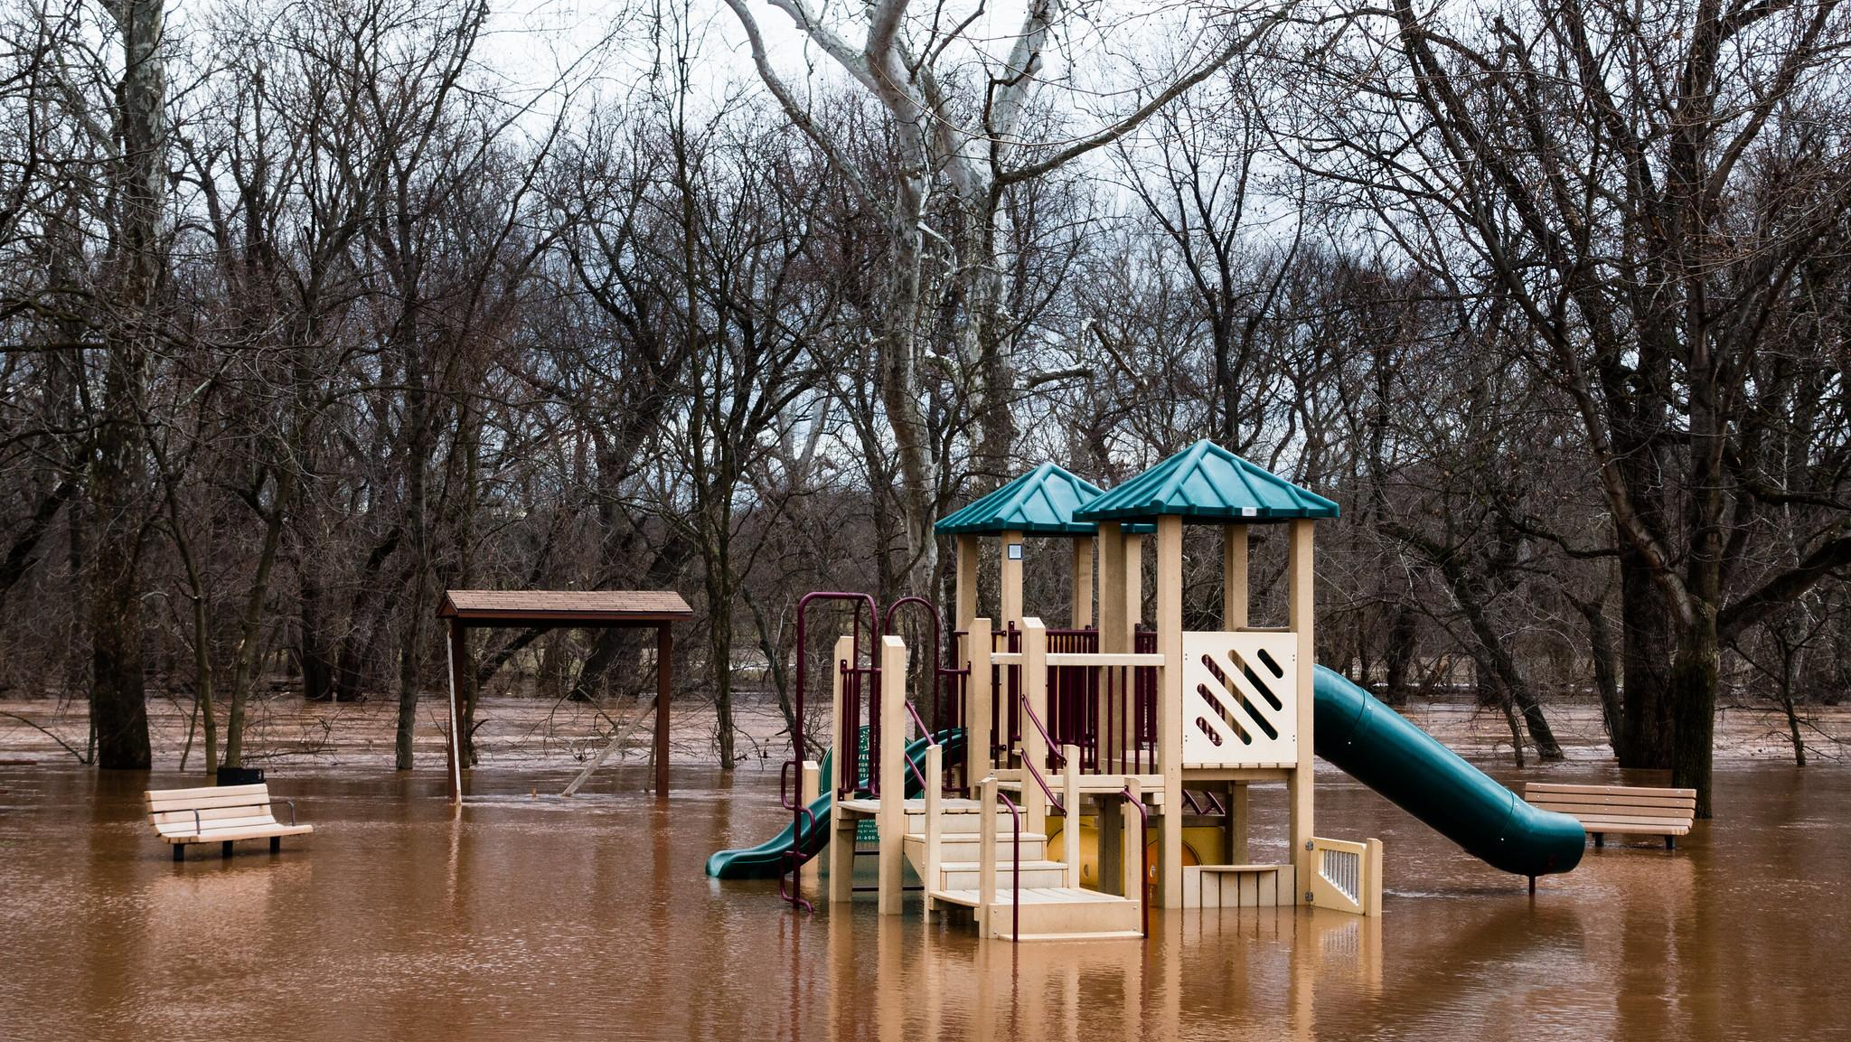
A Local Government Guide to the Chesapeake Bay
Module 8: Preparing Your Community for Water Extremes
Notes:
Photo by W. Parson/Chesapeake Bay Program

Slide 2
Table of Contents
1
Purpose
What You’ll Learn
Changing Conditions
Drought
Flooding
Climate Resilience
What You Can Do
To Learn More
Glossary
2
3
4
5
6
7
8
9
*Please refer to individual slide notes for data references and information sources.
Module 8: Preparing Your Community for Water Extremes
Notes:
Photo by W. Parson/Chesapeake Bay Program

Slide 3
A Guide For Local Governments
To help local government representatives better understand how the information in the modules aligns with their priorities, look for these icons:
As a local leader, your decisions set the course for your community. Your actions determine the health and vitality of your jurisdiction, as well as that of your local waterways and the Chesapeake Bay. You can achieve win-win outcomes by prioritizing local economic development, infrastructure resiliency, public health, and education while also protecting your environment.
This module is one in a series created by the Chesapeake Bay Program to support and inform decision making by local officials. We encourage you to examine the full suite of modules listed on the next slide.
Economic Development
Public Health & Safety
Infrastructure Maintenance & Finance
Education
Preparing for Water Extremes
Purpose

Slide 4
A Guide For Local Governments
Available Local Government Modules
How Your Watershed Works
Foundations of Clean Water
Healthy Water for the Economy
Capitalizing on the Benefits of Trees
Preserving Local Character and Landscapes
Protecting Your Infrastructure Through Stormwater Resiliency
Building the Workforce of Today and Tomorrow
Preparing Your Community for Water Extremes
Understanding and Supporting Your Agricultural Allies
Keys to Community Engagement
Your Health and the Environment
Preparing for Water Extremes
Purpose

Slide 5
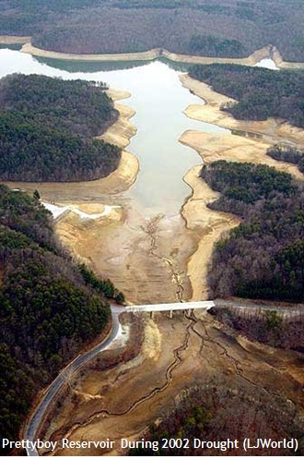
Laying Foundations
Flooding is not a new problem in the Chesapeake Bay watershed, but it is one that is intensifying. At the same time, drought is increasing across the region.
As the climate changes, local decision makers need public support and resources to prepare for, manage, and reduce local flooding and drought impacts.
Although climate change impacts everyone, the burden will not be shared equally. Resilience means addressing regional and societal inequities as well as protecting public safety and economic, natural, and infrastructural assets.
This problem is accelerating and the cost of not acting will only get higher– now is the time to prepare your community.
Preparing for Water Extremes
Purpose
Notes:
Photo from Lawrence Journal-World/LJWorld.com

Slide 6
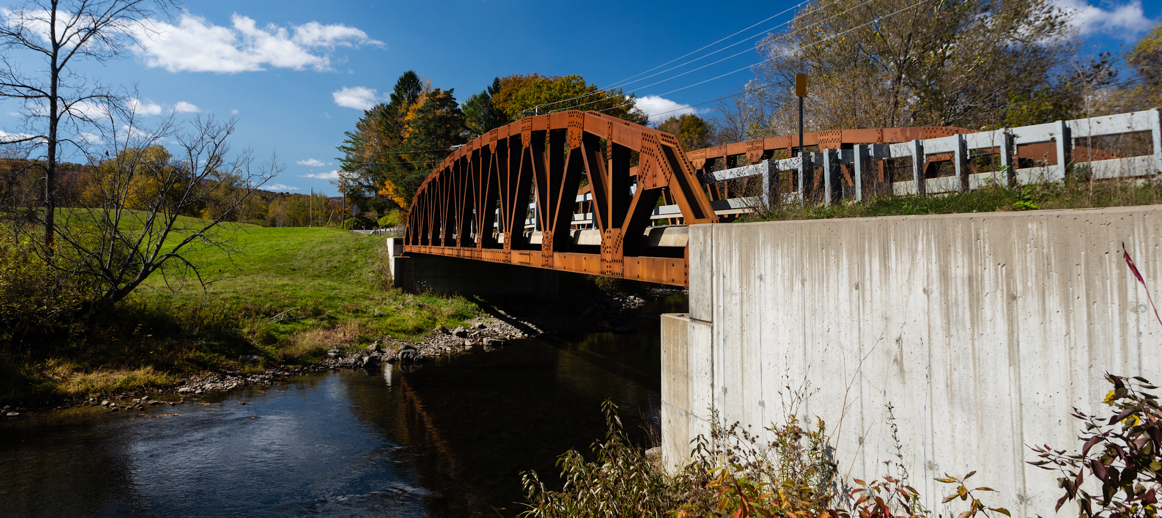
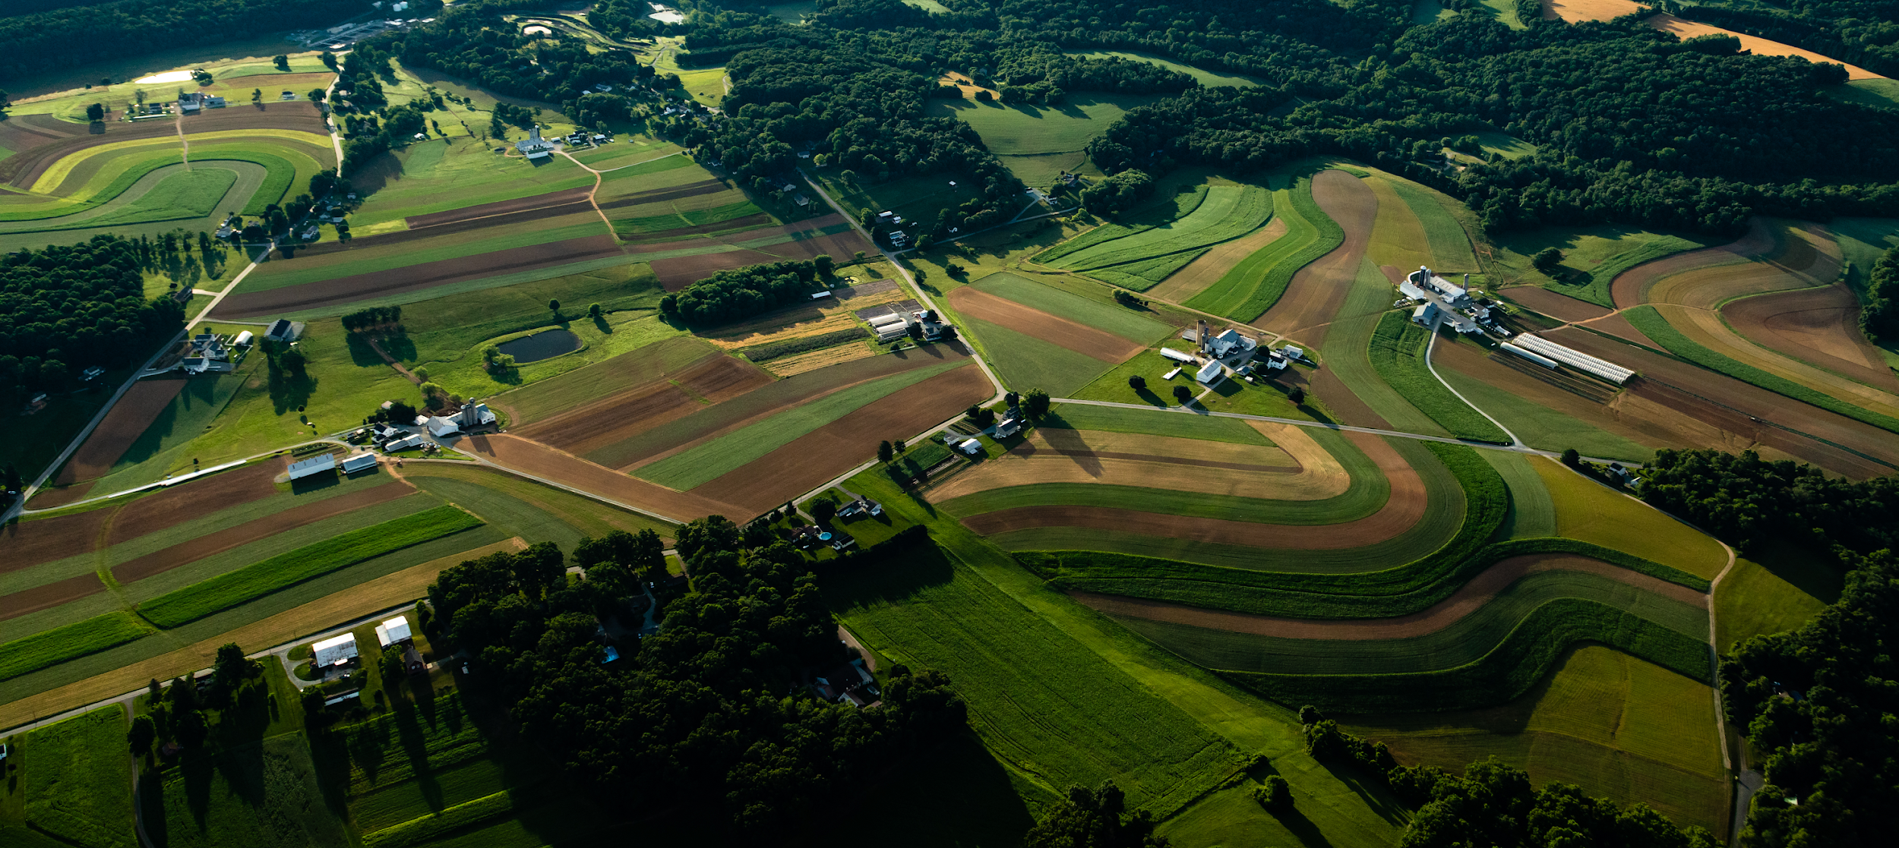
What You’ll Learn
How do flooding and drought impact my community?
Are weather patterns changing?
What can I do to prepare for future flooding and drought conditions?
Preparing for Water Extremes
What You’ll Learn
Notes:
Photos by W. Parson/Chesapeake Bay Program

Slide 7
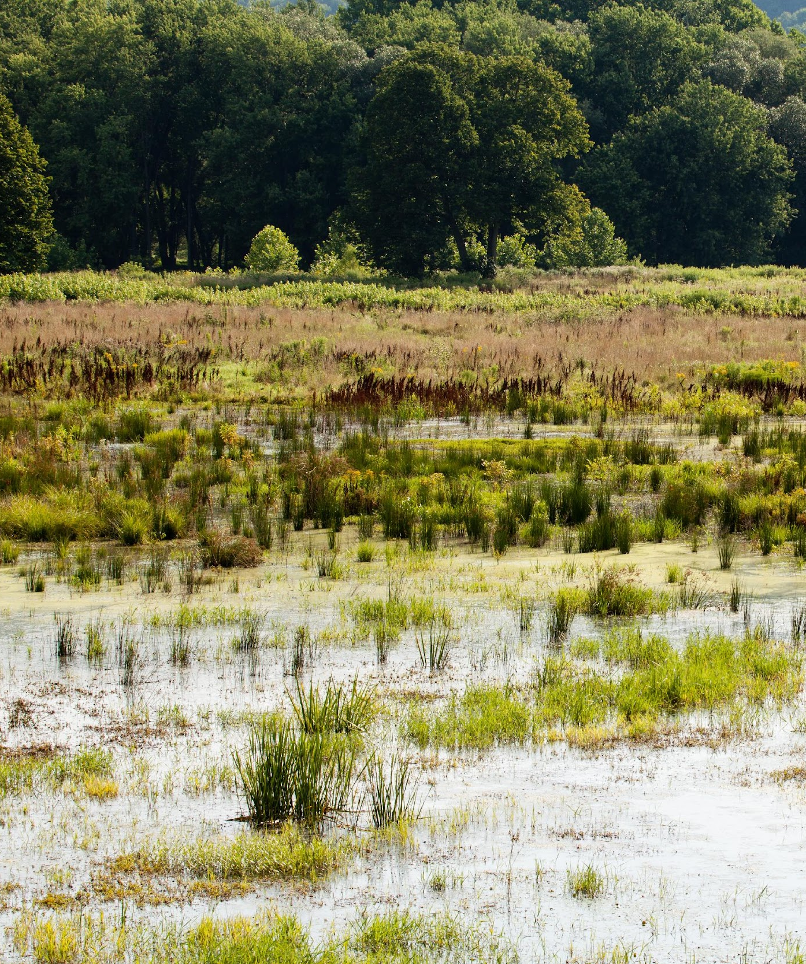
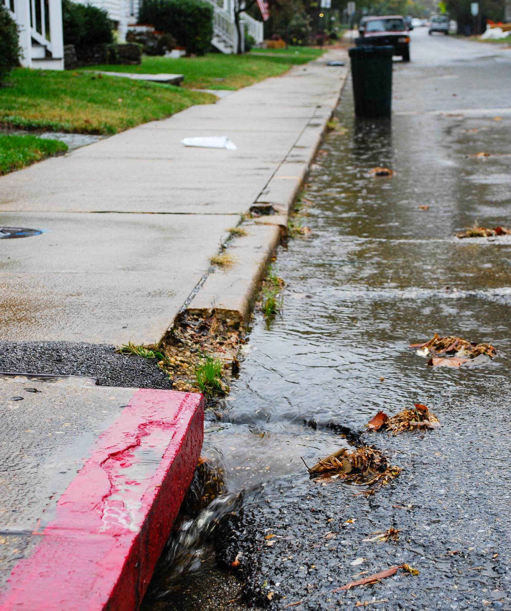
Changing Conditions
Long-term weather patterns are changing in ways that impact your community.
Notes:
Photo by W. Parson/Chesapeake Bay Program

Slide 8
Weather Versus Climate
As the National Oceanic and Atmospheric Administration (NOAA) puts it: Climate is what you expect, weather is what you get.
Climate comes from long-term averages of conditions in a particular area, such as what the typical temperature is, how windy it usually is, and how much rain or snow you can expect. Weather is the day-to-day conditions of the area, like if it is currently raining or what the temperature is right now. It can change over minutes, hours, days, or weeks.
Weather determines what you wear today:
Climate tells you what you need in your closet over the course of the year:
or
Preparing for Water Extremes
Changing Conditions

Slide 9
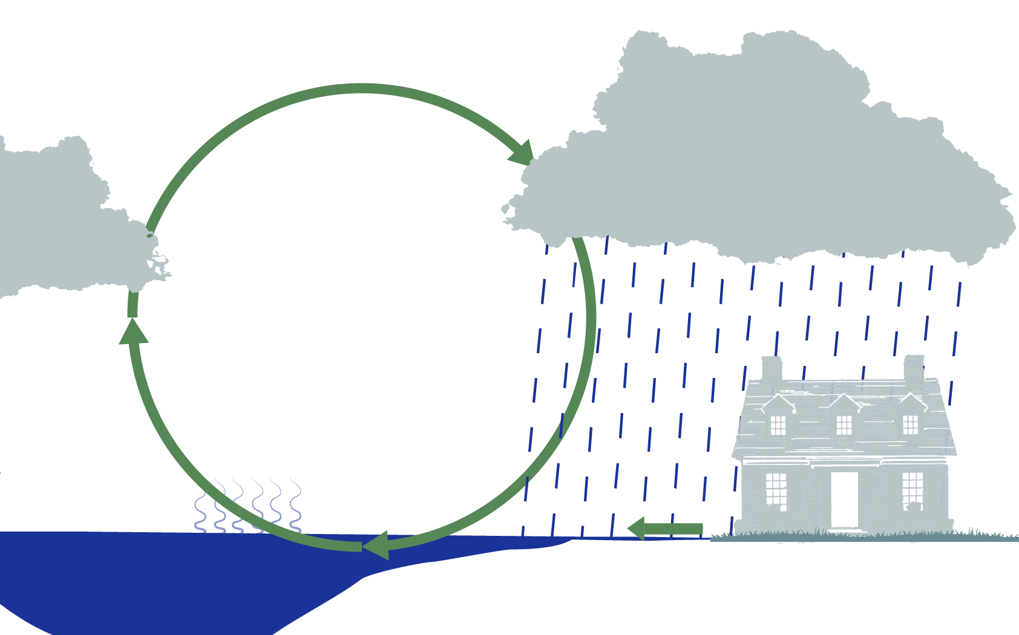
The Normal Water Cycle
Flooding can occur when more precipitation falls than can absorb into the ground. The excess water, called stormwater runoff, can cause damage and add pollutants to local waters.
Drought occurs when there is not enough precipitation to replenish the water consumed by your community and lost to evaporation.
Condensation
Precipitation
Evaporation
Stormwater Runoff
Preparing for Water Extremes
Changing Conditions

Slide 10
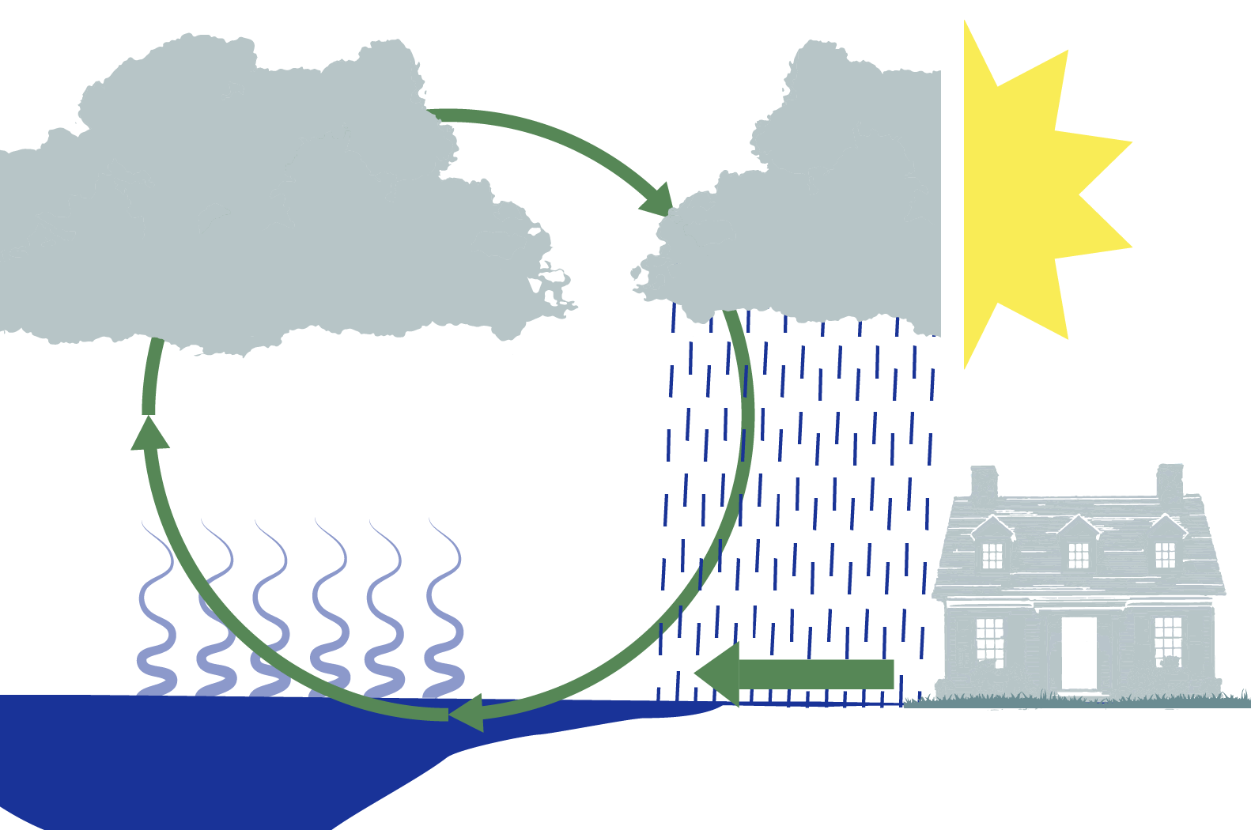
How Climate Change Impacts Water
Climate Connection
Higher temperatures cause more water to evaporate from the ground, drying out the soil.
Evaporation also fuels more rainstorms and dry soil cannot quickly absorb rain. This combination can lead to flash flooding.
Condensation
More Intense Precipitation
More Dry Periods
More Evaporation
More Stormwater Runoff
Preparing for Water Extremes
Changing Conditions

Slide 11
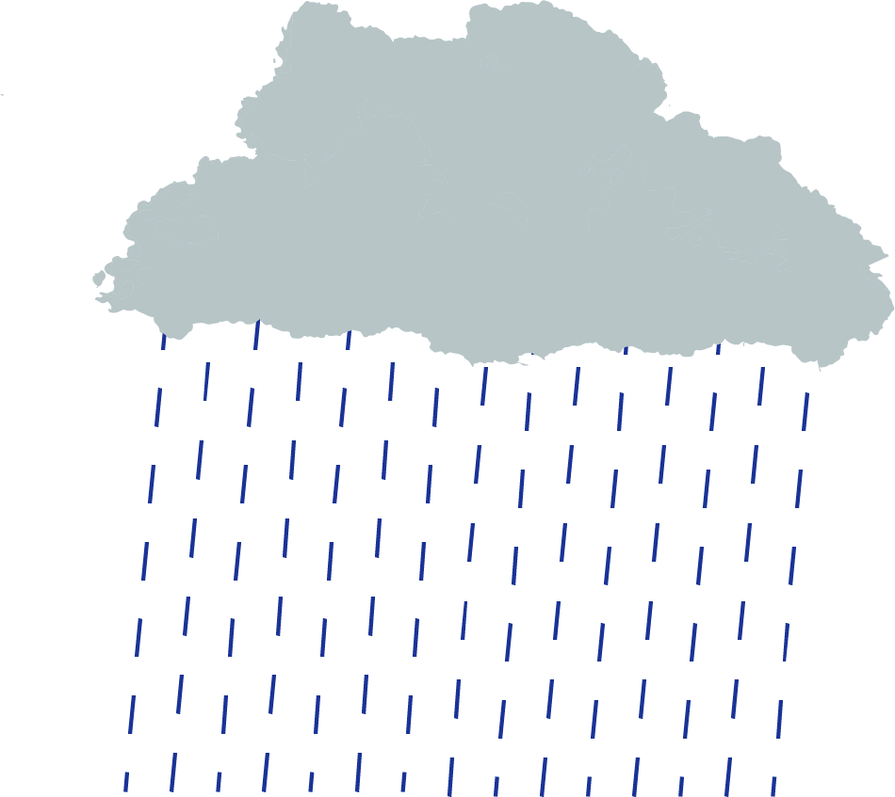
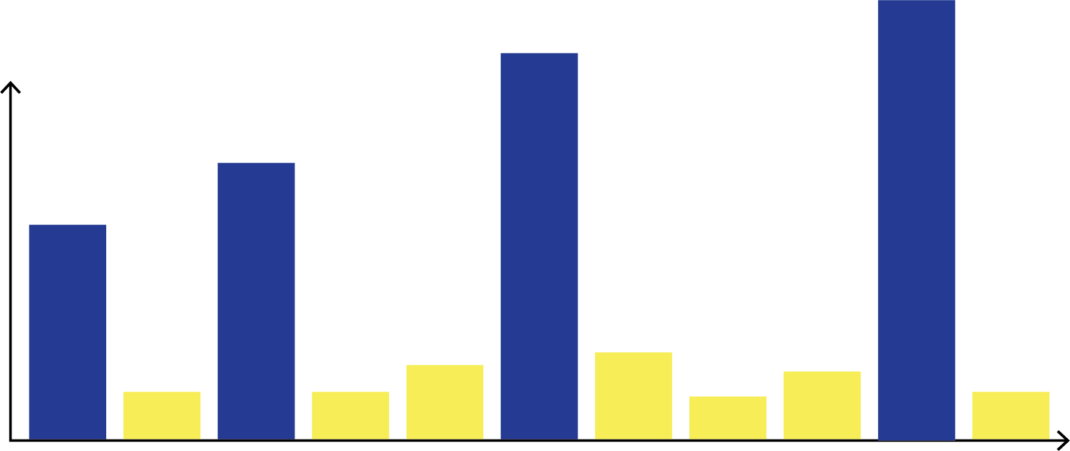
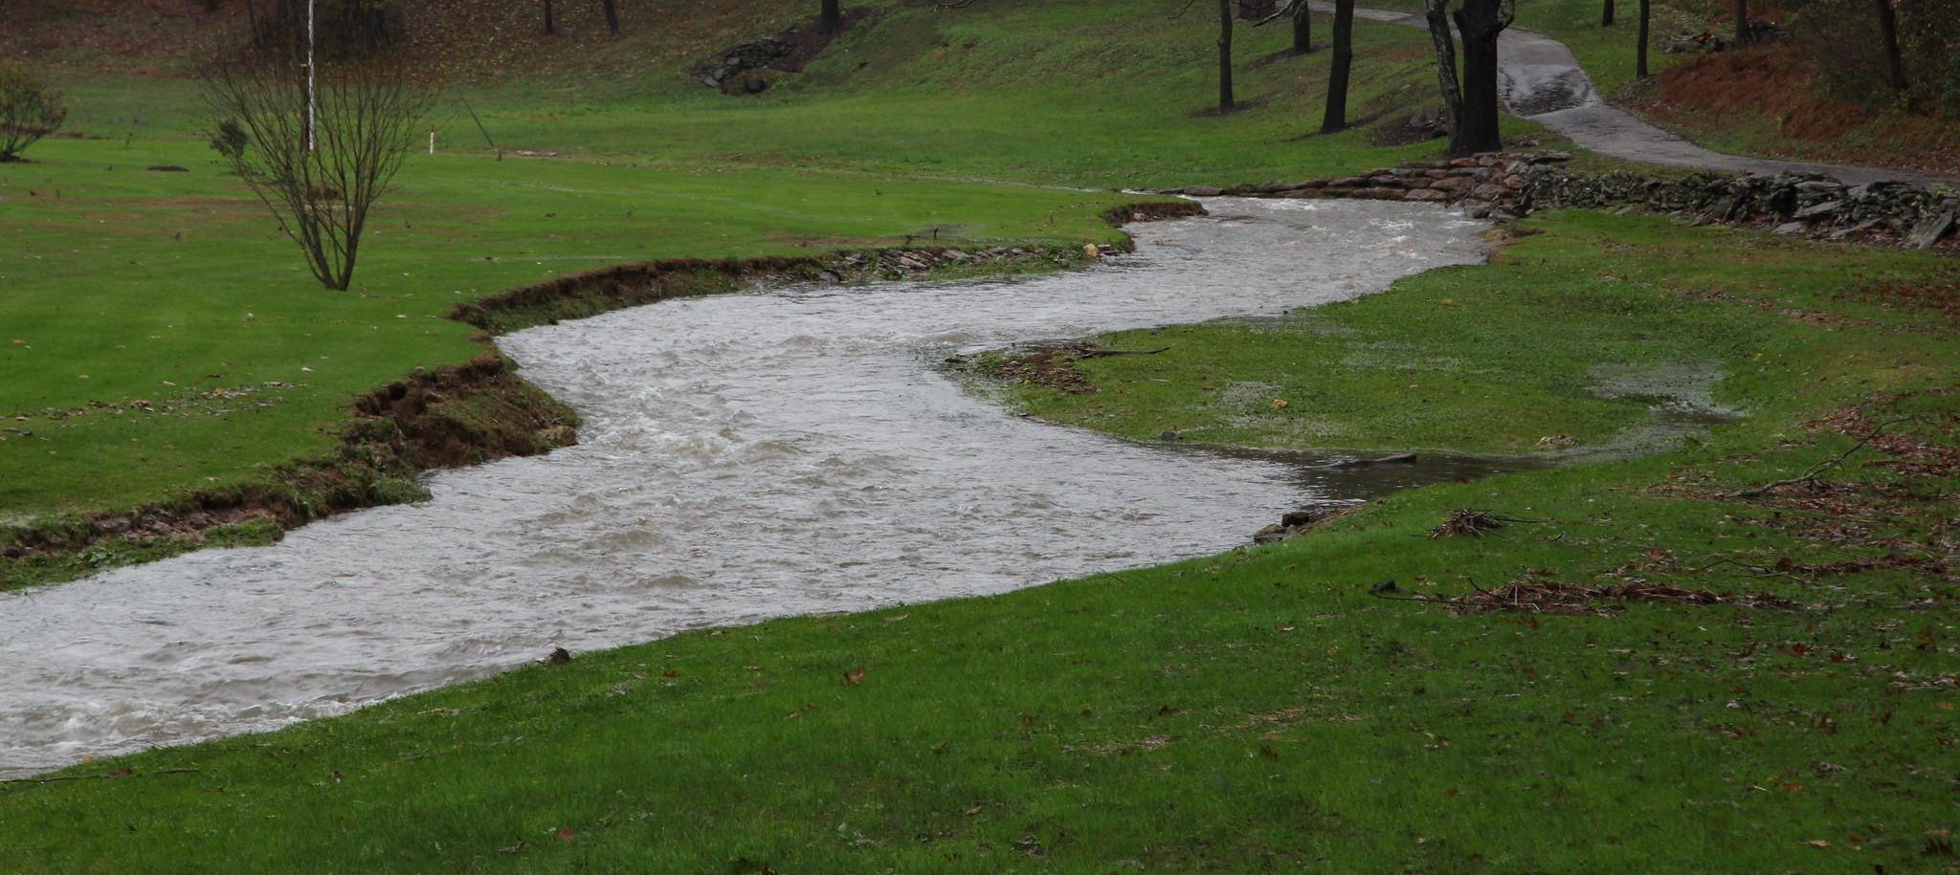
Water Projections
Climate Connection
Annual rainfall is expected to increase
Failure to account for changing weather patterns may lead to underestimating rainfall by as much as
6.5% or 2.7 inches by 2055
60%
in the Chesapeake Bay watershed.
Being unprepared for increased precipitation heightens risk of flood and infrastructure failure while decreasing the efficacy of established stormwater best management practices.
Rainfall
Time
Storms will get more intense with longer dry periods between rain events.
Preparing for Water Extremes
Changing Conditions
Notes:
Photo by S. Droter/Chesapeake Bay Program
References:
https://www.chesapeakebay.net/channel_files/40324/memo_3_summary_of_climate_projections_review_draft_9.4.20.pdf

Slide 12
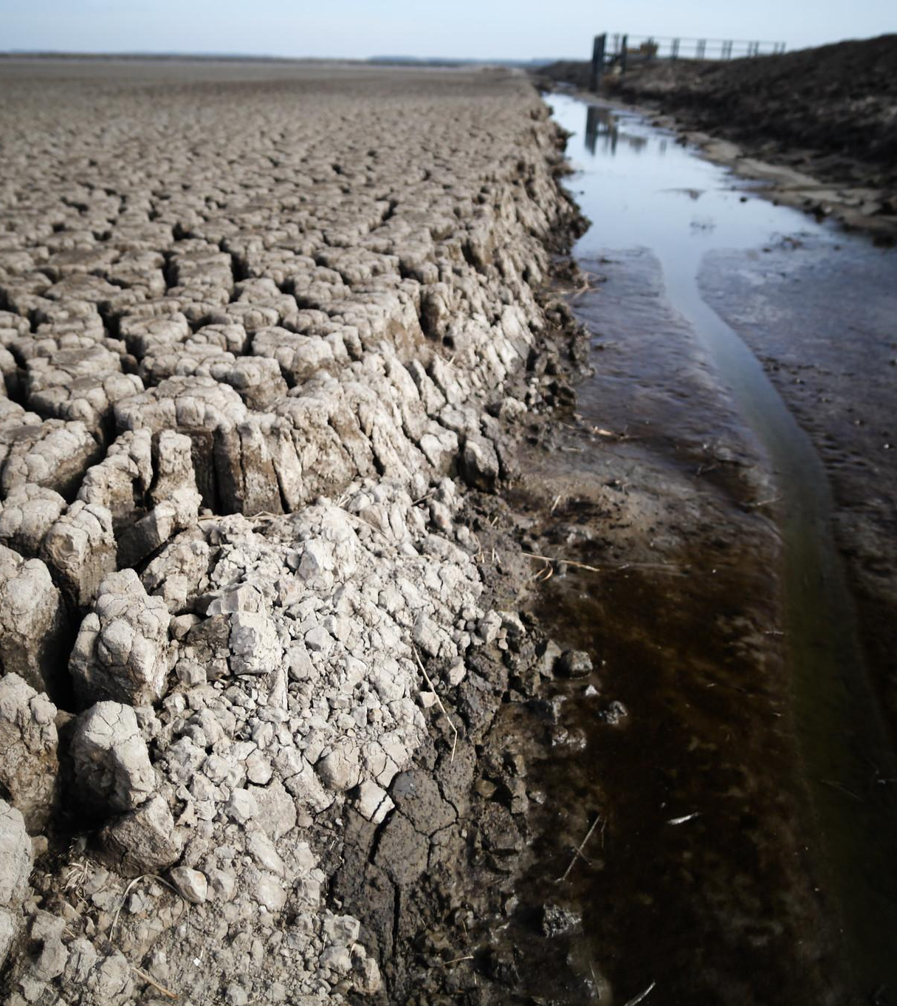
Drought
Water is critical for a thriving community. What happens when there’s not enough?
Notes:
Photo by S. Droter/Chesapeake Bay Program

Slide 13
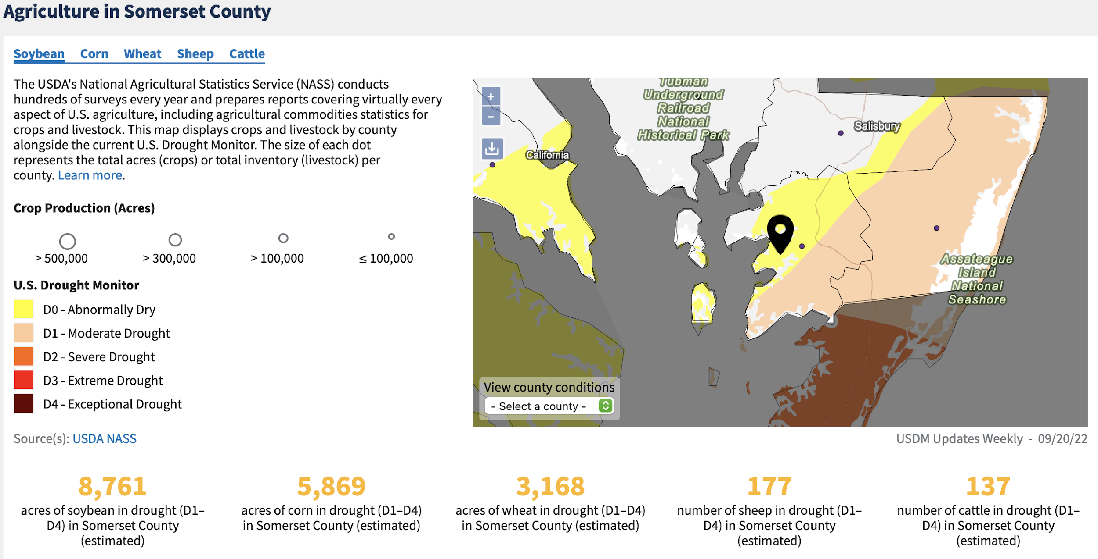
Drought
Climate Connection
Case study: Somerset County, MD
Periodic or sustained drought affects most U.S. regions, including the Chesapeake Bay watershed.
Drought in the U.S. is projected to become more intense and frequent, resulting in conflicts over water use and increasing vulnerability of infrastructure and communities.
The National Integrated Drought Information System (NOAA NIDIS) is a great tool for forecasting drought in your community.
Above is the drought map from September 2022 with impacts on agriculture. Below is a map of forecasted drought based on projected evaporation rates.
Preparing for Water Extremes
Drought
Notes:
References:
https://www.drought.gov/location/Rehobeth%2C%20Maryland

Slide 14
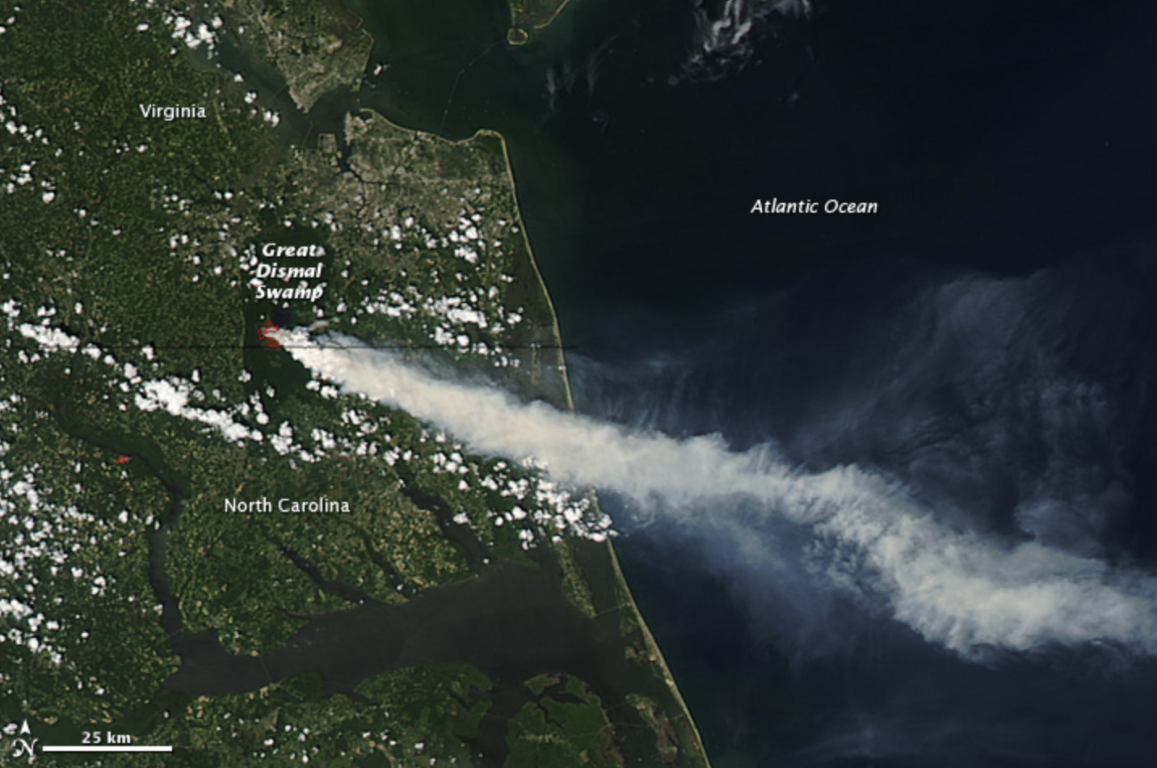
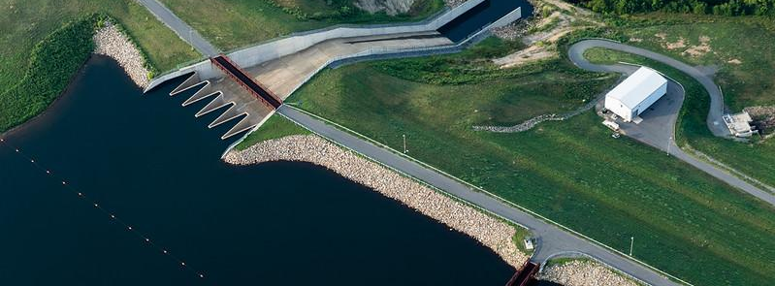
Drought Impacts
Drought impacts many industries, including energy, manufacturing, transportation, agriculture, and recreation. Learn more in the video below.
Access to drinking water is affected by drought, whether homes are on municipal water or private wells.
Case study: Wildfire at Great Dismal Swamp, VA
In addition to limiting water quantity, drought compounds problems by worsening water quality through increased salinity, algal blooms, and more. This creates human health and environmental concerns.
In 2011, drought dried the plants and soil in Great Dismal Swamp National Wildlife Refuge. When lightning struck, a fire began that burned for 111 days and cost $12.5 million to fight. It produced copious smoke, endangering the health of those living near the Refuge.
The cost of drought events averages over $9 billion per year in the United States.
Preparing for Water Extremes
Drought
Notes:
Photos by W. Parson/Chesapeake Bay Program and NASA
References:
https://earthobservatory.nasa.gov/images/51670/fire-in-great-dismal-swamp-virginia
https://www.pilotonline.com/news/environment/article_6004928d-ad61-55fb-8bef-1134b03e680e.html

Slide 15
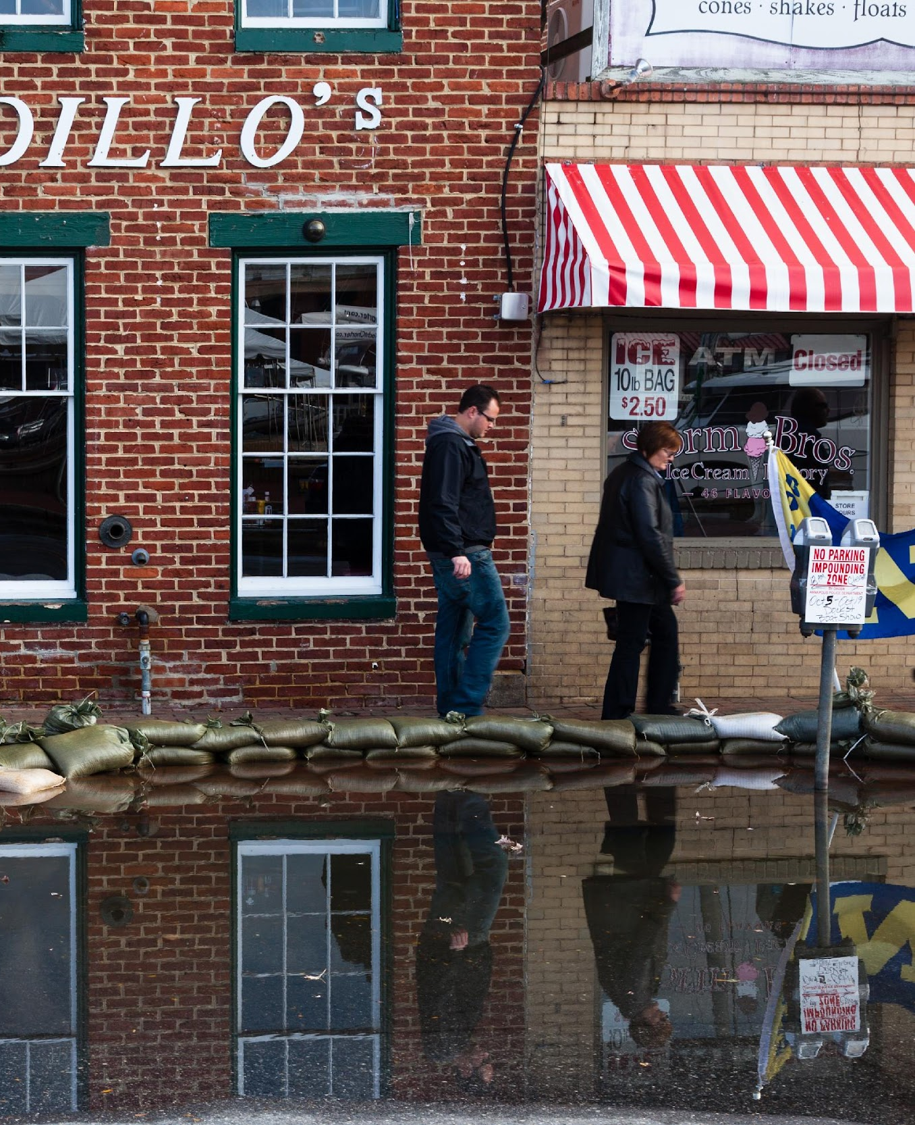
Flooding
Too much water can create just as many problems in your community as not enough.
Notes:
Photo by W. Parson/Chesapeake Bay Program

Slide 16
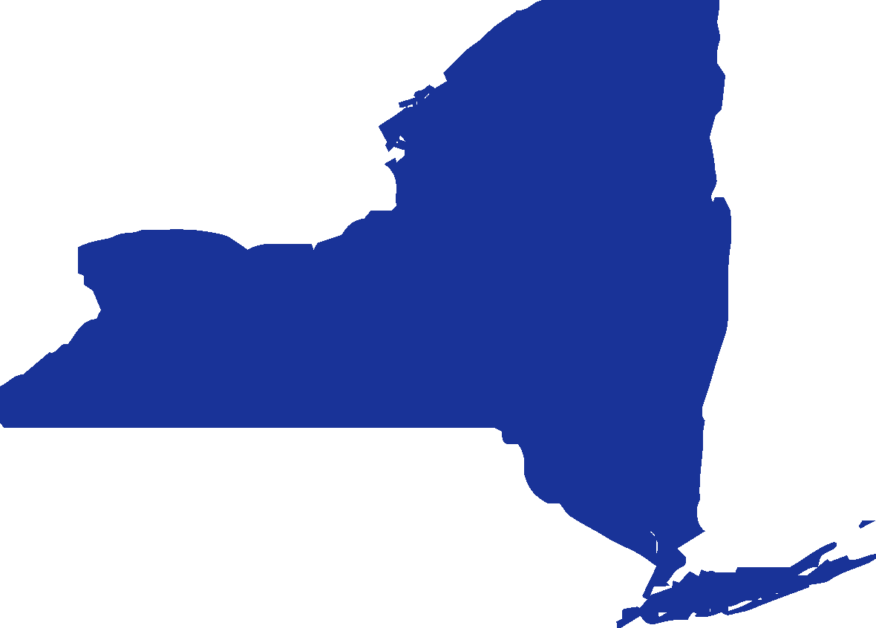
Flooding Impacts
Low-income families are more likely to live in flood zones and less likely to have flood insurance - only 26% of insured houses within the 100-year floodplain are low-income households.
Average annual flood insurance cost:
DC
DE
MD
NY
$817
$754
$629
$1273
PA
VA
WV
Weather and climate disasters are getting more costly. The cost of billion-dollar disasters over time in the US is shown below.
$1390
$805
$1337
Flooding cost the agriculture industry
$752.6 million
Billions of dollars
in the watershed states from 1995-2020
Preparing for Water Extremes
Flooding
Notes:
Photo by M. Land/Chesapeake Bay Program
References:
https://www.forbes.com/advisor/homeowners-insurance/flood-insurance-cost/
https://farm.ewg.org/cropinsurance.php?fips=00000&summpage=IN_TOPSTATES&regionname=theUnitedStates
https://ca.water.usgs.gov/projects/USGS-US-domestic-wells.html
https://www.fema.gov/sites/default/files/2020-07/fema_nfip_eval-costs-and-consequences.pdf
https://www.nrdc.org/experts/joel-scata/flood-insurance-subsidies-must-include-actions-lower-risk
https://www.census.gov/data/tables/time-series/demo/popest/2010s-state-total.html#par_textimage_1574439295

Slide 17
Flooding in Your Community
Climate Connection
Coastal
Both rising waters and sinking land are leading to more flooding along coasts. Storm surge, the additional sea water pushed on shore from a storm, is a significant issue for coastal communities. Nuisance flooding (driven by tidal activity) also presents a chronic risk to coastal communities, with cumulative damage potentially exceeding that from storms.
Urban
Because of a higher proportion of impervious surfaces, heavily developed areas experience more stormwater runoff. This can lead to localized flooding and infrastructure damage during storms. As your community grows, it’s important to keep in mind how water will move through growth areas.
Inland
Storm events are worsening with changes in the water cycle. We can expect more powerful storms with the potential for more flash flooding. Mudslides are an additional hazard associated with high-elevation storms. Rural communities are especially vulnerable due to capacity limitations and geographic isolation.
Preparing for Water Extremes
Flooding

Slide 18
Do You Know Your Flooding Terms?
Climate Connection
Floodplains are areas susceptible to being inundated by floodwaters from any source. They are being altered by the changing water cycle – floodplains in the future will be larger than they are today. This endangers more houses and infrastructure as time goes on.
Current floodplain
Floodplain in 2075
Preparing for Water Extremes
Flooding
Notes:
References:
https://www.fema.gov/pdf/nfip/manual201205/content/22_definitions.pdf

Slide 19
Do You Know Your Flooding Terms?
You may have also heard floods referred to as #-year floods, such as a 100-year flood.
It’s not what it sounds like - it means that the likelihood of a flood of that magnitude happening is 1 in 100, or a 1% chance in any year, not that a flood of that intensity occurs once every 100 years. That is why it is possible, and getting more likely with climate change, to see a 100-year flood two years in a row.
Preparing for Water Extremes
Flooding
Notes:
Photo by R. Magnien/NOAA

Slide 20
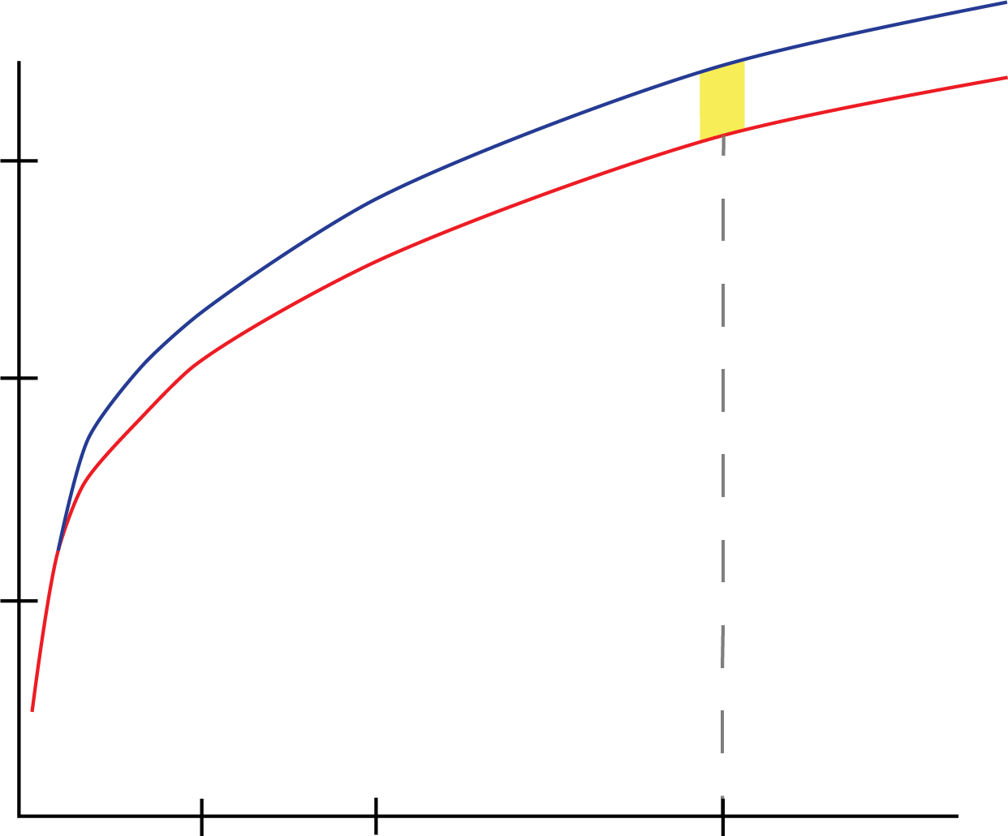
Measuring Rainfall Intensity
Climate Connection
Intensity-Duration-Frequency (IDF) curves represent how much rain falls, for how long, and how often it happens. They are used for forecasting flooding and informing water engineering and design. Because the water cycle is changing, we must adjust IDF curves and design specifications to be prepared for more intense and frequent rainfall.
The plot to the left for Luzerne County, PA shows the standard IDF curve in red and one that accounts for climate change in blue. Look up your county: https://midatlantic-idf.rcc-acis.org.
10% more rain projected for the same duration
Amount of Rain
Duration of Rain
Case study: Virginia Beach
The City of Virginia Beach updated its Public Works Design Standards Manual to adjust for increases in precipitation. The City already sees rainfall 10% above the standard projections and anticipates increases over the next 30 years. The Manual has been updated to increase IDF curve values by 20%, meaning that infrastructure design will now have to accommodate a larger amount of rainfall. This may increase costs initially, but the investment is in protecting the community.
Preparing for Water Extremes
Flooding
Notes:
Photo by W. Parson/Chesapeake Bay Program
https://www.adaptationclearinghouse.org/resources/virginia-beach-public-works-design-standards-manual-sea-level-rise-and-precipitation-adjustments-for-stormwater-management-design.html

Slide 21
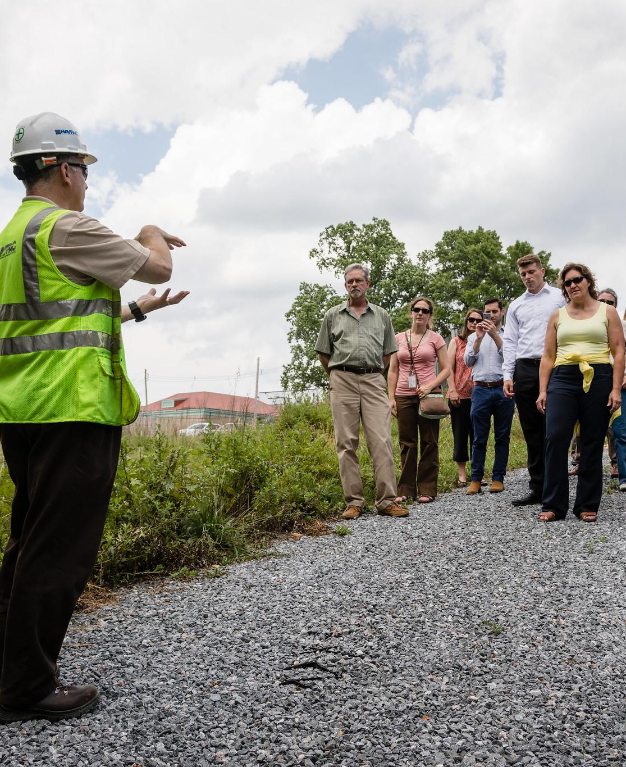
Climate Resilience
The climate is changing; is your community ready for the impacts?
Notes:
Photo by W. Parson/Chesapeake Bay Program

Slide 22
Climate Resilience
Climate resilience is the ability to anticipate, prepare for, and respond to hazardous events, trends, or disturbances related to climate. Being resilient to changes in climate can include:
Understanding your community’s exposure.
Assessing your vulnerability and risk.
Investigating your options.
Prioritizing and planning.
Taking action.
Preparing for Water Extremes
Climate Resilience

Slide 23
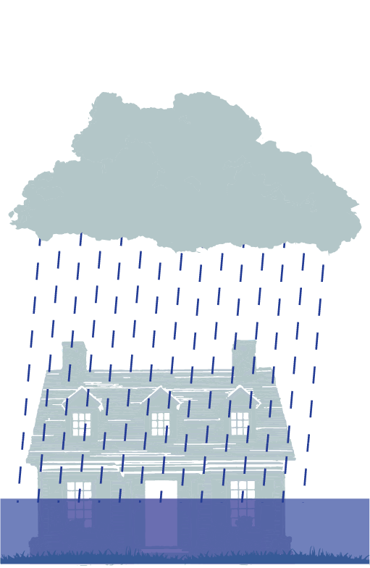
Rebuilding Stronger
Climate Connection
Water conditions in your community are changing. Business as usual in your community will leave you vulnerable to increasing drought and flooding; we can’t keep building for historical conditions and not expect to see increasing damage.
Avoiding future flood damage to new structures requires a two-part strategy:
1
New building standards, including keeping development out of the high-risk areas
2
Rebuilding stronger after damage
Preparing for Water Extremes
Climate Resilience

Slide 24
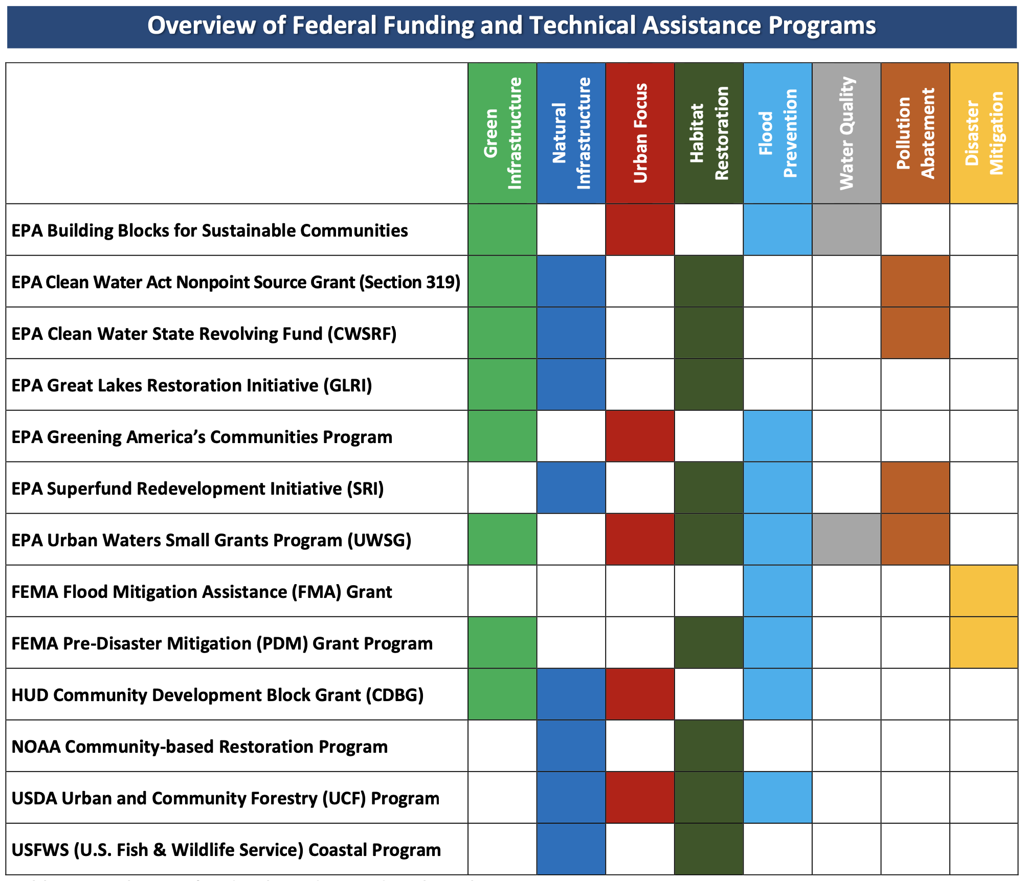
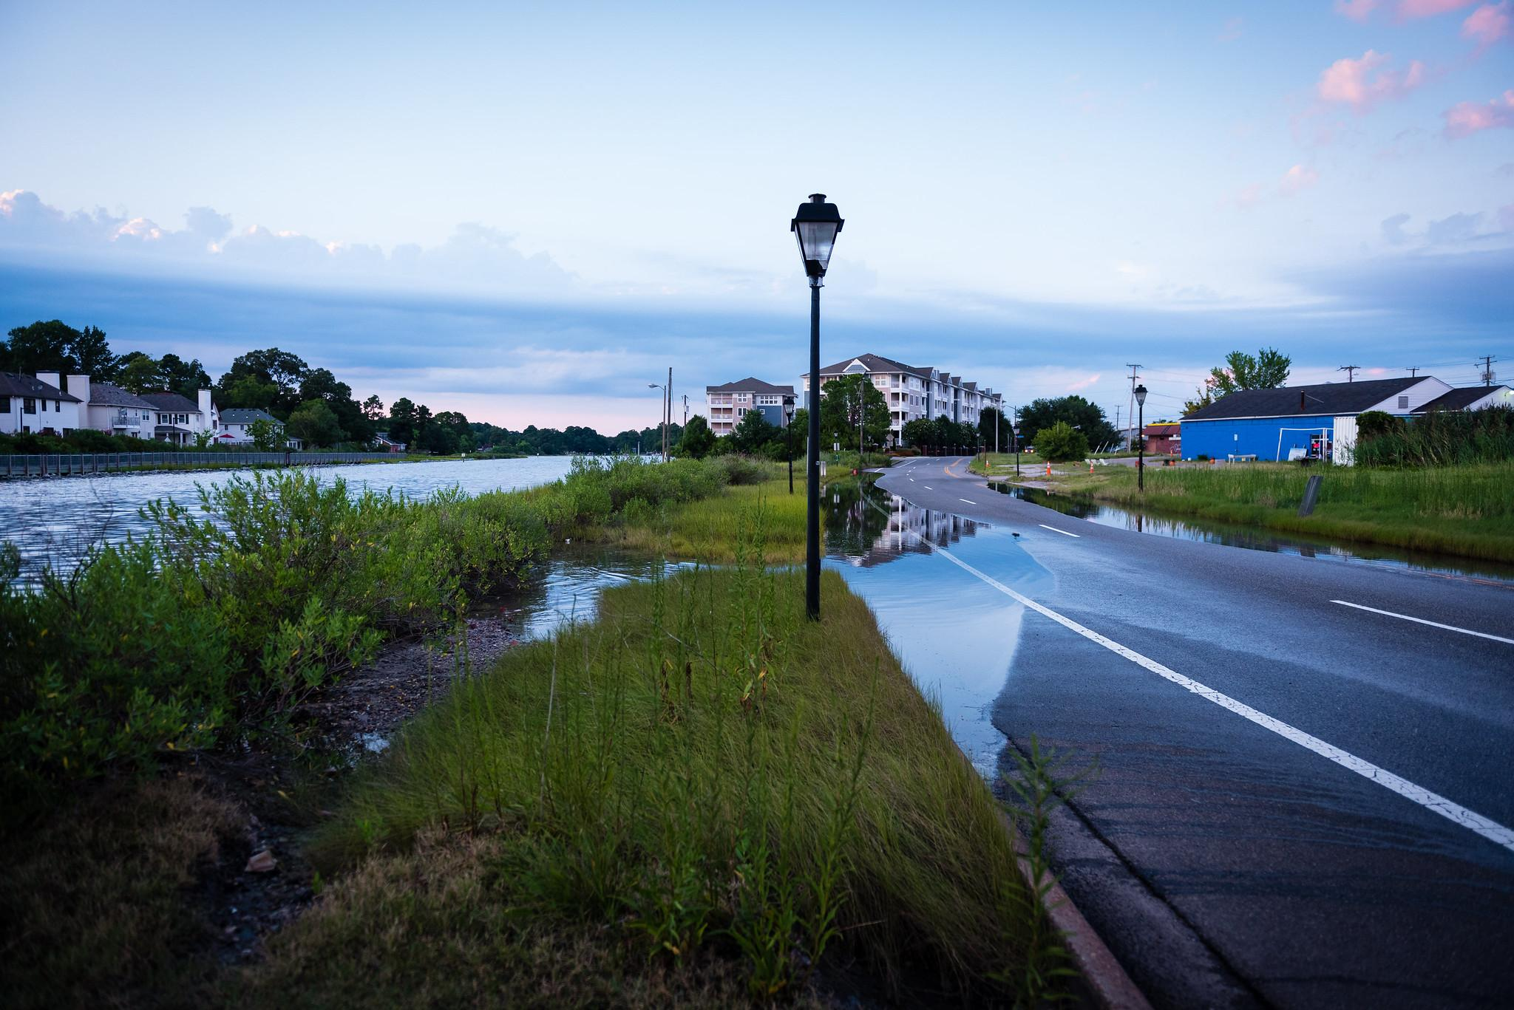
Funding
There are federal funds for mitigating flood risks, including those listed to the right.
The 2022 Inflation Reduction Act also included funding for resilience. The National League of Cities and the National Association of Counties are good resources on how to access resilience funding.
Table from the Environmental and Energy Study Institute
Case study: Community Rating System
FEMA Region 3 (which includes DE, DC, MD, PA, VA, and WV) has over 90 communities participating in FEMA’s Community Rating System. They earn credits for activities in public information, mapping and regulations, flood damage reduction, and warning and response.
Through the program, Norfolk, VA earns a 25% National Flood Insurance Program premium reduction.
Preparing for Water Extremes
Climate Resilience
Notes:
Photo by S. Ballard/Chesapeake Bay Program

Slide 25
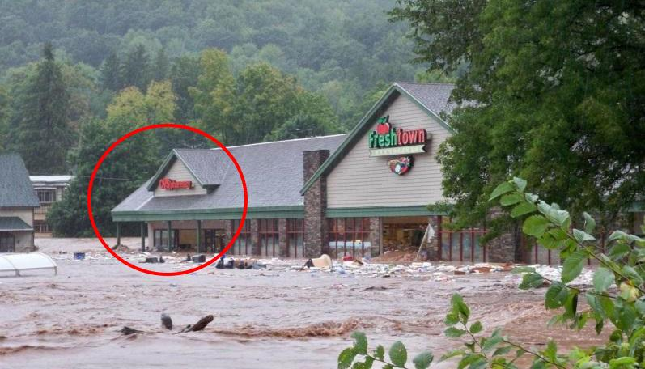
Tools for Resilience
Climate Connection
Incorporate effects of climate change into water, wastewater, and energy infrastructure planning using updated IDF curves
Watch the webinar for additional information
Register with the Chesapeake Stormwater Network to view climate and stormwater reports and other resources
Review the US Climate Resilience Toolkit to learn the five steps to resilience and how to achieve them, as well as case studies like the one below
Case study: Walton, NY
The Walton Flood Commission brought together 25 people from Walton and various state government offices to discuss flooding mitigation.
The flood commission suggested hiring a consultant to model a variety of flood scenarios and past storm events. There were also public meetings to educate and hear feedback. In the end, the village reclaimed the floodplain, reducing flooding and its impacts on the community.
Preparing for Water Extremes
Climate Resilience
Notes:
Photo by G. Dutcher/Delaware County Soil and Water Conservation District
References:
https://coast.noaa.gov/digitalcoast/training/walton-village.html

Slide 26
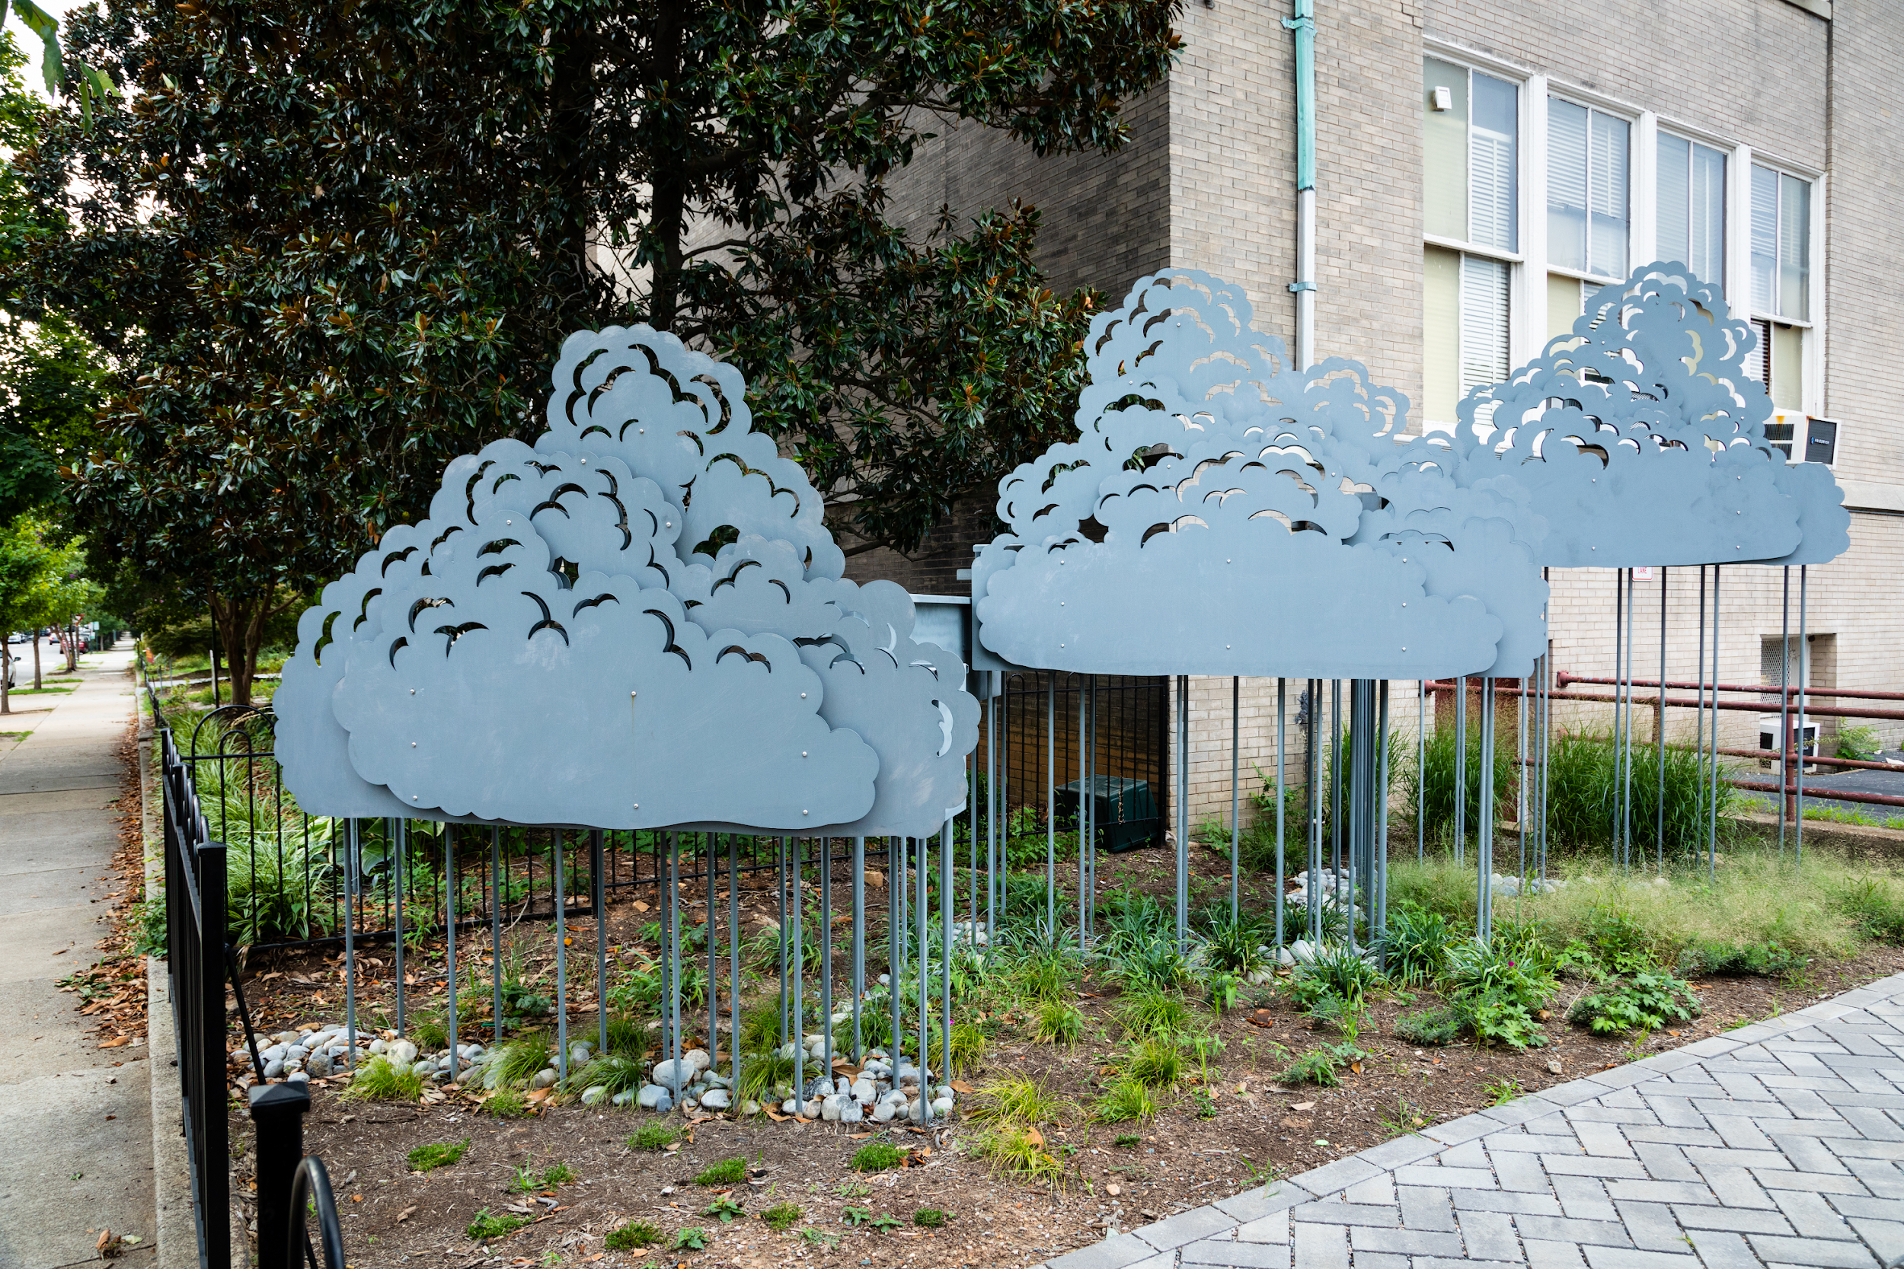
Partnerships
Increase your capacity by partnering with existing collaboratives.
Potential partners:
Soil and Water Conservation Districts
Nonprofits (local, regional, national)
Technical experts (foresters, engineers, natural resource consultants)
Schools (see case study)
Learn more about connecting with your community in Module 10: Keys to Community Engagement.
“Taking a School by Storm” is a runoff reduction effort at Binford Middle School that includes a garden with a rain-harvesting sculpture.
The project was funded with $200,000 awarded by the by National Fish and Wildlife Foundation through an EPA Small Watershed Grant.
Case study: Richmond, VA
Preparing for Water Extremes
Climate Resilience
Notes:
Photo by W. Parson/Chesapeake Bay Program

Slide 27
What You Can Do
Adopt a resilience plan in your community.
View a list of resources compiled by the Chesapeake Bay Program Climate Resiliency Workgroup and read this one-pager on resilience strategies.
Consider resilience in all future planning. Make sure that comprehensive plan updates include resilience as a cornerstone.
Start safety and preparedness campaigns to encourage property owners to get flood insurance and explain the risks of flash flooding.

Slide 28
To Learn More
US Climate Resilience Toolkit
Find and use tools, information, and subject matter expertise to build climate resilience in your community.
EJ Screen Chesapeake
Discover which portions of your community are most vulnerable to climate impacts.
NOAA Data Snapshots
View and use an up-to-date archive of freely available climate maps – great for websites or presentations.
FEMA
Review the FEMA website for information on flooding and insurance, including the updated Risk Rating 2.0 system used to calculate flood insurance premiums.
Wetlands Watch Sea Level Rise Adaptation Guide
View a Virginia-specific guide of existing programs and authorities that you can use to take action on flooding and sea level rise.
American Flood Coalition’s Resources
Find and use resources like an adaptation guide, disaster handbook, and flood funding finder.

Slide 29
Glossary
Climate
The average weather conditions for a particular location and over a long period of time
Weather
The state of the atmosphere, including temperature, atmospheric pressure, wind, humidity, precipitation, and cloud cover
Best Management Practices
Actions that people can take to prevent pollution from entering their local waterways
Floodplains
Areas susceptible to being inundated by floodwaters from any source
Intensity-Duration-Frequency (IDF) curves
Graphical tools that describe the likelihood of a range of extreme rainfall events. They relate rainfall intensity with its duration and frequency of occurrence for the purposes of flood forecasting and civil engineering.
Climate Resilience
The ability of living resources, habitats, public infrastructure and communities to withstand adverse impacts from changing environmental and climate conditions, like flooding and increased temperatures

Slide 30
Images and Graphics
Drought Impacts
Photos by W. Parson/Chesapeake Bay Program and NASA
Flooding
Photo by W. Parson/Chesapeake Bay Program
Flooding Impacts
Photo by M. Land/Chesapeake Bay Program
Do You Know Your Flooding Terms? 1
Graphics by Green Fin Studio
Do You Know Your Flooding Terms? 2
Photo by R. Magnien/NOAA
Measuring Rainfall Intensity
Photo by W. Parson/Chesapeake Bay Program
Climate Resilience 1
Photo by W. Parson/Chesapeake Bay Program
Climate Resilience 2
Photo by W. Parson/Chesapeake Bay Program
Rebuilding Stronger
Graphics by Green Fin Studio
Funding
Photo by S. Ballard/Chesapeake Bay Program
Tools for Resilience
Photo by G. Dutcher/Delaware County Soil and Water Conservation District
Partnerships
Photos by W. Parson/Chesapeake Bay Program
Title Page
Photo by W. Parson/Chesapeake Bay Program
Table of Contents
Photo by W. Parson/Chesapeake Bay Program
Laying Foundations
Photo from Lawrence Journal-World/LJWorld.com
What You’ll Learn
Photos by W. Parson/Chesapeake Bay Program
Changing Conditions
Photo by W. Parson/Chesapeake Bay Program
Weather Versus Climate
Graphics by Green Fin Studio
The Normal Water Cycle
Graphics by Green Fin Studio
How Climate Change Impacts Water
Graphics by Green Fin Studio
Water Projections
Photo by S. Droter/Chesapeake Bay Program
Drought
Photo by S. Droter/Chesapeake Bay Program

