Slide 1
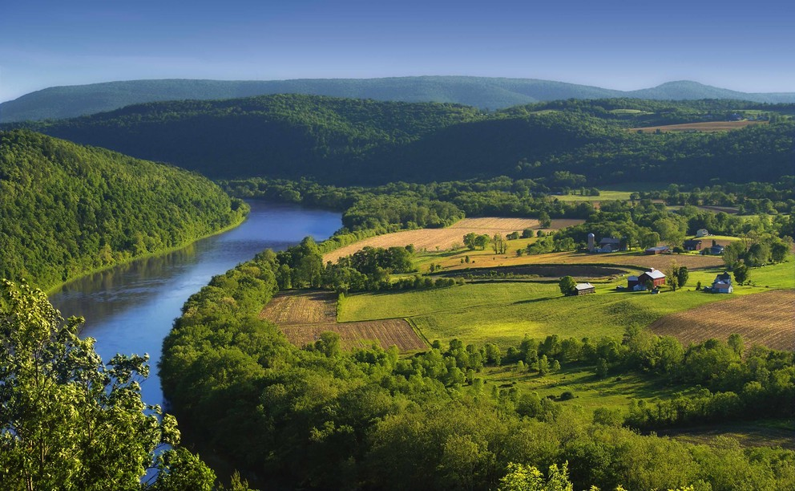
A Local Government Guide to the Chesapeake Bay
Module 5: Preserving Local Character and Landscapes
Notes:
Photo credit: Nicholas A. Tonelli/Wikimedia Commons, as posted by Penn State University

Slide 2
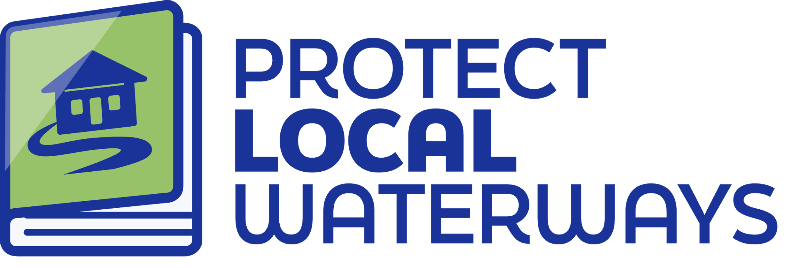
Content Developed By
A Local Government Guide to the Chesapeake Bay
Visit Us

Slide 3

Table of Contents
1
Purpose
What You’ll Learn
Collective Impacts
Natural Resilience
Local Government Toolbox
What You Can Do
To Learn More
Glossary
2
3
4
5
6
7
8
*Please refer to individual slide notes for data references and information sources.
Module 5: Preserving Local Character and Landscapes
Notes:
Photo from the Chesapeake Conservation Partnership

Slide 4




A Guide For Local Governments
As a local leader, your decisions set the course for your community. Your actions determine the health and vitality of your jurisdiction, as well as that of your local waterways and the Chesapeake Bay. You can achieve win-win outcomes by prioritizing local economic development, infrastructure resiliency, public health, and education while also protecting your environment.
This module is one in a series created by the Chesapeake Bay Program to support decision making by local officials. We encourage you to examine the full suite of modules:
How Your Watershed Works
Foundations of Clean Water
Healthy Water for the Economy
The Benefits of Trees
Preserving Local Character and Landscapes
Protecting Your Infrastructure Through Stormwater Resiliency
Building the Workforce of Today and Tomorrow
Preparing Your Community for Water Extremes
Understanding and Supporting Your Agricultural Allies
Keys to Community Buy-In for the Environment
Your Health and the Environment
To help local government representatives better understand how the information in the modules aligns with their priorities, look for these icons:
Economic Development
Public Health & Safety
Infrastructure Maintenance & Finance
Education
Preserving Local Character and Landscapes
Purpose

Slide 5
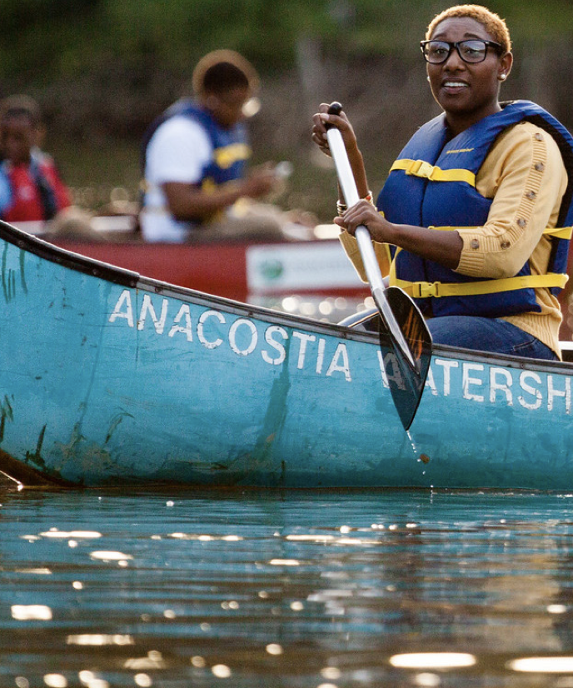
Planning for Your Community
The landscapes around the Chesapeake Bay watershed are economically, ecologically, culturally, and recreationally valuable to the people and communities of the region. Conserving these landscapes protects your community’s values and quality of life by providing access to healthy water and green spaces.
Comprehensive planning efforts that consider local development, community facilities, housing, and roads can also protect local waterways and ecosystems. Investments in preventing land use conversion now can save you costly clean up and restoration efforts in the future. This module provides foundational information, planning resources, and case studies to support your decision-making processes.
Although all levels of government have a role to play in conservation, local governments are on the front lines.
- Chesapeake Bay
Trust, 2017
Preserving Local Character and Landscapes
Purpose
Notes:
Photo by W. Parson/Chesapeake Bay Program

Slide 6
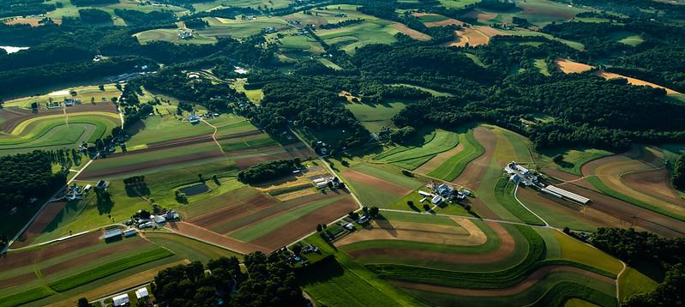
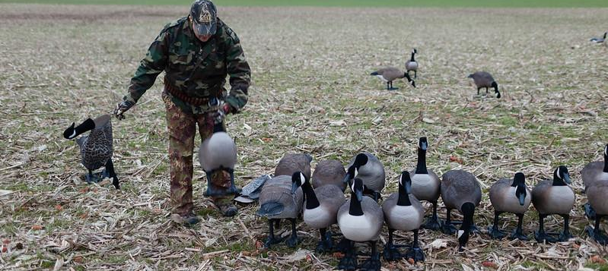
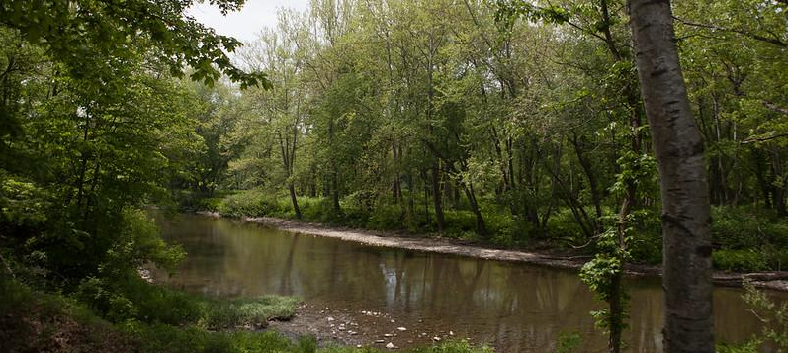
What You’ll Learn
How do land use planning and conservation strategies support my community?
What tools can I use to understand land use changes in my community?
Where can I find more resources to help my community plan for the future?
Preserving Local Character and Landscapes
What You’ll Learn
Notes:
Photos by W. Parson and S. Droter (Chesapeake Bay Program)

Slide 7
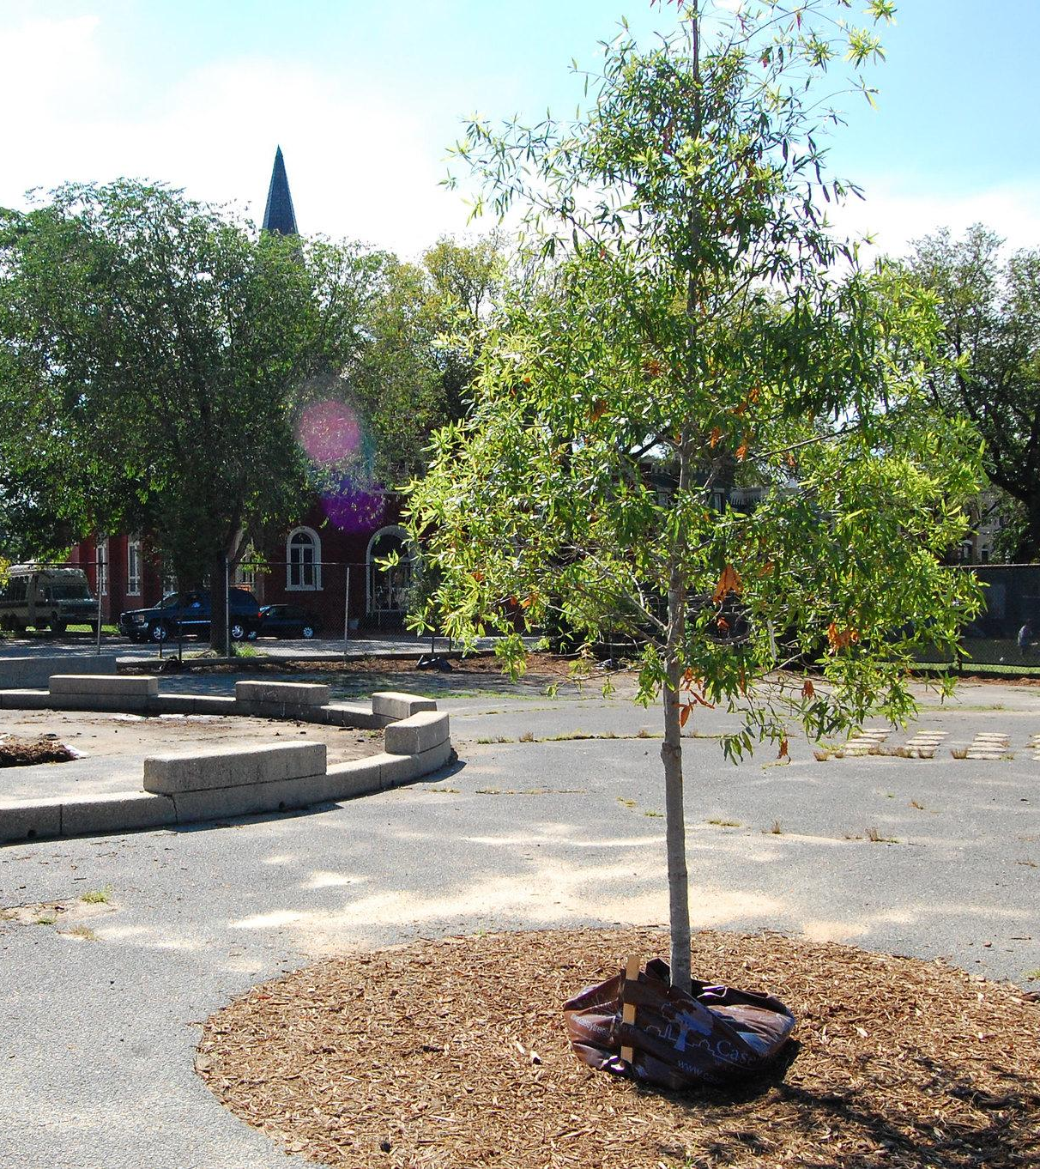
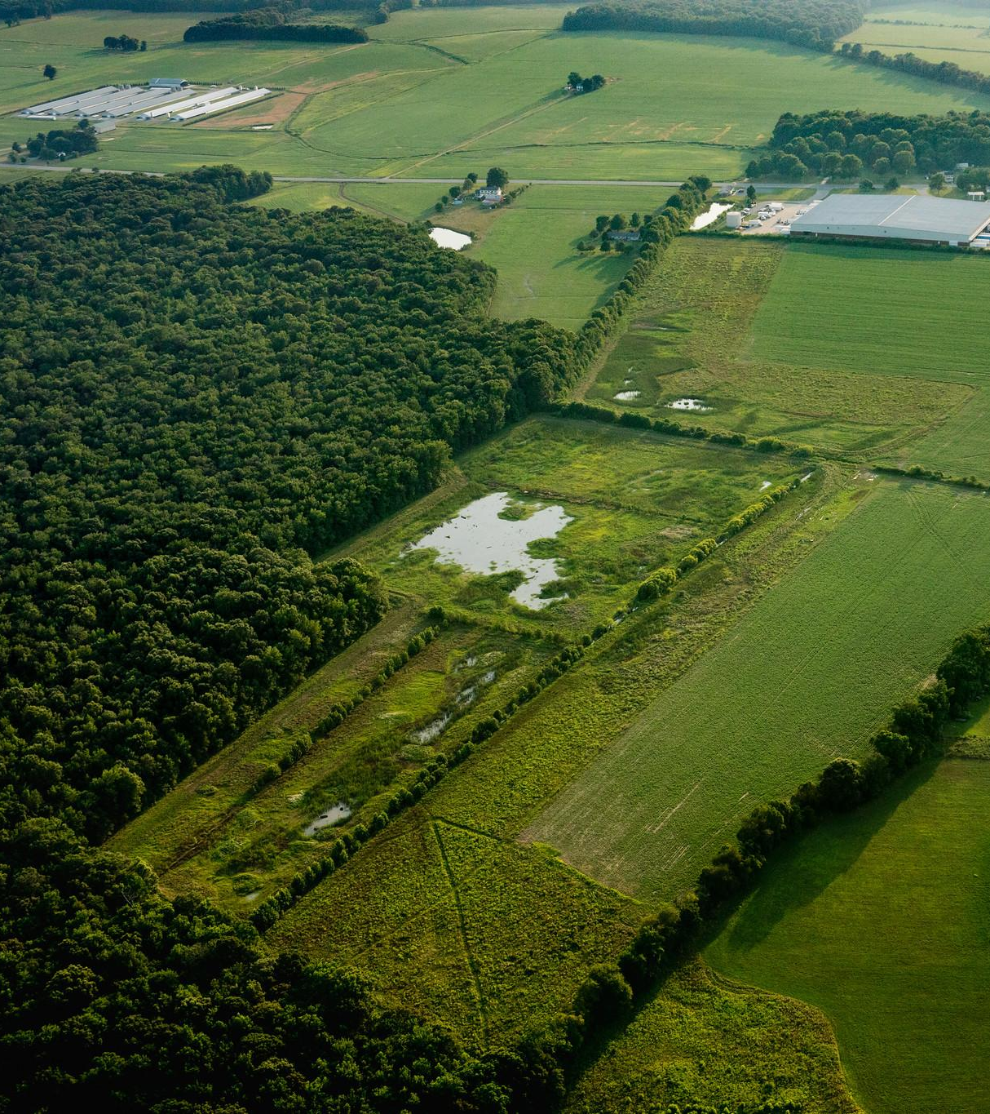
Collective Impacts
You and your community make decisions about local land use that impact the character of your local landscapes, quality of life, and the future of your home. Your decisions may also affect the whole region.
Notes:
Photo by A. Pimental/Chesapeake Bay Program

Slide 8
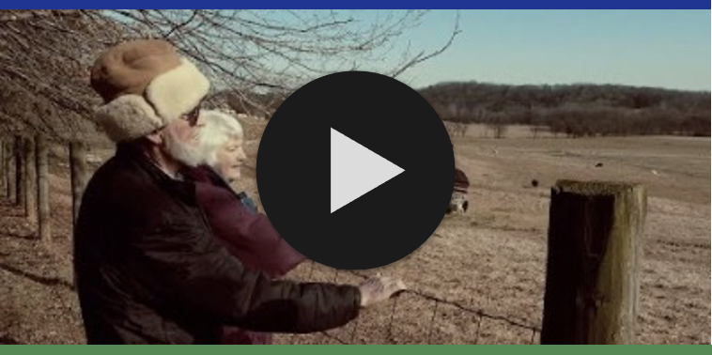
Agriculture
Conserving farmland is an important local, state and federal priority. The Chesapeake watershed’s farms ensure permanent, sustainable, and local sources of food for the region’s population. Although farms can alter hydrology and add nutrients and sediment to local waterways, farmlands also offer a great deal of economic and cultural value. They are an essential source of income, provide jobs, and connect us to the land. Many farms organize agritourism activities for visitors, such as festivals, farm and vineyard tours, corn mazes, and more. In 2015, agritourism stimulated $2.2 billion in economic activity in Virginia alone.
Case study: Misty Meadow Farm, VA
Robert and Linda Clements have owned Misty Meadow Farm since 1974. After caring for the land for decades, they decided they didn’t want to see it get developed. They set up a conservation easement (see slide 20) to protect it for future generations.
Watch the Virginia Outdoors Foundation video on the left to hear their story.
Preserving Local Character and Landscapes
Collective Impacts
Notes:
References:
V. P. Magnini, The Economic and Fiscal Impacts of Agritourism In Virginia https://www.vatc.org/wp-content/uploads/2017/06/TheEconomicAndFiscalImpactsOfAgritourismInVirginia.pdf

Slide 9
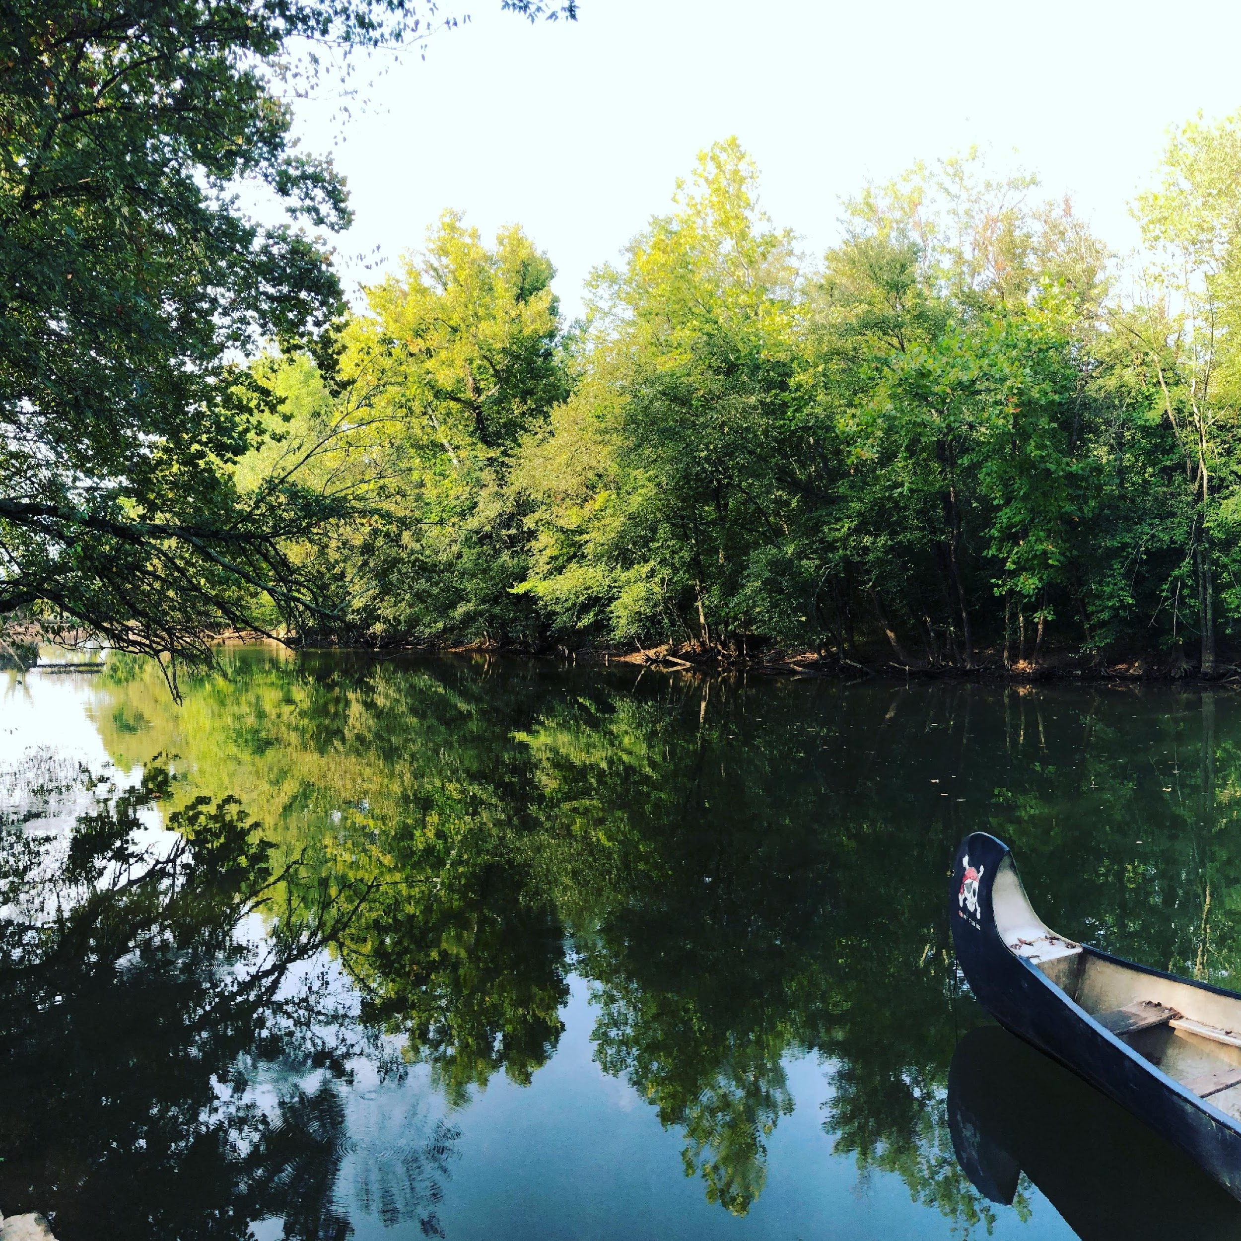
Value of Forests
Trees improve the health of your community by cleaning the air we breathe and the water we drink and swim in. They also decrease deadly heat island effects and lower stress and crime rates.
Homes near natural forests earn $10k higher property premiums. The forests in the Chesapeake Bay watershed provide $24 billion in ecological benefits (like carbon dioxide removal and flood control).
Forests absorb and slow runoff, decreasing the risk of damaging floods. Riparian forest buffers also filter out excess nitrogen for half the cost of filtering through wastewater treatment plants ($3.10 per pound of nitrogen compared to $8.56).
Studies show that more trees near schools correlates with higher student performance and improved wellness. Access to trees and natural landscapes also provides opportunities for hands-on environmental education.
Preserving Local Character and Landscapes
Collective Impacts
For more information, see module 4: The Benefits of Trees
Notes:
References:
Public Health
https://www.chesapeakebay.net/channel_files/26661/tree_canopy_wip_temaplate_11.30.18_kw.pdf
https://www.mdpi.com/2225-1154/8/1/12/htm
The Impact of Green Space on Violent Crime in Urban Environments: An Evidence Synthesis, M. Shepley et al. 2019 https://www.mdpi.com/1660-4601/16/24/5119
Economics
Shoup, L., & Ewing, R. (2010). The economic benefits of open space, recreation facilities and walkable community design. A Research Synthesis. Princeton, NJ, Active Living Research, a National Program of the Robert Wood Johnson Foundation.
Infrastructure
The Economic Benefits of Protecting Healthy Watersheds, EPA, https://www.epa.gov/sites/production/files/2015-10/documents/economic_benefits_factsheet3.pdf
Education
The link between school environments and student academic performance. B. S. Kweon et al. https://www.sciencedirect.com/science/article/abs/pii/S1618866716300140
Photo by L.L. Kern, Unsplash

Slide 10
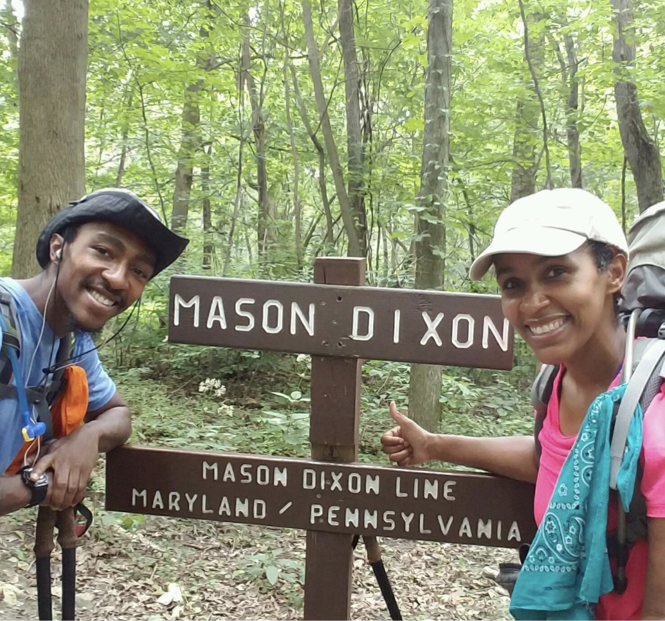
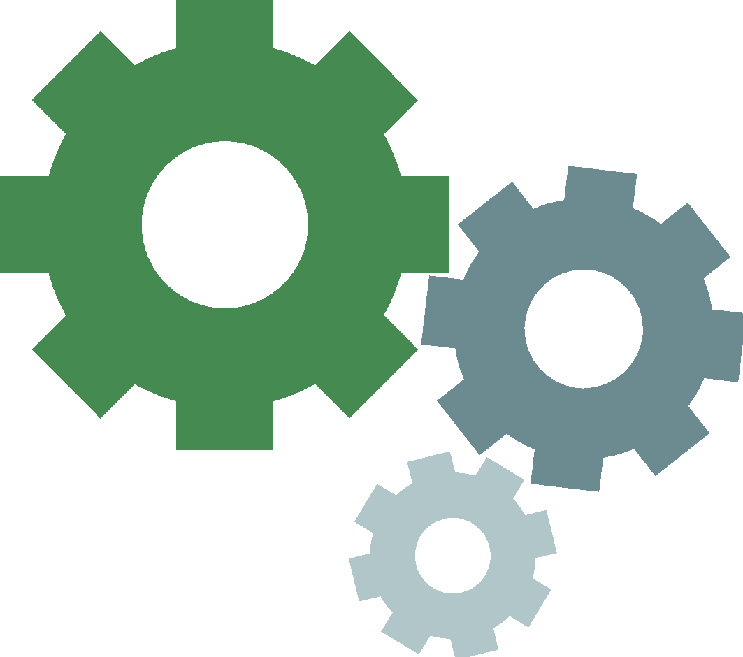

Outdoor Recreation
There is increasingly high demand for access to outdoor recreation. From walking to fishing and birdwatching to kayaking, access to natural open space and waterways can improve public health and quality of life. To learn more about public access (specifically to water) in your community, visit the Chesapeake Bay Program Public Access searchable map.
The numbers below show the 2019 value of the outdoor recreation economy in the watershed states, which relies on conserved natural spaces.
732,645
American jobs
$63.2 BILLION
1234 5678 8765 4321
value added
Preserving Local Character and Landscapes
Collective Impacts
Notes:
References:
ChesapeakeProgress - https://www.chesapeakeprogress.com/map/public-access-sites-in-the-chesapeake-bay-watershed
The Bureau of Economic Analysis https://www.bea.gov/data/special-topics/outdoor-recreation
Photo from the Appalachian Trail Conservancy
Map from https://www.chesapeakeprogress.com/map/public-access-sites-in-the-chesapeake-bay-watershed

Slide 11
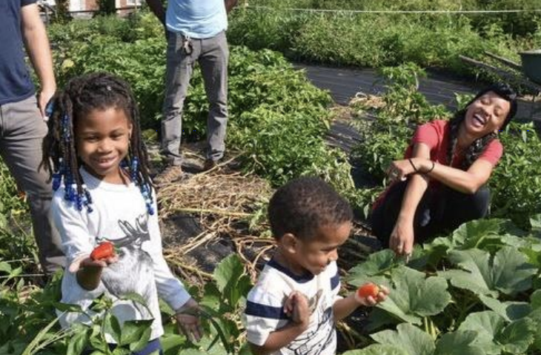
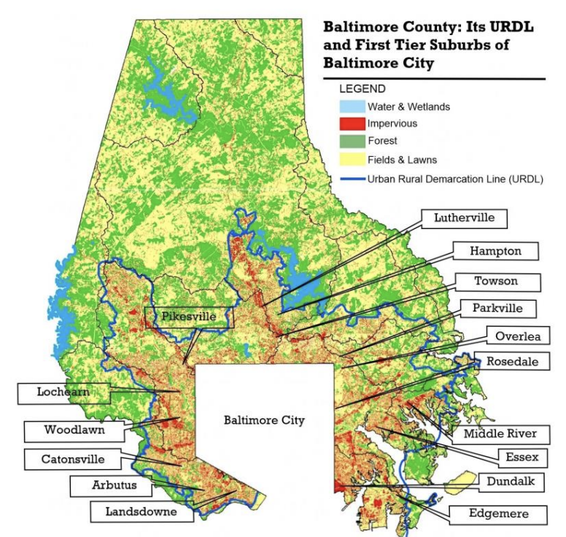
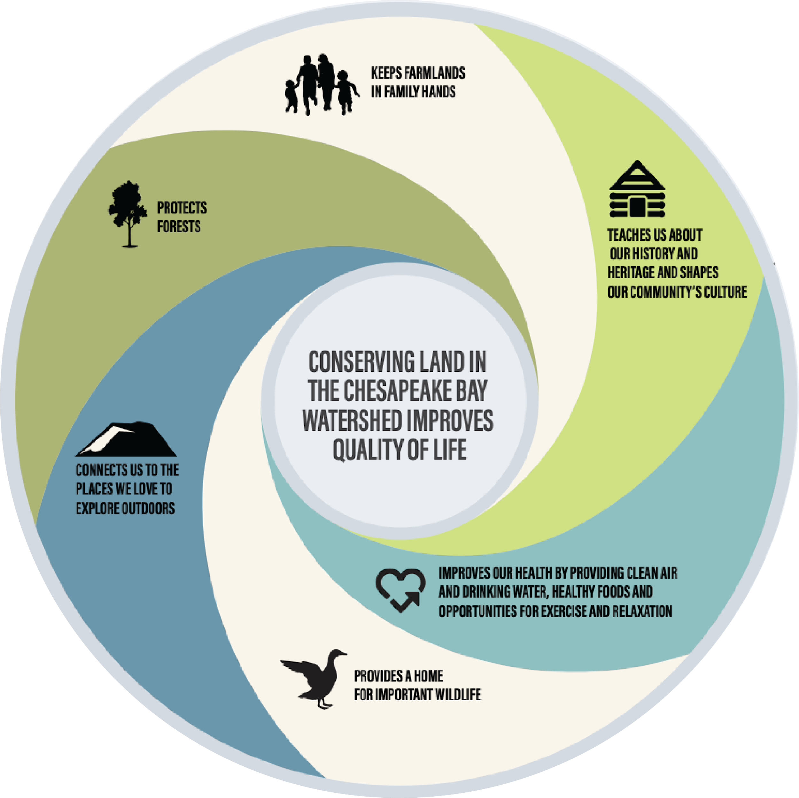
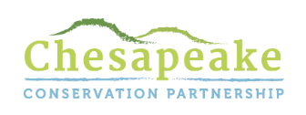
Increasing Open Space
Case study: Baltimore County, MD
Baltimore County’s Urban Rural Demarcation Line (URDL) prohibited public utilities outside its boundaries to protect open spaces from development. However, the planning did not account for access to parks and open space, and as a result, over half of the residents within the URDL lack access to open space, affecting their quality of life.
NeighborSpace works with communities within the URDL to protect & improve open space. Their work reduces runoff, buffers streams, and increases recreational opportunities and property values. They have conserved 21 sites totaling 99 acres including historical heritage trails, gardens, forest trails, and pocket parks. They are funded by donations, grants, and incentives, like open-space waiver fee funds.
Preserving Local Character and Landscapes
Collective Impacts
Notes:
Images from NeighborSpace: https://drive.google.com/file/d/1SXw8C4LsiUNd5zH2YGHV5Jmr37Qh1vx7/view and the Chesapeake Conservation Partnership: https://www.chesapeakeconservation.org/wp-content/uploads/2019/07/Narrative-Toolkit-Tools-for-Communicating-Conservation-Messages.pdf

Slide 12
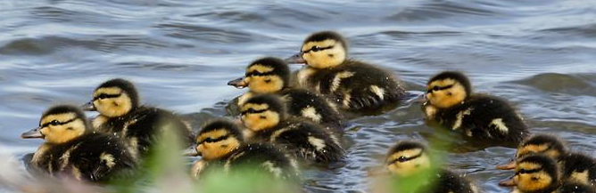
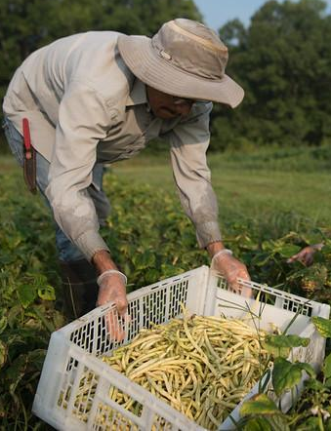
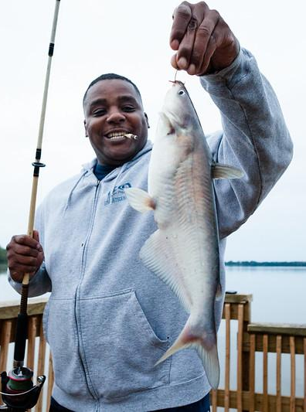
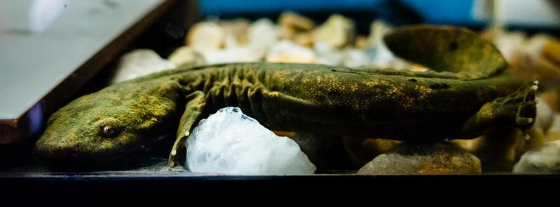
Targeted Actions
You can increase the effectiveness of your conservation investments through collaboration and place-based action.
Land conservation should be targeted and intentional, protecting lands that are facing multiple threats to make the biggest positive impact. Consider the value of land conservation options through several lenses, like:
Recreational and
historical value
Improving local
climate resilience
Water quality
Habitat connectivity
Farmland and
forest productivity
Safeguarding biodiversity
The needs of underrepresented and underserved communities
Preserving Local Character and Landscapes
Collective Impacts
Notes:
Photos by W. Parson, K. Rutowski, and S. Droter (Chesapeake Bay Program)

Slide 13
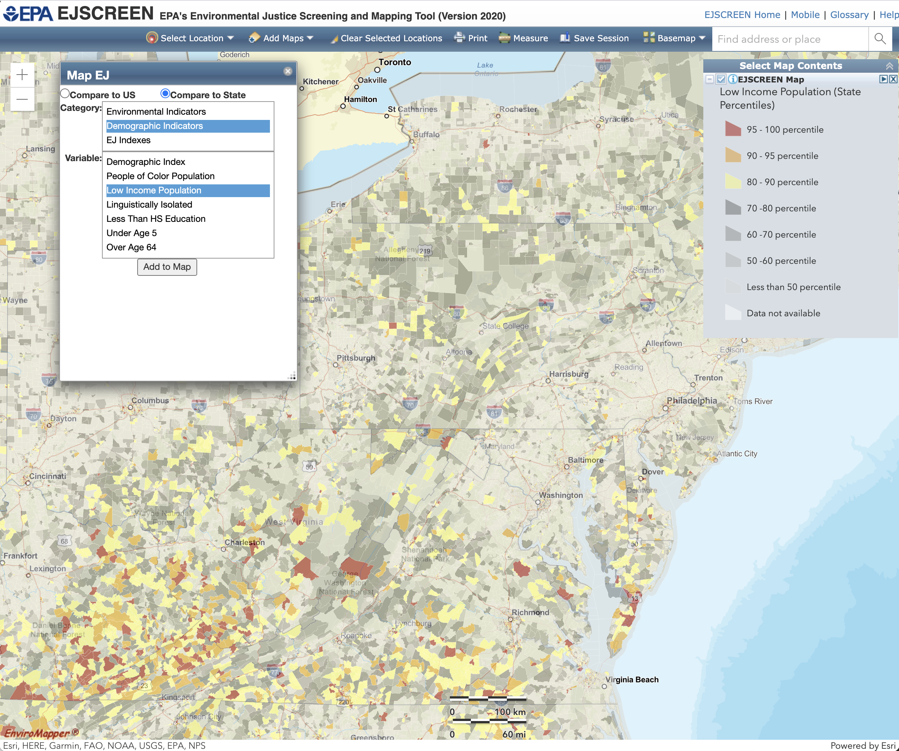
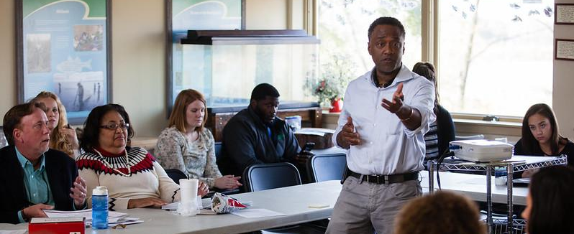
EPA’s EJSCREEN
EJSCREEN is an environmental justice mapping and screening tool that combines environmental and demographic indicators. The tool allows you to view a map of your jurisdiction and see what areas might be vulnerable, including communities of color, low-income populations, and places with potential environmental quality issues.
Using EJSCREEN could help you understand and highlight locations that may be candidates for further review when making land use decisions in your community. A customized tool for the Chesapeake region is in development by the Chesapeake Bay Program.
Preserving Local Character and Landscapes
Collective Impacts
Notes:
Photo by W. Parson/Chesapeake Bay Program

Slide 14
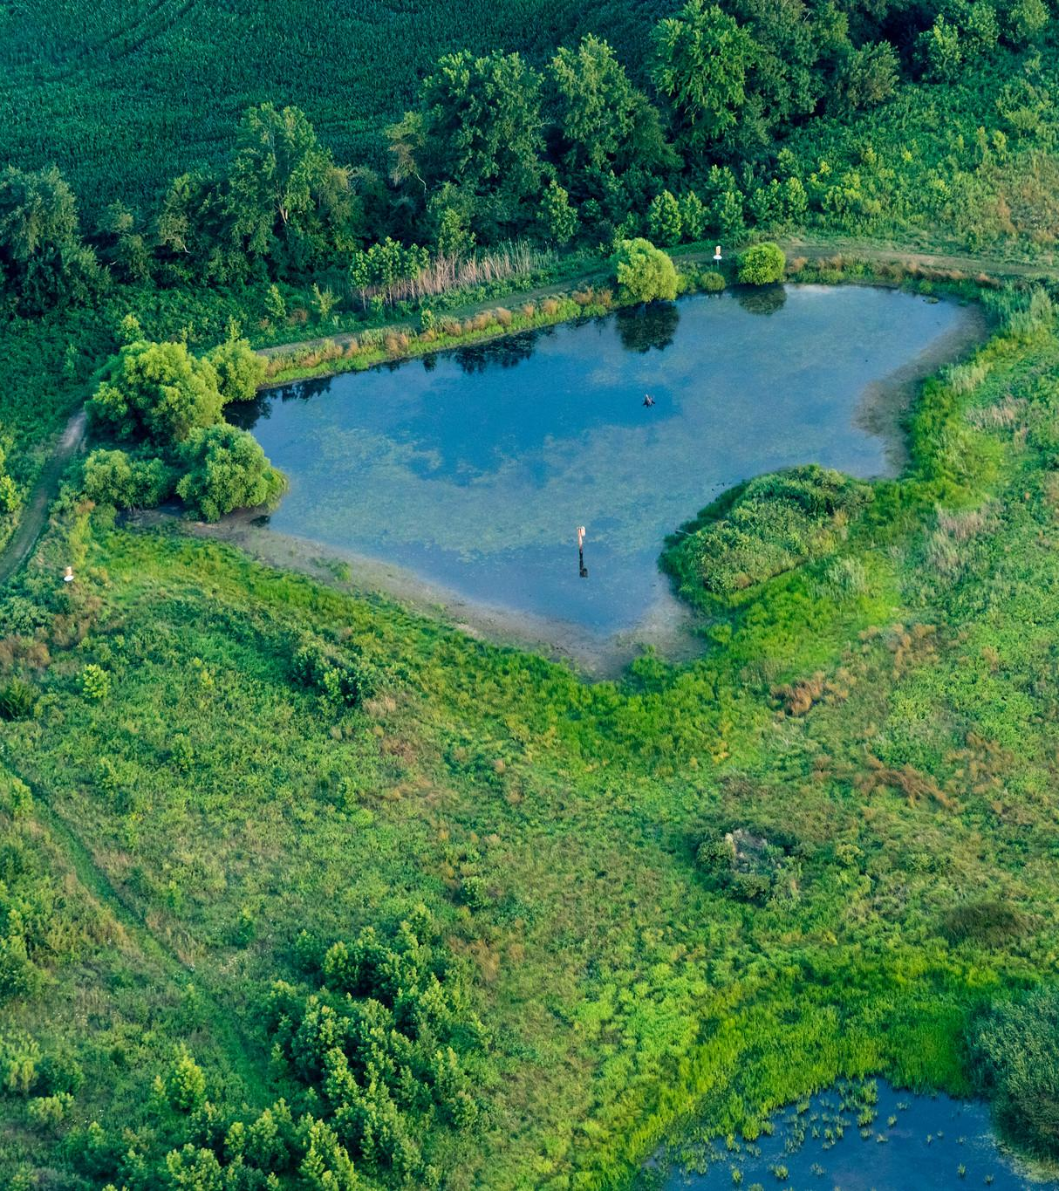
Natural Resilience
Wetlands, forests, and other natural landscapes provide cost-effective flood protection for your community.
Notes:
Photo by W. Parson/Chesapeake Bay Program

Slide 15
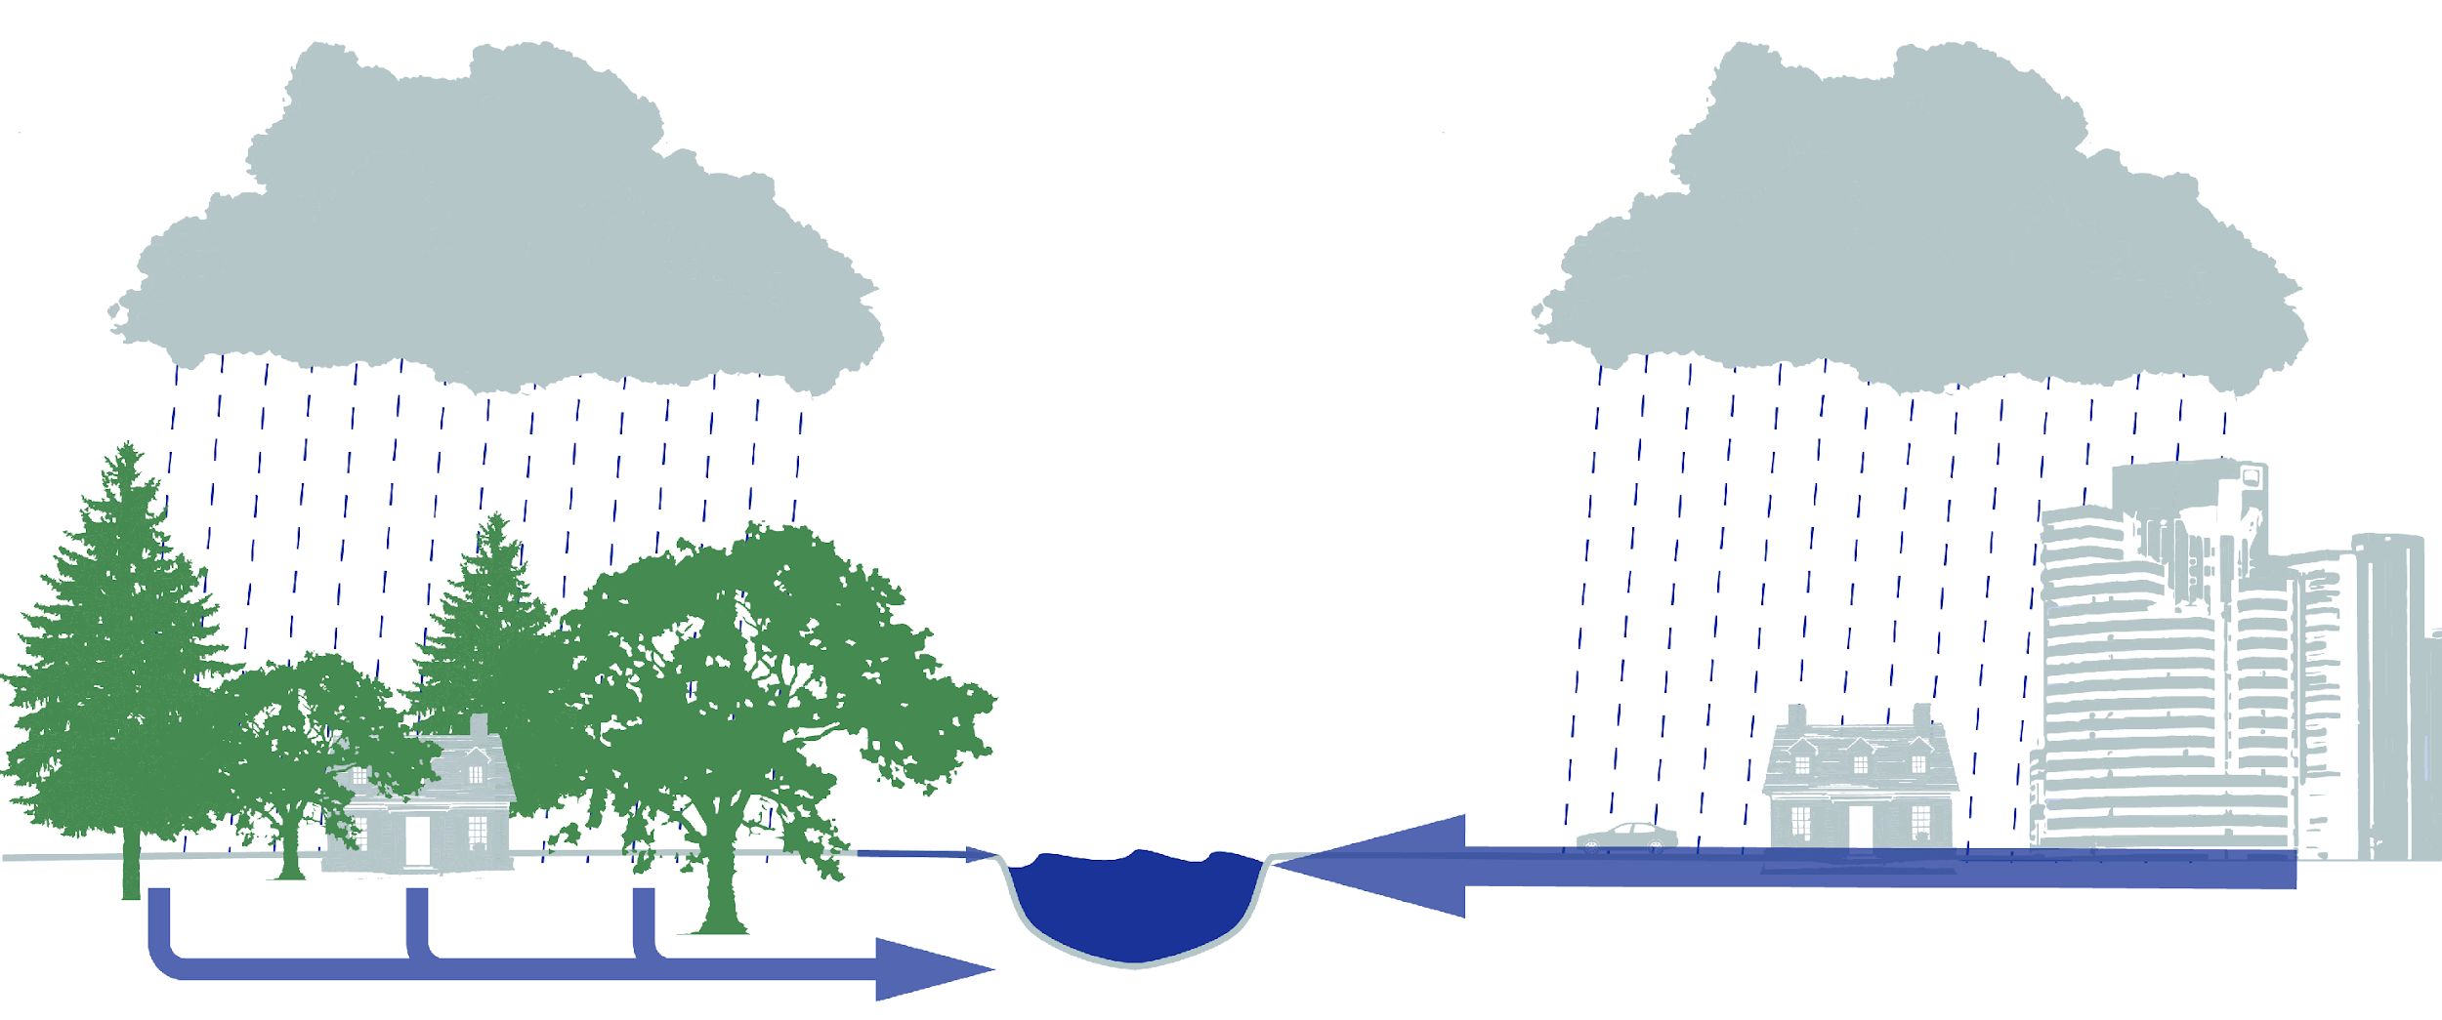
Land Use and Stormwater
Forests, wetlands, and other natural landscapes are very good at soaking up rain. However, impervious surfaces (like roads, roofs, and parking lots) prevent water from soaking in. This water can carry pollutants into local waterways and flood your community, negatively impacting infrastructure (like roads), your community’s health, the local economy, and schools. Learn more about stormwater in Module 6.
Climate Connection
Warmer air holds more moisture which means more intense and frequent precipitation events as the climate warms. Increased rainfall has the potential to overwhelm waterways and stormwater systems, increasing flood and erosion risks across towns and cities. Rising sea levels and storm surge also increase flood and erosion risks.
RUNOFF
More rain is absorbed by trees, wetlands, and natural landscapes
Preserving Local Character and Landscapes
Natural Resilience

Slide 16
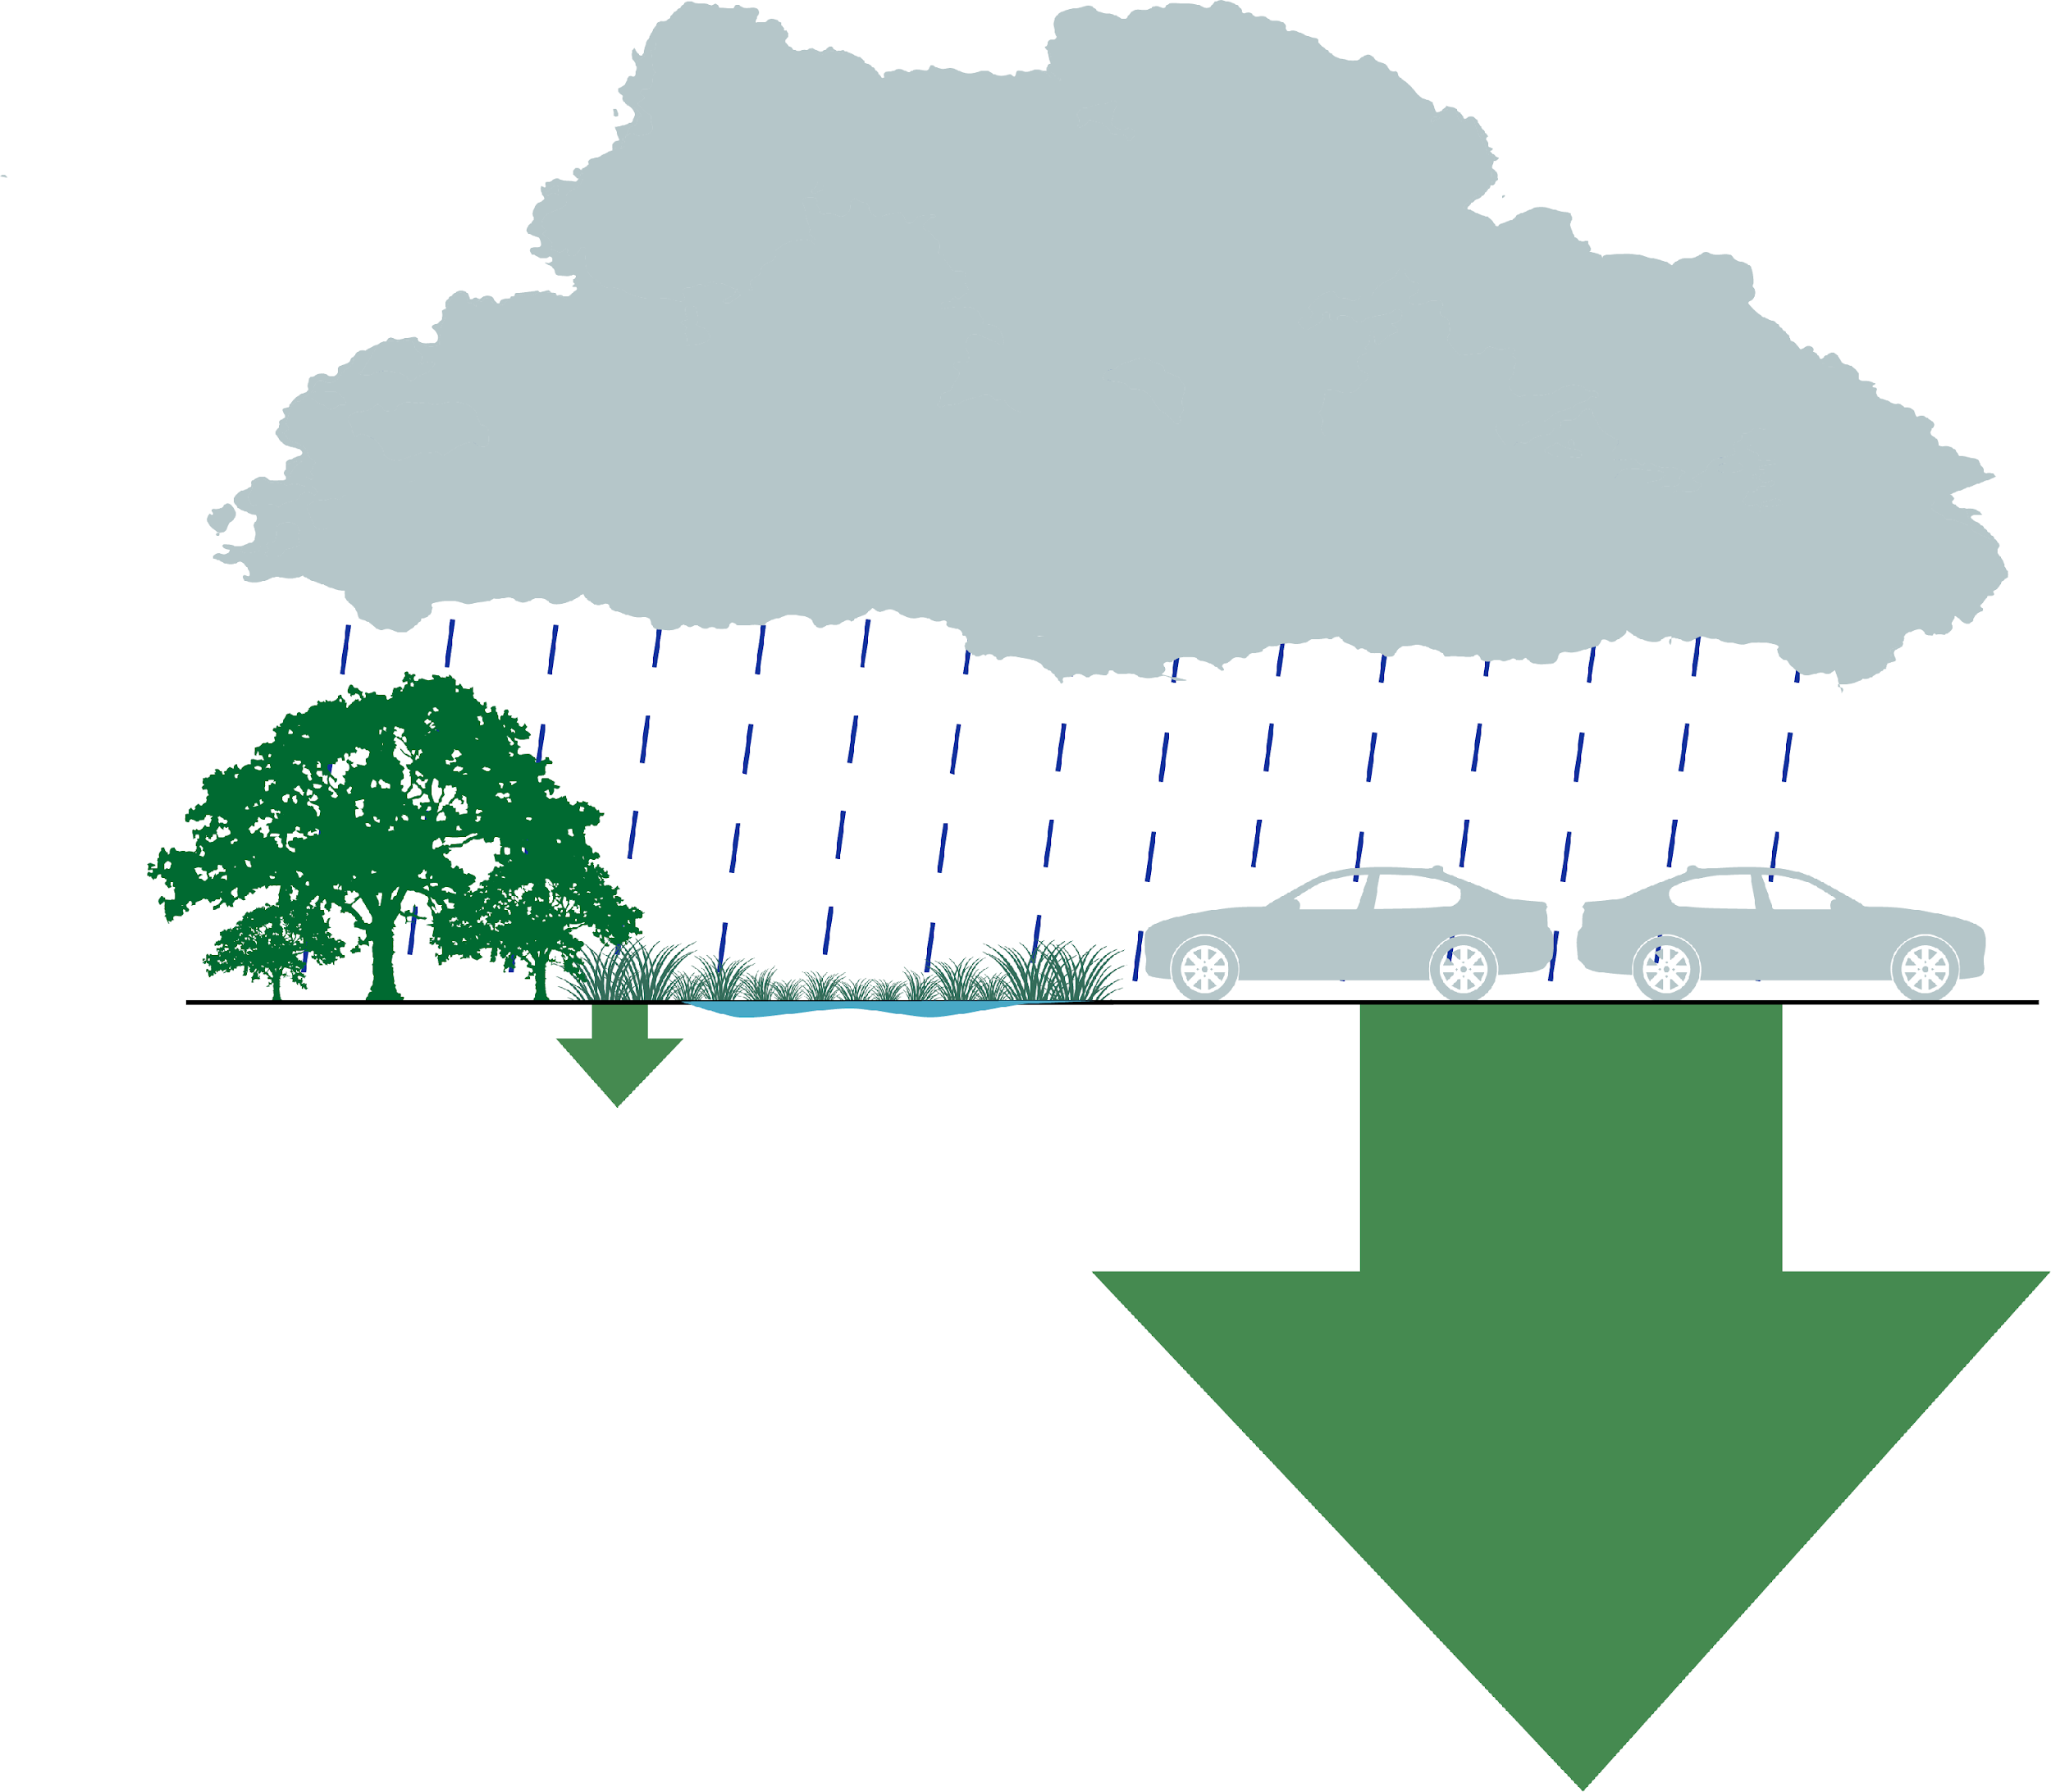
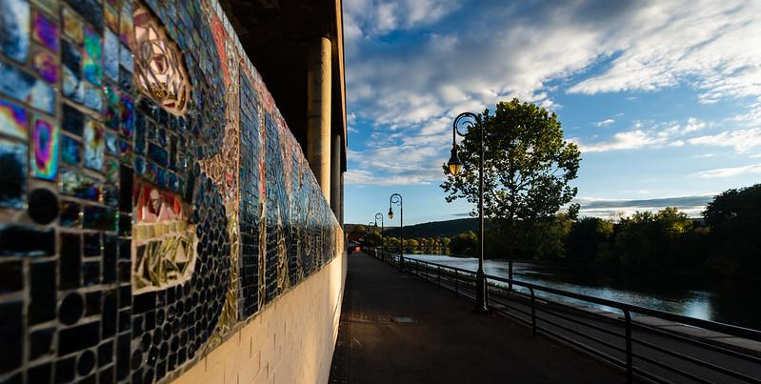
Wetlands
Compare and Contrast
Wetlands are nature’s flood insurance. Wetlands capture, hold and slowly release runoff, creating buffer zones that could prevent damage to the surrounding infrastructure. Wetlands do all of this while also supporting diverse wildlife and providing many other ecosystem services.
When one inch of rain falls, a wetland only releases 750 gallons of runoff.
A parking lot of the same size releases 36x as much, over 27,000 gallons!
750
gallons
27,000
gallons
27,000
gallons
Case study: Binghamton, NY
After record-breaking floods in 2005 and 2011 that caused $675 million in property damages, Binghamton set its sights on building back stronger and more resilient.
One of over 170 flood-mitigation projects (funded from federal agencies like FEMA, community development block grants, municipalities, and school districts) was creating a wetland at a highway interchange to catch and absorb floodwater.
Preserving Local Character and Landscapes
Natural Resilience
Notes:
References:
https://extension.psu.edu/the-role-of-trees-and-forests-in-healthy-watersheds
Floods drive Binghamton toward sea change of resiliency by Ad Crable, Bay Journal December 2020 https://www.bayjournal.com/eedition/page-16/page_4b7f4d42-7047-509f-a7bc-fae17293d235.html
Photo by W. Parson/Chesapeake Bay Program

Slide 17
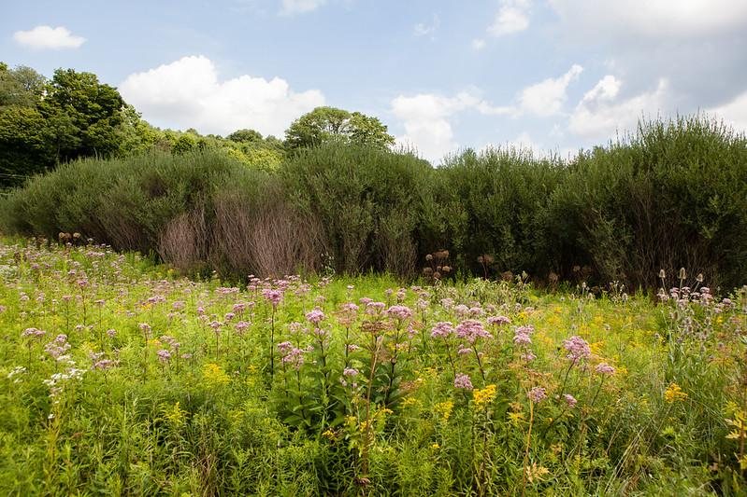
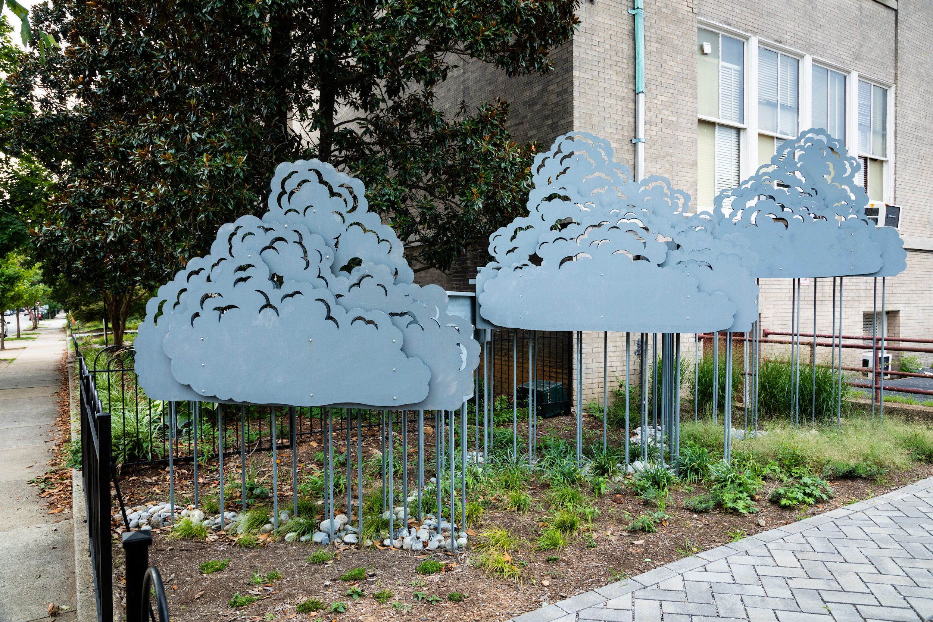
Green Infrastructure
Green infrastructure uses systems that incorporate natural processes and technology inspired by nature.
It is often less costly, less disruptive to the environment, and better for your community’s wellbeing than gray infrastructure. Projects can be large or small and installed in a variety of locations, from farms to schools.
Case study: York County, PA
Don and Ann English planted 4 acres of riparian forest buffer on their farm, Happy Hollow Farm. They included trees to filter and absorb stormwater, but also plants that produce nuts, berries, honey and syrup that they hope will be a future stream of revenue. The PA Department of Conservation and Natural Resources has a grant program for multifunctional buffers like the English’s. As of 2020, the program helped fund about 350 acres of new buffers — both multifunctional and conventional — in the state’s portion of the watershed.
Case study: Richmond, VA
“Taking a School by Storm” is a schoolyard retrofit project at Binford Middle School. It reduces stormwater runoff using several methods, including a rain garden with a collaboratively-designed rain harvesting sculpture. This schoolyard project provides hands-on learning for the students who helped plan and execute it. The project was funded with $200,000 awarded by the by National Fish and Wildlife Foundation through the EPA’s Small Watershed Grants Program.
Preserving Local Character and Landscapes
Natural Resilience
Notes:
Photos from the Chesapeake Bay Program

Slide 18
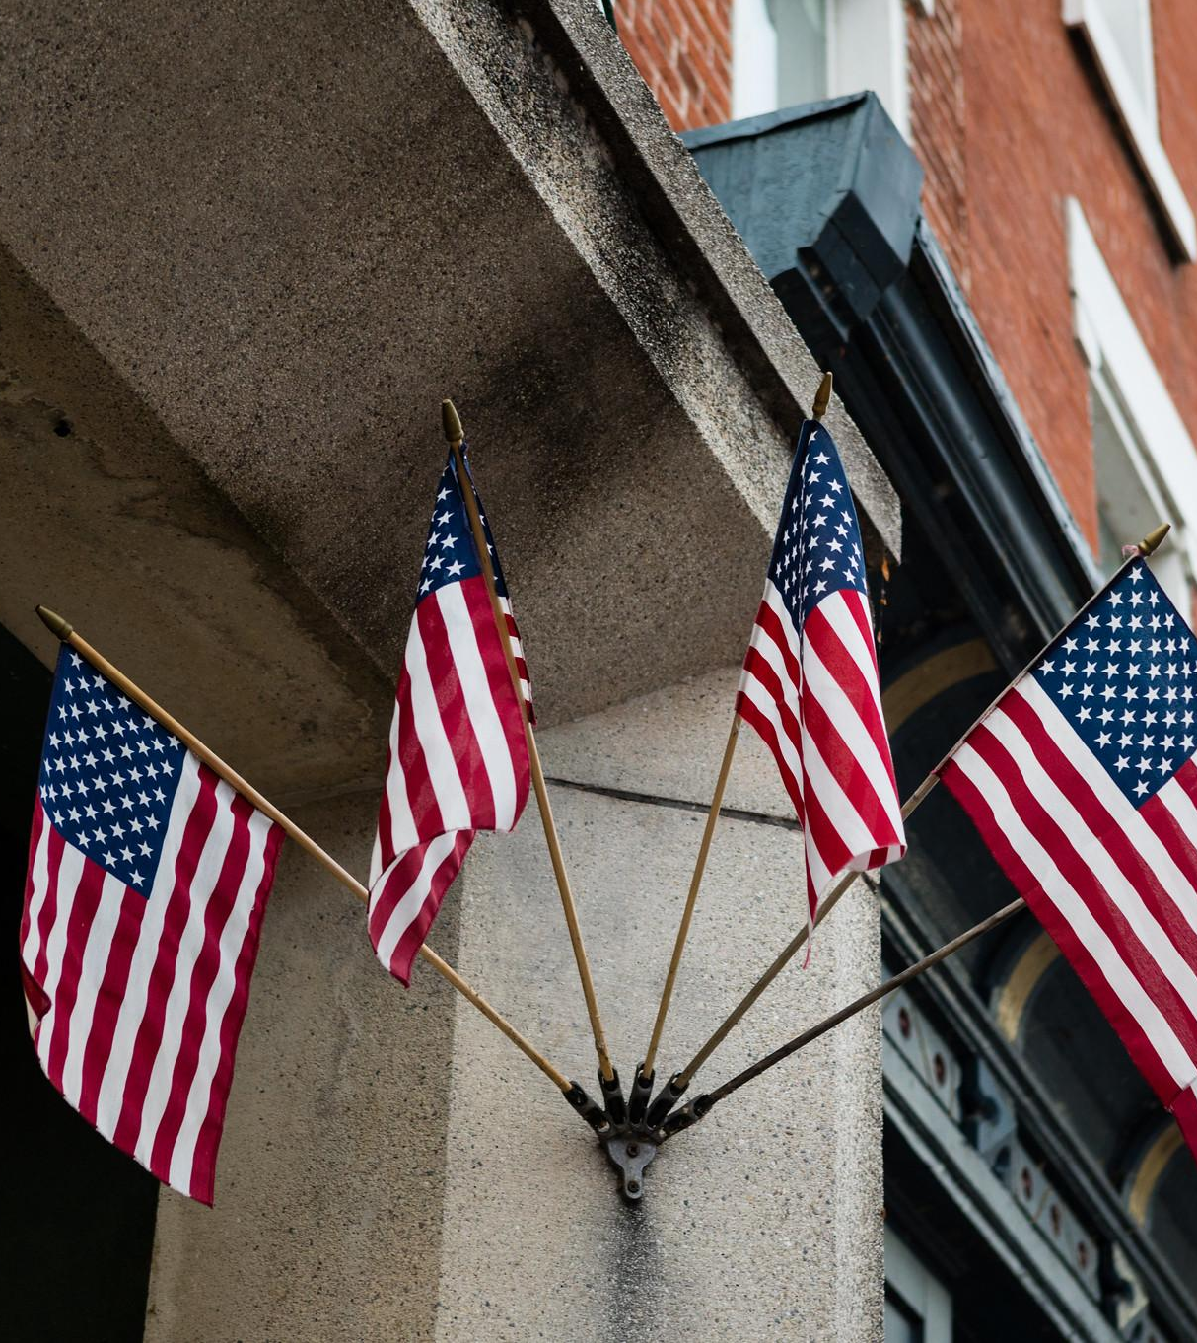
Local Government Toolbox
Your toolbox includes regulatory and voluntary tools. Let’s explore which tools can help you preserve your community’s character and natural landscapes.
Notes:
Photo by W. Parson/Chesapeake Bay Program

Slide 19

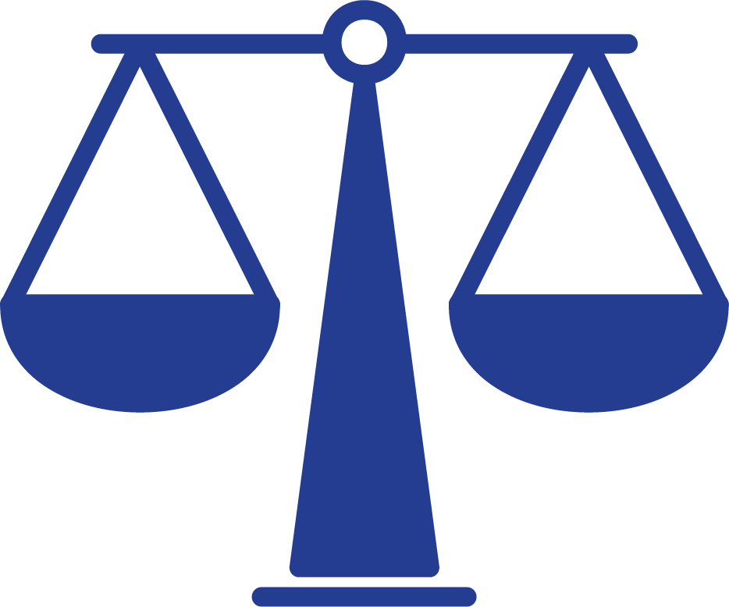



The Tools
Regulatory:
Comprehensive Planning
Zoning Ordinances
Subdivision Ordinances
Impact Fees
Urban Service Boundaries
Voluntary:
Conservation Easements and Purchase of Development Rights
Transfer of Development Rights
When deciding which combination of tools to use, consider:
legal context
existing regulations
balance regulation
and incentive
political landscape
capacity
Preserving Local Character and Landscapes
Local Government Toolbox

Slide 20
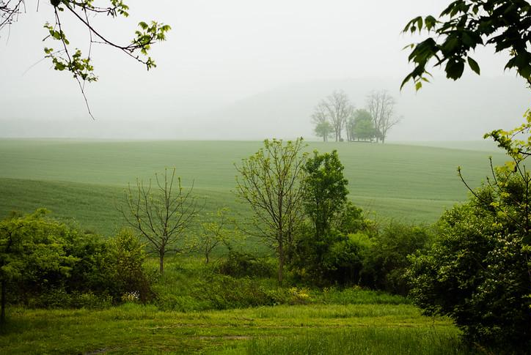
Comprehensive Planning
The comprehensive plan, also known as a general or master plan, includes long-range goals and objectives to guide all activities that affect the local government. Jurisdictions can include farms, forests, and wetlands as preferred land uses in their plan, guiding development towards urban and suburban areas that can accommodate it while preserving open space.
Future growth in Calvert County, MD
An analysis of growth and resources needed to support that growth (infrastructure, services, natural resources) determined that the County would not have sufficient resources. To align population forecasts and capacity, the County developed a comprehensive plan with tighter growth restrictions.
Incentives in Chester County, PA
In PA, counties do not have the legal authority to adopt and enforce comprehensive plans that stipulate municipal land use. So, the County adopted a non-binding comprehensive plan and a grant program for municipalities to revise and align their documents with the county.
Preserving Local Character and Landscapes
Local Government Toolbox
To learn more, explore the toolkit
Notes:
Photo by W. Parson/Chesapeake Bay Program

Slide 21
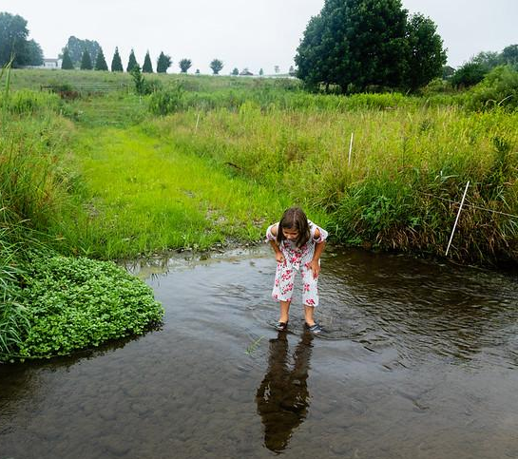
Zoning Ordinance
A zoning ordinance is a regulatory tool that establishes zoning districts, permitted uses, and restrictions with defined penalties for violations. Jurisdictions can restrict development on farms, forests, and wetlands through use zoning and density zoning. Under use zoning, a jurisdiction assigns land to a protected zone that restricts certain uses (e.g., commercial development). With density zoning, a jurisdiction assigns land to zones with restrictions on the number of units per acre (e.g., one housing unit per 25 acres).
Water quality in Seaford, DE
Seaford is a historical riverside community. The pristine Nanticoke River is highly valued by the Seaford community because of its rich history and recreational opportunities. The City uses a zoning ordinance to control development and protect water quality. The ordinance also overlays stormwater treatment requirements on some zones.
Agriculture in Lancaster County, PA
Caernarvon Township used a zoning ordinance to create an Agricultural District that spans 9,000 acres, including the Agricultural Security Area. The ordinance regulated the development and use of that land to eliminate uses not compatible with agriculture and require that any future inhabitants in this zone accept the impacts associated with agricultural businesses.
Preserving Local Character and Landscapes
Local Government Toolbox
To learn more, explore the toolkit
Notes:
Photo by W. Parson/Chesapeake Bay Program

Slide 22
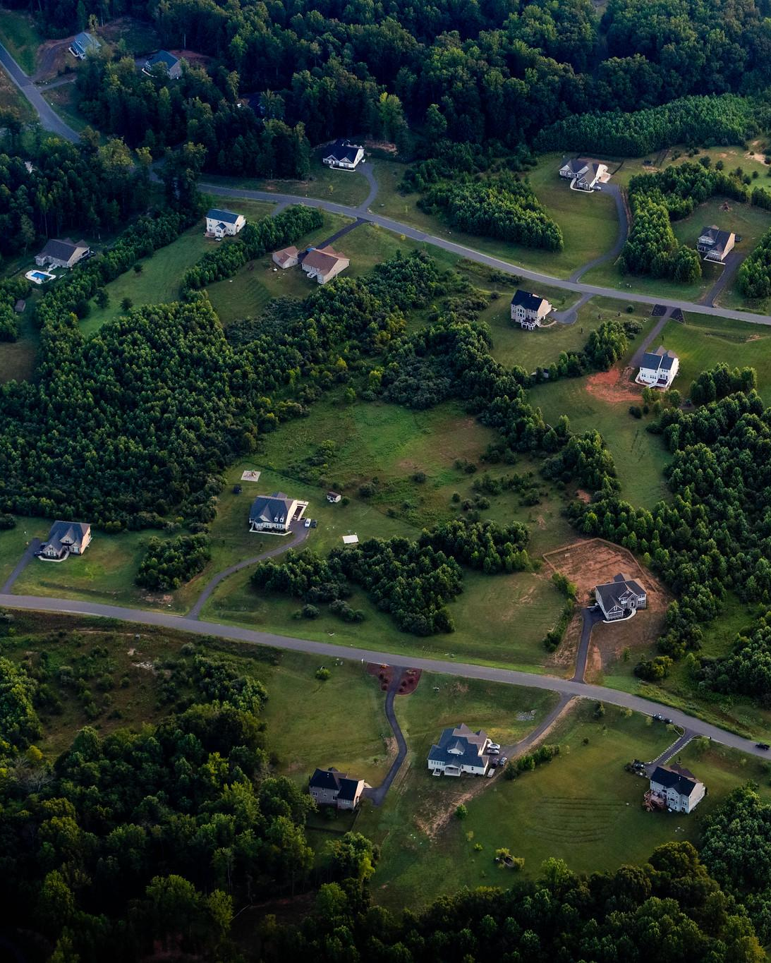
Subdivision Ordinance
A subdivision ordinance regulates if, how, and when a landowner can divide, consolidate, develop, or change boundaries based on the land’s characteristics. If a landowner wants to divide a large parcel of land into multiple lots, building sites, or other changes, an ordinance can coordinate site design that improves the community rather than degrades it.
Adaptation in Hardy County, WV
The County adopted a zoning ordinance followed by a comprehensive plan. Over the years, they updated their land use policies in response to community concerns. In 2009, they added a subdivision ordinance to address over-development that they were seeing in their community. There was not enough demand to fill subdivisions that were being developed and the ordinance curbed the division and development, preventing land loss to vacant lots.
Preserving Local Character and Landscapes
Local Government Toolbox
To learn more, explore the toolkit
Notes:
Photo by W. Parson/Chesapeake Bay Program

Slide 23
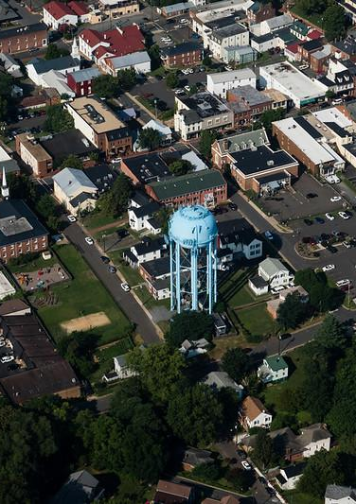
Impact Fees and Taxes
Impact fees have developers pay for new or expanded public facilities that serve their developments. The types of public facilities funded range from transportation to libraries, depending on the state and jurisdiction. Local governments are responsible for determining the fair fee amount. Impact fees allow developers to share the cost of expensive infrastructure systems, which incentivizes cluster and infill development. Jurisdictions can also use the impact fees to support new parks, recreation facilities and open space.
Infill and transit in Montgomery County, MD
The County collects an impact tax for new buildings that differs for different locations, with the lowest fee for areas where the County want to encourage development, such as around existing Metro Stations. Other desirable building projects, like affordable housing projects and bioscience facilities, are exempt from the tax altogether.
Preserving Local Character and Landscapes
Local Government Toolbox
To learn more, explore the toolkit
Notes:
References:
http://www.impactfees.com/publications%20pdf/Maryland_ImpactFees03.pdf
Photo by W. Parson/Chesapeake Bay Program

Slide 24
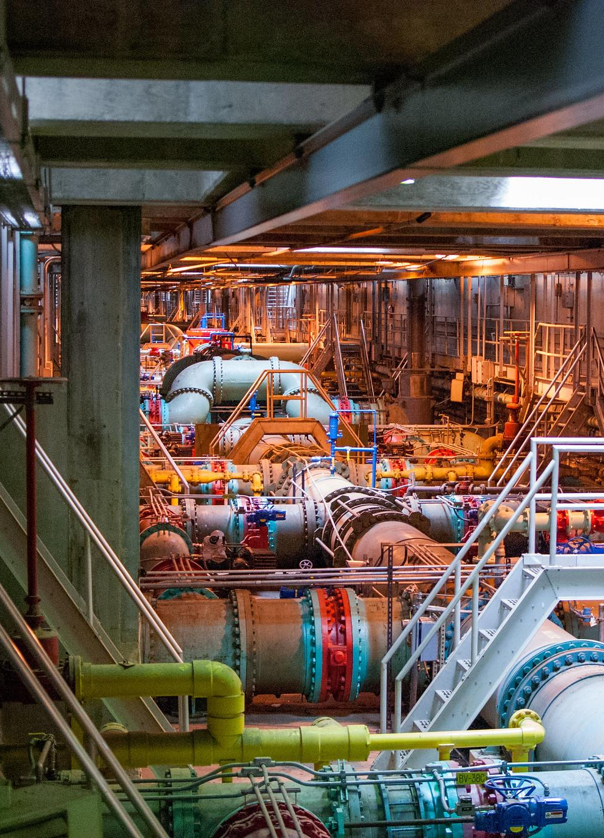
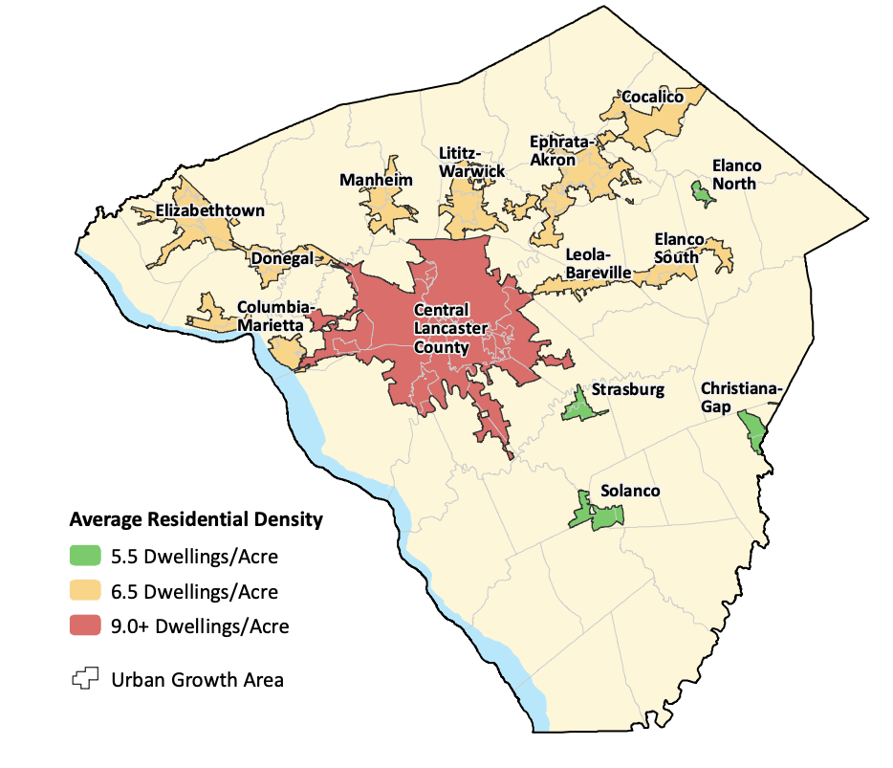
Urban Service Boundaries
To learn more, explore the toolkit
An urban service boundary defines urban and rural areas and limits the extension of public services. Development outside the boundary must rely on private systems, which is a disincentive. An urban-rural demarcation line (URDL) or an urban growth area (UGA) similarly demarcates urban and rural areas with an emphasis on where the jurisdiction wants and does not want new development.
Growth in Lancaster County, PA
The County aims to build 85% of new dwellings in designated UGAs to protect agricultural and forested land outside of those areas. To attain this goal, redevelopment and infill are prioritized and water/sewer services are extended outside of the UGAs only if the health of the community is threatened.
Preserving Local Character and Landscapes
Local Government Toolbox
Notes:
References:
https://conservationtools-production.s3.amazonaws.com/library_item_files/1690/1897/20181025_places2040_full-plan-final_small.pdf?AWSAccessKeyId=AKIAIQFJLILYGVDR4AMQ&Expires=1615406307&Signature=nOB1gr5G8K1SIY4HF6rgC5A63zY%3D
Photo by A. Pimental/Chesapeake Bay Program

Slide 25
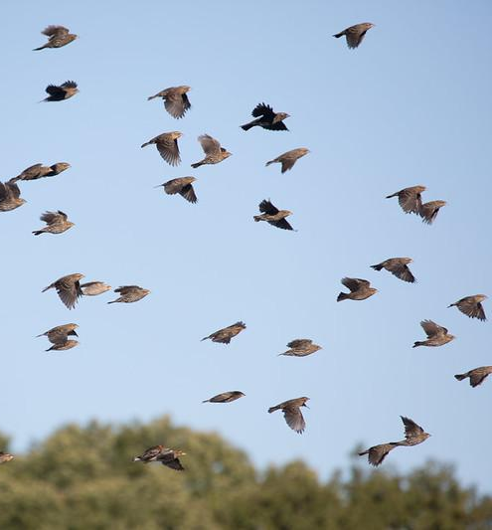
Conservation Easements
A conservation easement is a voluntary agreement between a landowner and another party to protect specific resources on the property. Some easements are donated with the landowner receiving a tax benefit in lieu of payment. An easement can also be created by the landowner selling the development rights to a public agency through a purchase of development rights (PDR) program. An appraiser determines the value of the development rights by calculating the difference between the market values of the property without and with an easement.
Some sources of funding for easements:
Delaware
Agricultural Conservation Easements
Agricultural Lands Preservation Districts
Forest Legacy Program
Forestland Preservation Program
Maryland
Program Open Space
Rural Legacy Program
Maryland Agricultural Land Preservation Foundation
Maryland Environmental Trust
New York
New York Environmental Protection Fund
Agricultural Assessment Program
Pennsylvania
Community Conservation Partnership Program
Rivers Conservation Grant Program
Department of Agriculture
Virginia
Virginia Land Conservation Foundation
Department of Agriculture and Consumer Services
Virginia Outdoors Foundation
West Virginia
Voluntary Farmland Protection Act
General Obligation Bonds
Preserving Local Character and Landscapes
Local Government Toolbox
To learn more, explore the toolkit
Notes:
Photo by W. Parson/Chesapeake Bay Program

Slide 26
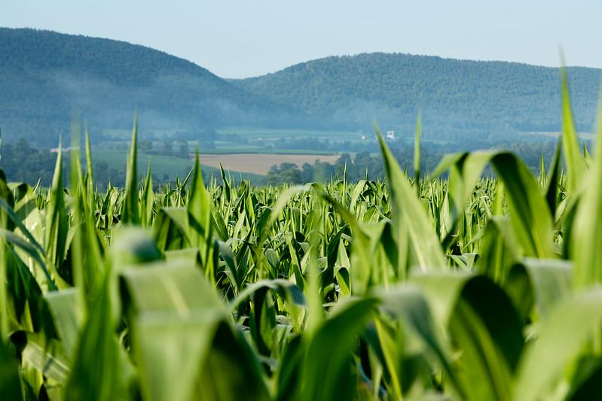
Transfer of Development Rights
A transfer of development rights (TDR) program allows a landowner to sell their land’s development rights to a buyer for use on other land, while retaining ownership and existing agricultural or forestry uses. TDR programs specify who can sell rights, usually in areas targeted for preservation, and where buyers can apply those rights (in areas targeted for development). It also specifies how the development rights can be used, like allowing the buyer to develop at greater densities or increased height than would otherwise be allowed. For the program to be effective, downzoning in the receiving area is typical to incentivize the use of the development rights by the buyer.
Protecting family farms in Stafford County, VA
The County found their TDR program to be a politically popular option, as it manages growth without harming the rights or equity of landowners. Many landowners in their community could not profitably maintain family farms and were facing pressure to sell their properties to developers, which has been mitigated by the TDR program.
Preserving Local Character and Landscapes
Local Government Toolbox
To learn more, explore the toolkit
Notes:
Photo by W. Parson/Chesapeake Bay Program

Slide 27



What You Can Do
Explore the data on land use and the rate at which it is changing for your community by using the tools in the next slide. Use the data to identify vulnerable areas and prioritize your conservation efforts.
Share this toolkit with your planning commission or department and discuss the tools that your community can use to plan for the future.
Support conservation actions, such as incorporating appropriate regulatory and voluntary tools, during your community’s next comprehensive planning activity.

Slide 28
To Learn More
Conservation Land Use Policy Toolkit
  Learn about tools local governments can use to slow the conversion of farmland, forestland, and wetlands
American Farmland Trust’s Farms Under Threat: The State of the States
  Read how to plan for and protect agricultural lands
Chesapeake Bay Program’s Accounting for Growth fact sheet
  Learn about projected population growth and what that means for your jurisdiction
USGS’s Chesapeake Bay Phase 6 Land Use Viewer
  Explore high-resolution land cover data
EPA’s EnviroAtlas
  Interact with geospatial data, tools, and resources related to ecosystem services, their stressors, and human health to help inform policy and planning decisions
Chesapeake Bay Program’s Chesapeake Bay Watershed Data Dashboard
  Along the top of the window, select the “Land Policy & Conservation” tab to explore additional resources

Slide 29
Glossary
Agritourism
  Farms that contain a recreational or educational enterprise component, such as tours of a working farm and pick-your-own fruits
Urban Heat Island
  Urbanized areas that experience higher temperatures than outlying areas
Stormwater Runoff
  Precipitation that does not evaporate or soak into the ground but instead flows over the land and into the nearest waterway
Environmental Justice
  The fair treatment and meaningful involvement of all people regardless of race, color, national origin, or income, with respect to the development, implementation, and enforcement of environmental laws, regulations, and policies
Impervious Surfaces
  Paved or hardened surfaces that do not allow water to pass through (e.g., roads, rooftops, sidewalks, pools, patios, and parking lots)
Living Shoreline
  A protected, stabilized coastal edge made of natural materials, such as plants, sand, or rock
Green Infrastructure
  Nature-based solutions that use soil and vegetation to help slow the flow of runoff and manage rainwater where it falls
Riparian Forest Buffer
  An area of trees, shrubs, and other perennial plants adjacent to a river, stream or other waterway.

