Slide 1
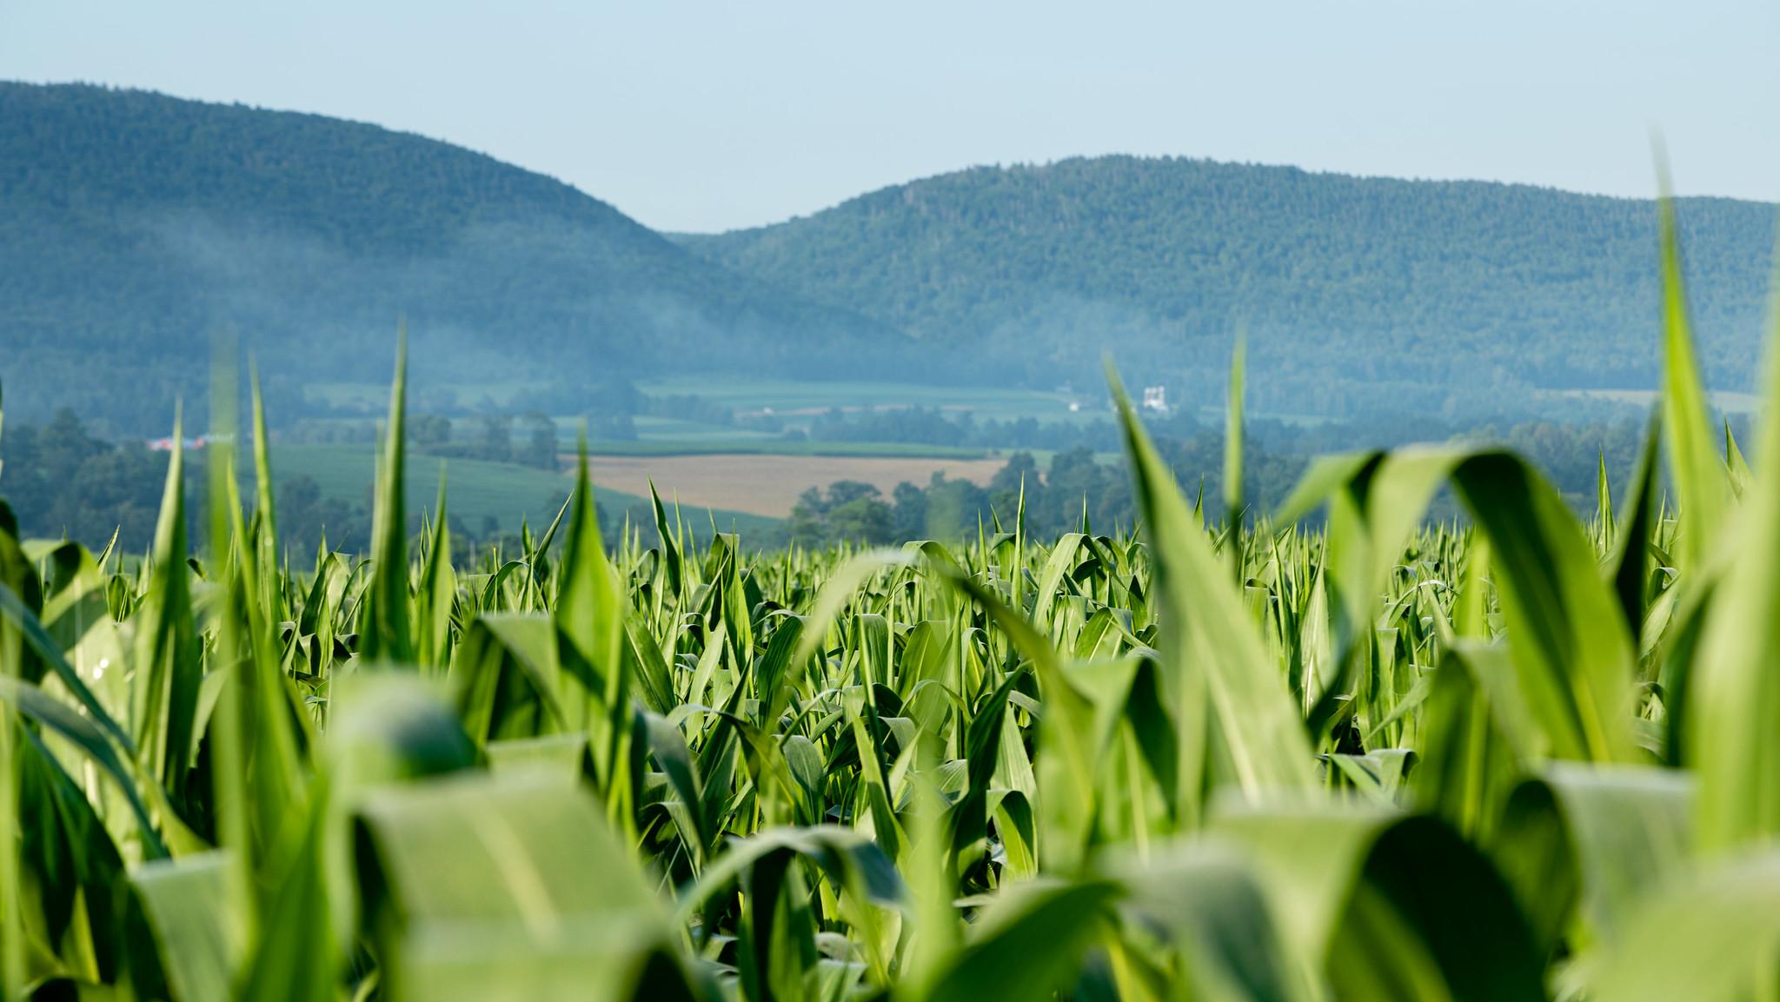
A Local Government Guide to the Chesapeake Bay
Module 9: Understanding and Supporting Your Agricultural Allies
Notes:
Photo by W. Parson/Chesapeake Bay Program

Slide 2
Table of Contents
1
Purpose
What You’ll Learn
All About Ag
Community Benefits
Best Management Practices
Supporting Agriculture
What You Can Do
To Learn More
Glossary
2
3
4
5
6
7
8
9
*Please refer to individual slide notes for data references and information sources.
Module 9: Understanding & Supporting Agriculture
Notes:
Photo by L. Boorhem-Stephenson/Chesapeake Bay Program

Slide 3
A Guide For Local Governments
To help local government representatives better understand how the information in the modules aligns with their priorities, look for these icons:
As a local leader, your decisions set the course for your community. Your actions determine the health and vitality of your jurisdiction, as well as that of your local waterways and the Chesapeake Bay. You can achieve win-win outcomes by prioritizing local economic development, infrastructure resiliency, public health, and education while also protecting your environment.
This module is one in a series created by the Chesapeake Bay Program to support and inform decision making by local officials. We encourage you to examine the full suite of modules listed on the next slide.
Economic Development
Public Health & Safety
Infrastructure Maintenance & Finance
Education
Understanding & Supporting Agriculture
Purpose

Slide 4
A Guide For Local Governments
Available Local Government Modules
How Your Watershed Works
Foundations of Clean Water
Healthy Water for the Economy
Capitalizing on the Benefits of Trees
Preserving Local Character and Landscapes
Protecting Your Infrastructure Through Stormwater Resiliency
Building the Workforce of Today and Tomorrow
Preparing Your Community for Water Extremes
Understanding and Supporting Your Agricultural Allies
Keys to Community Engagement
Your Health and the Environment
Understanding & Supporting Agriculture
Purpose

Slide 5
Laying Foundations
Farmers are inextricably linked to the land.
They rely on the land, nurture the soil, and closely watch environmental conditions. Farmers in the watershed use management practices on their farms to protect natural resources and safeguard water quality in local streams, rivers, and the Chesapeake Bay. This legacy of environmental stewardship stretches back almost 100 years.
Local governments have a vested interest in a strong agricultural industry. Agriculture provides many benefits to your community, including locally-produced food, agrarian character, jobs, taxes, and more. You can work with farmers to achieve outcomes that benefit your community, the agricultural industry, and your local environment.
Understanding & Supporting Agriculture
Purpose
Notes:
Photo by M. Rath/Chesapeake Bay Program

Slide 6
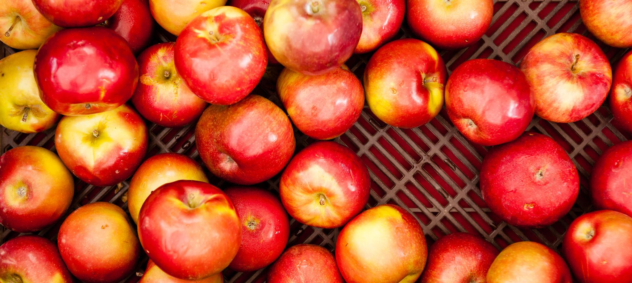
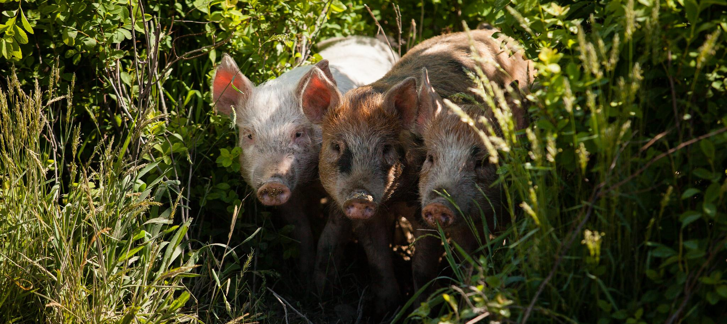
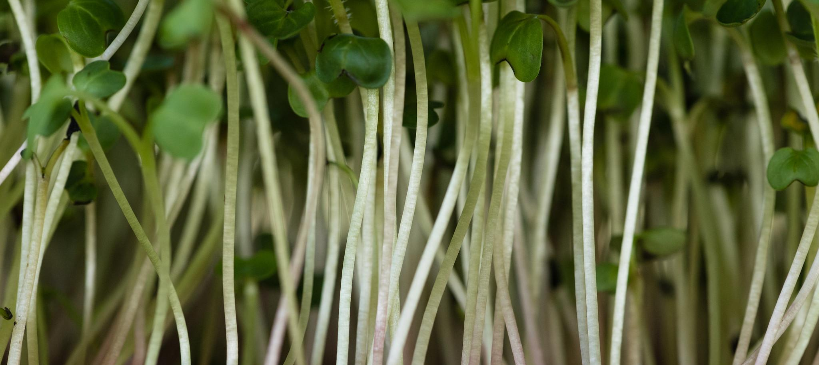
What You’ll Learn
How does agriculture benefit my community?
What goals do I have in common with farmers?
What can I do to support my agricultural allies?
Understanding & Supporting Agriculture
What You’ll Learn
Notes:
Photos by W. Parson and K. Rutowski/Chesapeake Bay Program

Slide 7
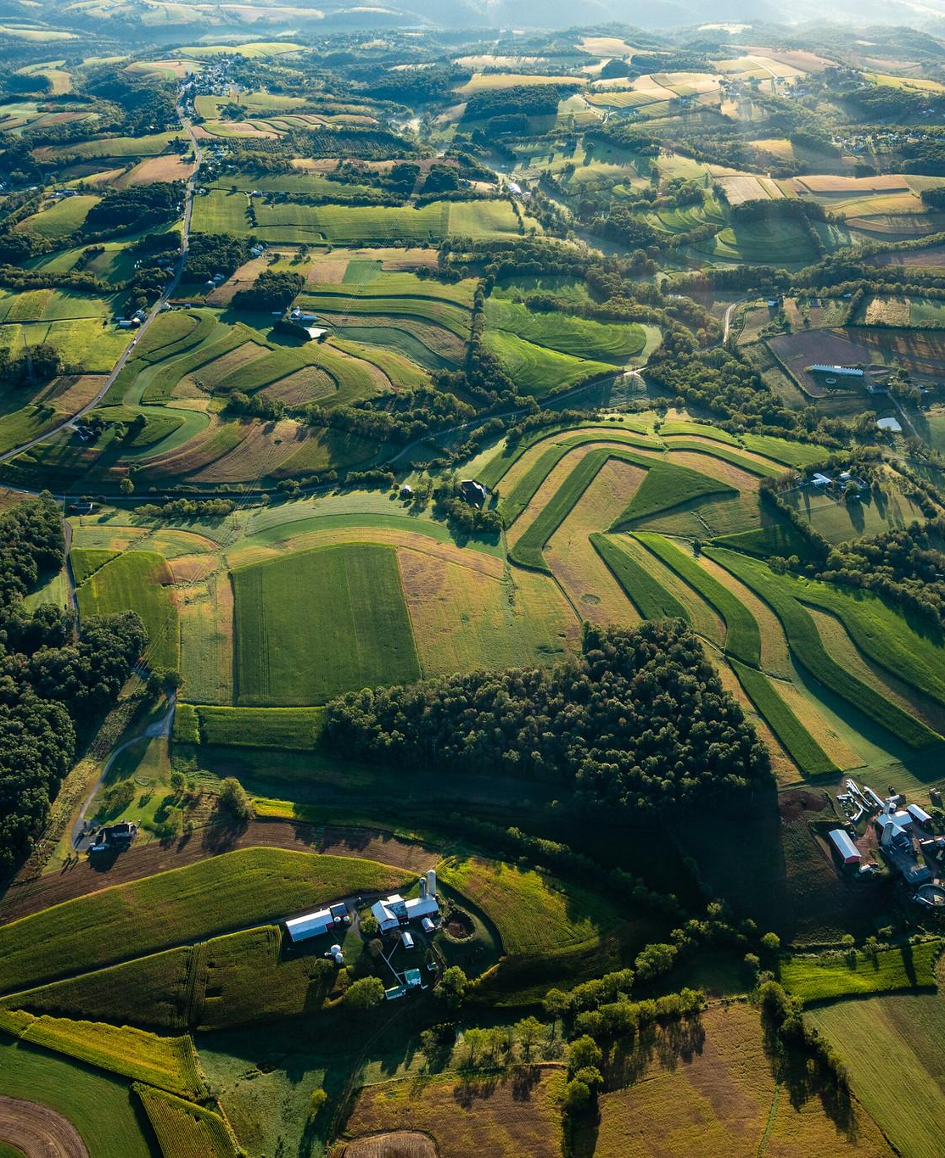
All About Ag
Explore what the agricultural industry looks like in your state and throughout the watershed.
Notes:
Photo by W. Parson/Chesapeake Bay Program

Slide 8
What Is Agriculture?
This might seem like an easy question, but there are many answers.
For the purposes of the U.S. Census, a farm is any establishment which produces and sells $1,000 or more of agricultural products during the year. Some definitions of agriculture include forestry, aquaculture, and more. For the purposes of this module, we will be focusing on land-based crop and livestock farming.
Understanding & Supporting Agriculture
All About Ag
Notes:
Photo by W. Parson/Chesapeake Bay Program

Slide 9
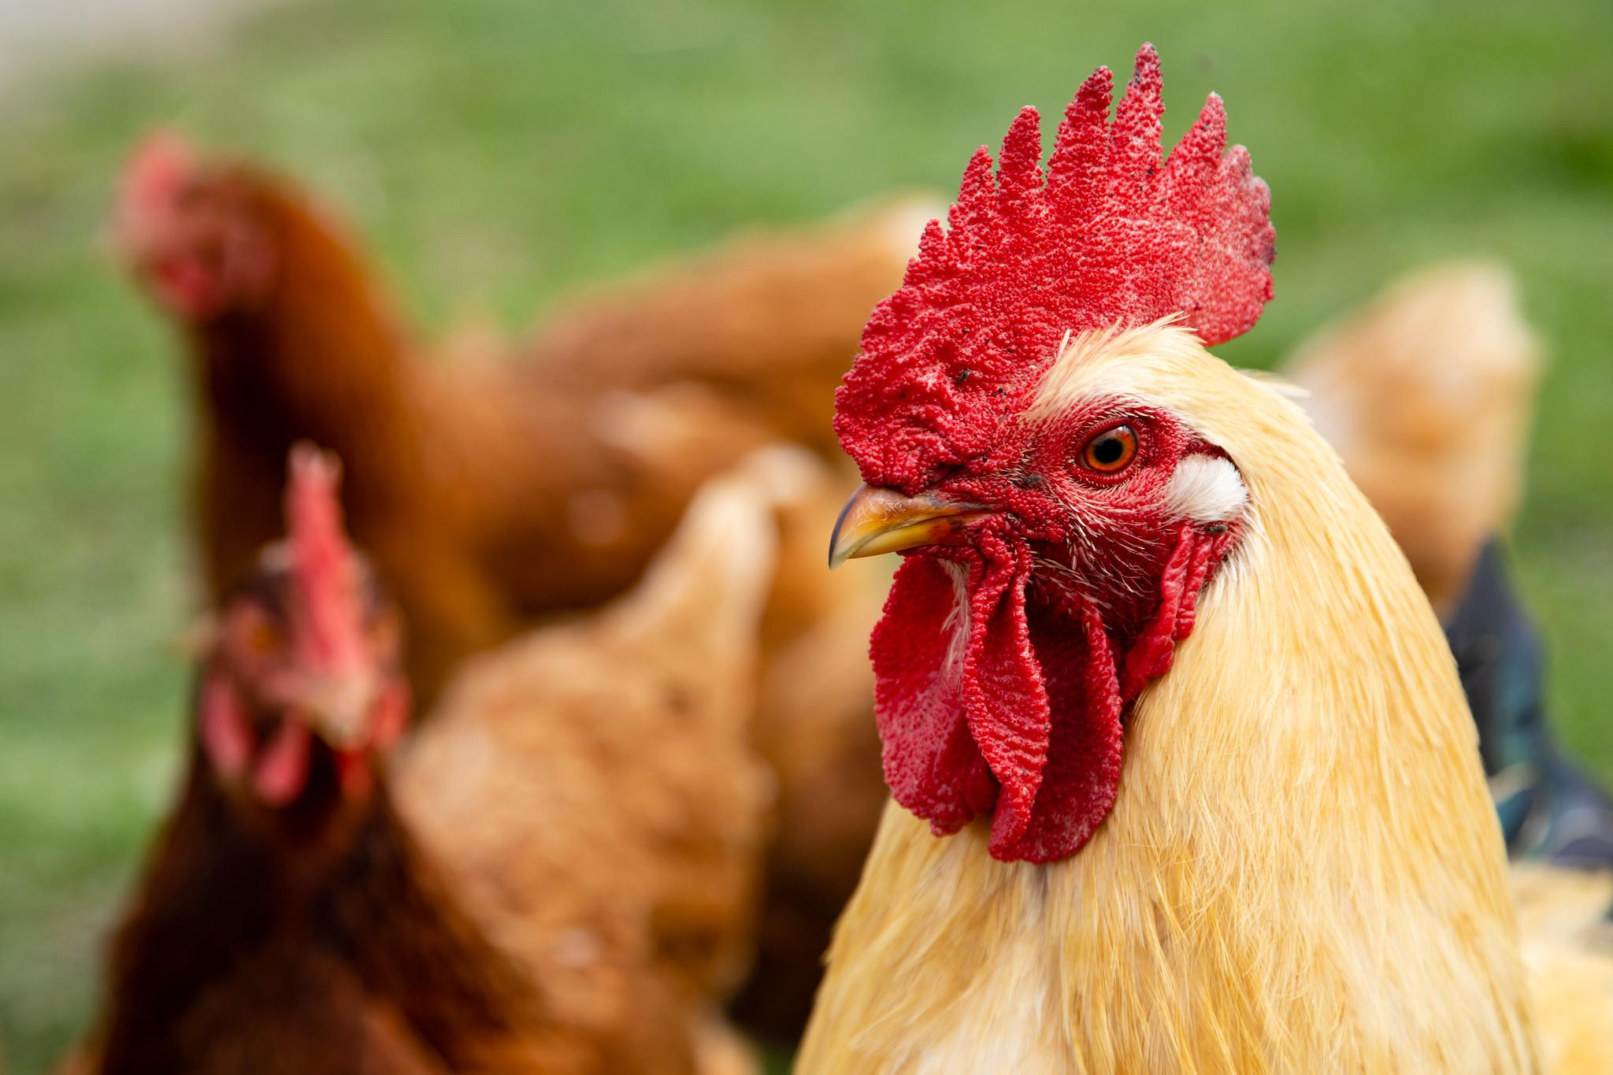
What Is Agriculture?
There are many types of crop and livestock farms.
Small family farms
Retirement farms
Off-farm-occupation farms
Farming-occupation farms: low-sales and high-sales
Midsize family farms
Large-scale family farms
Large farms
Very large family farms
Nonfamily farms
The most prevalent farm type in the US is off-farm-occupation, whose operators report that farming is not their primary occupation. Most farms are family farms and under 500 acres in the watershed states.
Number of farms in the watershed states
Size (acres)
Understanding & Supporting Agriculture
All About Ag
Notes:
Photo by W. Parson/Chesapeake Bay Program
References:
https://www.ers.usda.gov/webdocs/publications/102808/eib-231.pdf?v=6746.3
2017 Census of Agriculture: https://www.nass.usda.gov/Publications/AgCensus/2017/index.php

Slide 10
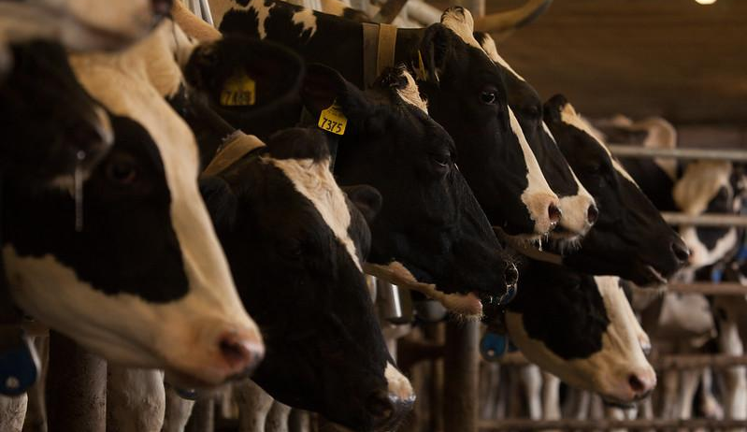
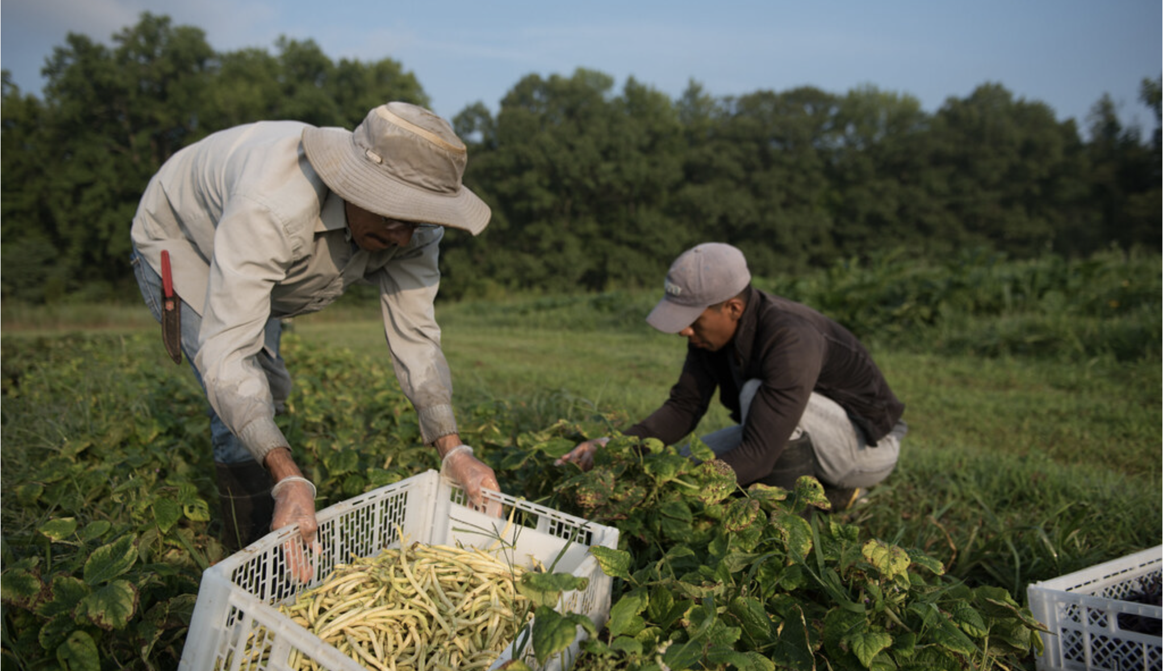
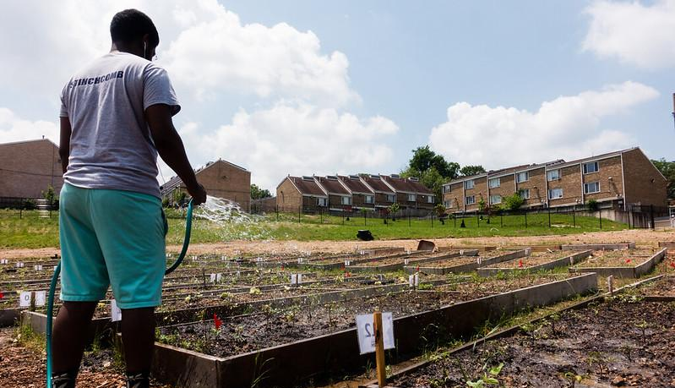
What Is Agriculture?
Other farm types to be aware of:
CAFOs (Concentrated Animal Feeding Operations) – a large agricultural facility that raises animals at high-density. A CAFO may produce meat, eggs, or milk.
Organic farm – a farm that does not use synthetic fertilizers or pesticides. These farms may still use naturally-derived fertilizers or pesticides (like biological pesticides).
Urban farm – the cultivation, processing and distribution of agricultural products in urban areas. Urban farms may include community gardens, rooftop farms, hydroponic facilities, and vertical production. Does your current zoning prevent or support urban farming practices, like converting old warehouses to vertical farming?
Understanding & Supporting Agriculture
All About Ag
Notes:
Photos by W. Parson and K. Rutowski/Chesapeake Bay Program

Slide 11
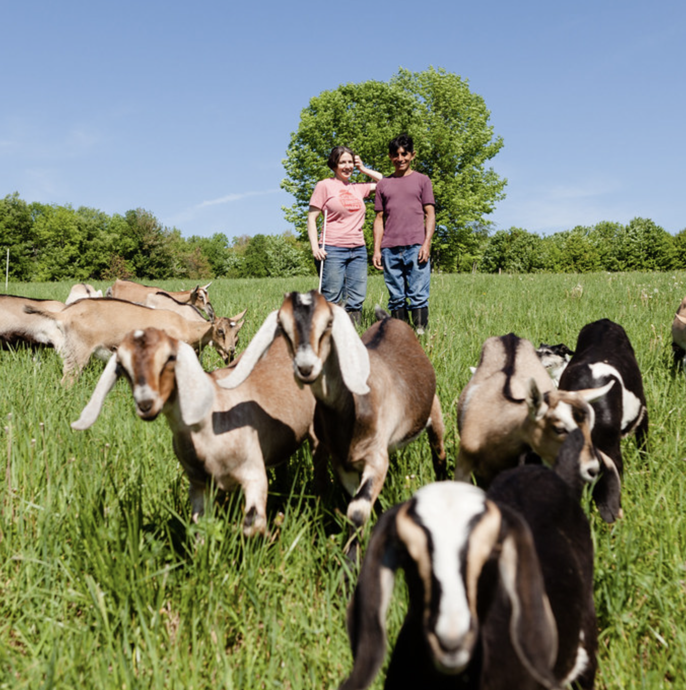
Agriculture By The Numbers
According to the 2017 Census of Agriculture:
There are over
The agriculture industry accounts for
168,000 farms
184,000+ jobs
in the Chesapeake Bay watershed states, covering
in the Bay watershed states.
28 million acres.
The value of agricultural products sold in the Bay watershed states totals
Over 20% of the watershed is used for agriculture.
$21.8 billion.
In the watershed states, there are:
1.6 million pigs
630,000 acres of wheat
5.2 million cows
1.7 million acres of soybeans
1.1 billion chickens
3.5 million acres of corn
x100
Only 35% of food spending in the region goes to local businesses.
Understanding & Supporting Agriculture
All About Ag
Notes:
Photo by W. Parson/Chesapeake Bay Program
References:
2017 Census of Agriculture: https://www.nass.usda.gov/Publications/AgCensus/2017/index.php
2019 Chesapeake Foodshed Assessment: https://agnr.umd.edu/sites/agnr.umd.edu/files/files/documents/Hughes%20Center/2019__Chesapeake-Foodshed-Assessment_02.pdf

Slide 12
Agriculture By The Numbers
Case study: Swoope, VA
Agriculture is responsible for about 40% of the nitrogen, 45% of the phosphorus, and 62% of the sediment entering the Chesapeake Bay annually.
Because agriculture plays such a big role in water quality, there is also a lot of potential and opportunities for farmers to make a difference in the quality of your local waterways. By and large, farmers have many incentives to make their farms more environmentally friendly, including:
optimizing the health of their land, herd, and/or crops.
preserving their land for future generations.
local, state, and federal regulations and incentives.
Bobby Whitescarver enrolled in Virginia’s cost-share program to fence his cows out of his stream. He chose to install fences in order to distribute water sources throughout his property, exclude cows from calving risk areas like steep banks, improve herd health, to make his operation more efficient, and to reduce local water pollution.
Read his guest column in Virginia Mercury for more.
$
Understanding & Supporting Agriculture
All About Ag
Notes:
Photo by W. Parson/Chesapeake Bay Program
References:
Chesapeake Bay Program: https://d18lev1ok5leia.cloudfront.net/chesapeakebay/documents/agriculture_backgrounder-final.pdf

Slide 13
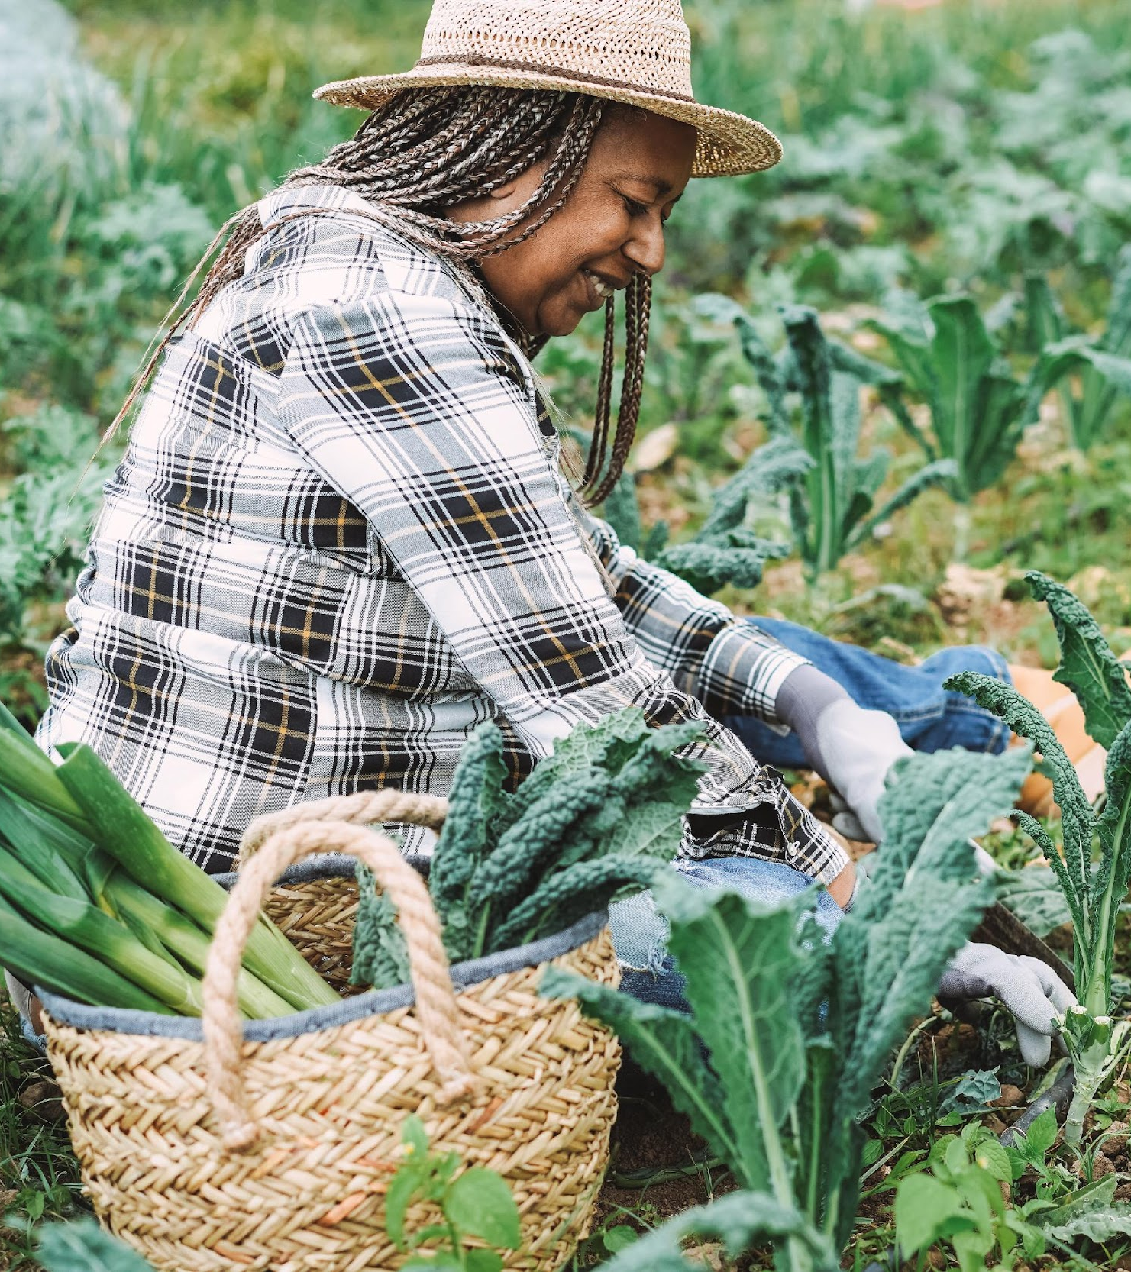
Community Benefits
From food security to job creation, agriculture has many benefits to your community.
Notes:
Photo by S. Droter/Chesapeake Bay Program

Slide 14
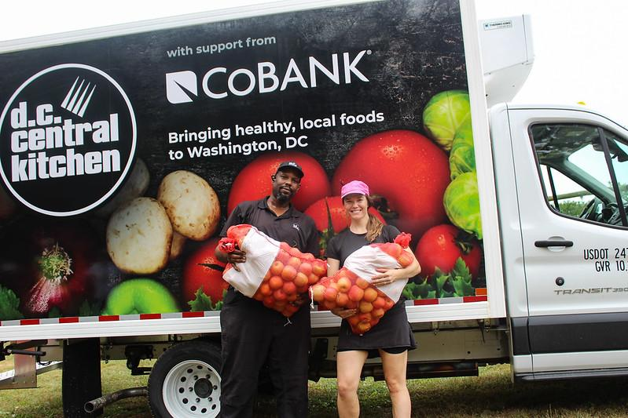
Food Production
There are over 18 million people in the Chesapeake Bay watershed – they spend about $57.3 billion on food annually.
A community subsisting on locally-grown food sees numerous economic benefits, from keeping money in your community to creating jobs (more than 3 times as many jobs are created by farms with some direct marketing versus wholesale farms) to increased tax revenue. In addition, consumers across income levels are willing to pay more for local food – a benefit to your agricultural allies.
Case study: DC Central Kitchen (DCCK)
Food insecurity disproportionately affects populations that are minority, immigrant, rural, and economically vulnerable. DCCK in Washington, DC takes food that would have been thrown out, like produce that is misshapen or bruised, from regional farms and makes meals for homeless shelters, low-income schools, and others in need. DCCK also provides job training and fresh produce to corner stores in low-income communities.
Understanding & Supporting Agriculture
Benefits
Notes:
Photo by DC Central Kitchen
References:
2019 Chesapeake Foodshed Assessment: https://agnr.umd.edu/sites/agnr.umd.edu/files/files/documents/Hughes%20Center/2019__Chesapeake-Foodshed-Assessment_02.pdf
https://www.stlouisfed.org/-/media/project/frbstl/stlouisfed/files/pdfs/community-development/harvesting-opportunity/harvesting_opportunity.pdf#page=15
https://www.stlouisfed.org/-/media/project/frbstl/stlouisfed/files/pdfs/community-development/harvesting-opportunity/harvesting_opportunity.pdf#page=79

Slide 15
Community Identity
48%
of Americans surveyed in 2020 would choose a rural area or town if they could live anywhere
They may be attracted to the scenic landscapes, the proximity to nature and outdoor recreation, the privacy of large lots, the safety relative to cities, or because it can be less expensive. Even people who do not live in a community may choose to visit to experience agritourism.
Agriculture can be very important to your community’s identity and your residents’ perceptions of where they live, work, and play. In addition, agriculture contributes to your community’s quality of life in monetary ways, through increasing property values and paying large portions of the taxes that support public services and school systems.
Understanding & Supporting Agriculture
Benefits
Notes:
References:
https://news.gallup.com/poll/328268/country-living-enjoys-renewed-appeal.aspx

Slide 16
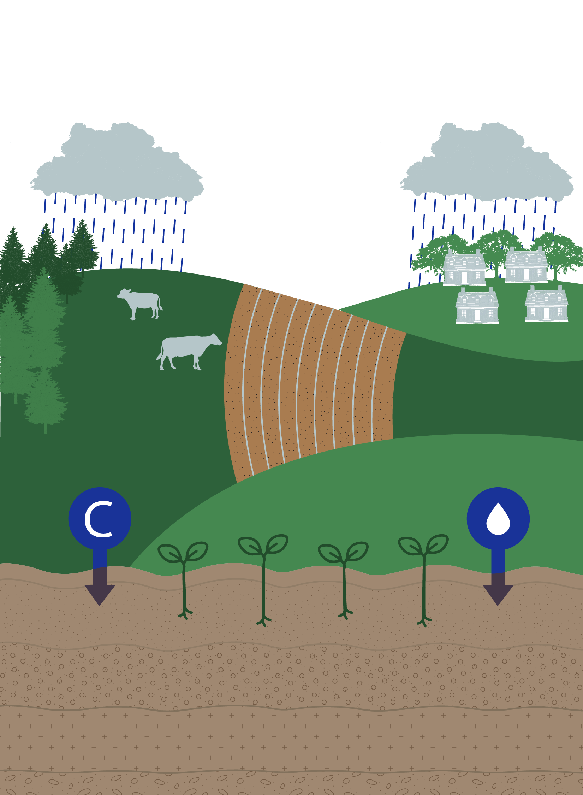
Stewardship
The Benefits of Healthy Soil
Farmland offers many opportunities for stewardship:
Carbon sequestration – potentially, agricultural land in the US could store 5% of annual carbon dioxide emissions per year.
Healthy soil – a critical component to growing crops or feeding livestock, but also absorbs water and prevents erosion and polluted runoff.
Land preservation/wetland restoration – with farmland covering a fifth of the watershed, protecting that land from development could have a large impact.
Increased biodiversity – leads to healthier pastures, increased pollinator activity and production, and promotes the spread of healthy environments across the local landscape.
Carbon storage
Plants that are more resistant (to pests and extreme weather) and have higher crop yields
Water storage
Understanding & Supporting Agriculture
Benefits
Notes:
References:
https://www.c2es.org/2021/02/u-s-farmers-can-plow-fertile-ground-for-climate-solutions/

Slide 17
Best Management Practices
Farmers are key allies in making your local waterways healthier.

Slide 18
What Are Best Management Practices?
Best management practices, or BMPs, are practical actions that farmers can take to reduce nitrogen, phosphorus, and sediment loads to local waterways and improve environmental and public health.
The BMPs that we will focus on in this module are:
Farming Practices
Nutrient management plan*
Crop rotation/rotational grazing
Structural Practices
Composting/waste control
Land Management
Stream protection
Wetlands conservation/restoration
Benefits of BMPs:
Nutrient reduction
Erosion reduction
Habitat creation
$
Profitability
Healthier plants, animals, and people
Understanding & Supporting Agriculture
BMPs
*Nutrient management plans are a required BMP – the others listed here are not required.
Notes:
Photo by R. Magnien/NOAA

Slide 19
Farming & Structural Practices
$
$
Rotation
Crop rotation and rotational grazing follow the same principle of changing crop plants or moving animals between pastures on a schedule determined by the farm’s needs. Benefits of crop rotation include increased plant diversity, weed suppression, reduced pesticide/fertilizer costs, and less soil erosion. Benefits of rotational grazing include better forage quality, less erosion, and better distribution of nutrients.
Nutrient Management
A nutrient management plan is generally required for any farm or agricultural land that produces plants, food, fiber, animals, or other agricultural products. They analyze farm practices and conditions to determine the optimal amount, form, and application process of nutrients needed to achieve optimum yields while preventing excess nutrients from impacting waterways.
Waste Control
Waste control might include actions like building animal waste storage structures; composting waste; and incepting, collecting, and treating runoff, agricultural wastes, or manure. These actions improve nutrient management, protect herd health, and reduce losses to surface water and groundwater.
Understanding & Supporting Agriculture
BMPs
Notes:
References:
https://extension.psu.edu/nutrient-management-planning-an-overview
https://agriculture.ny.gov/system/files/documents/2022/06/ag_bmp_catalogue.pdf

Slide 20
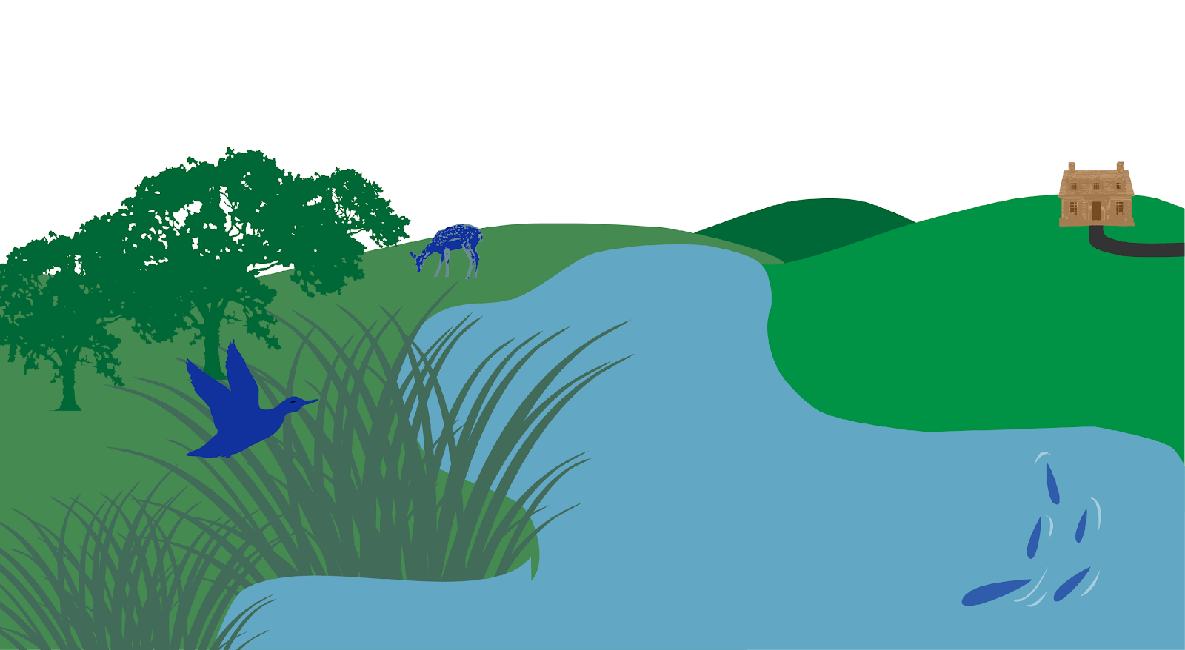
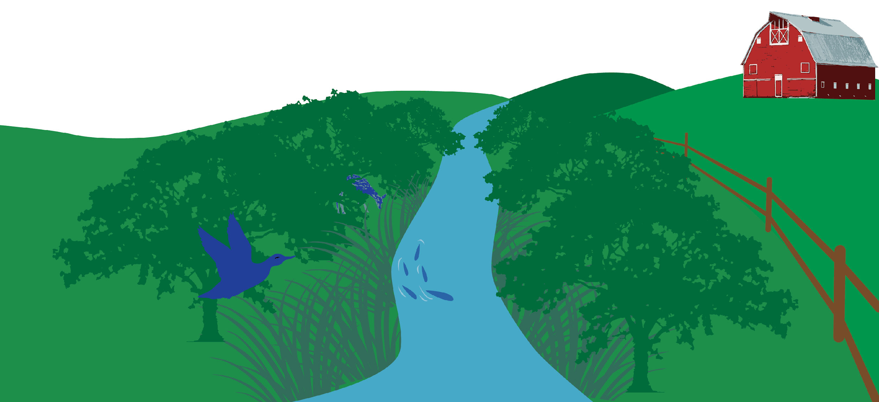
Land Management
Stream protections
This category includes animal exclusion fencing, stream crossings, riparian buffers, and streambank stabilization. Fencing keeps livestock out of local waterways, improving animal health and reducing nutrient and sediment inputs. Riparian buffers use trees to filter runoff from a farm before it enters local waterways. Streambank stabilization reduces erosion.
Wetlands
Like riparian buffers, wetlands restoration or construction provide a natural filter for water running off a farm before it reaches local waterways. This reduces nutrient and sediment inputs while also providing habitat for many desirable wildlife species, like fish and ducks.
Understanding & Supporting Agriculture
BMPs
Notes:
Photo by R. Magnien/NOAA

Slide 21
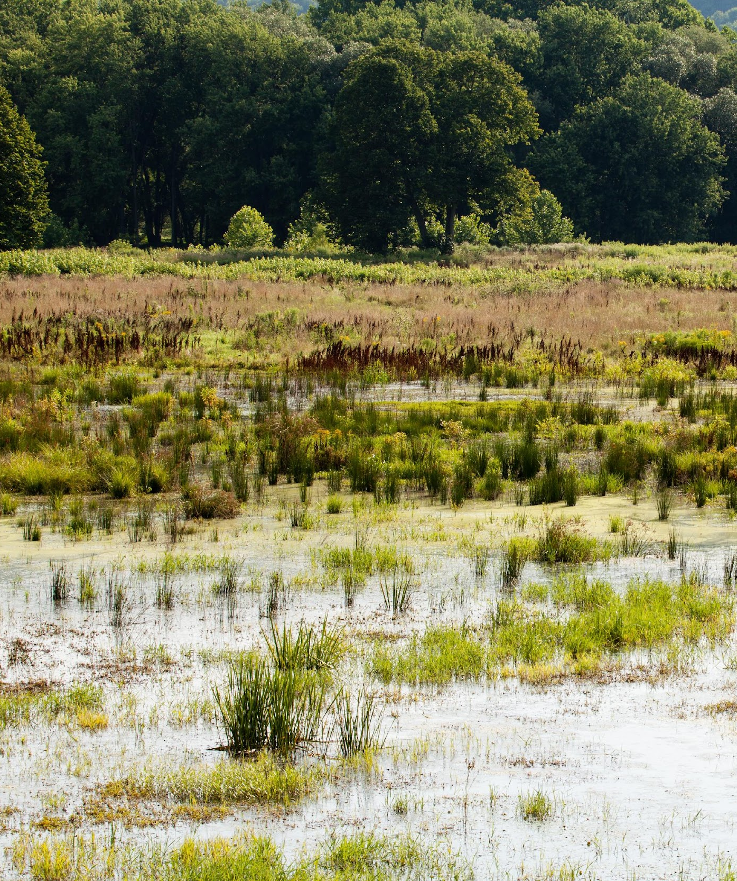
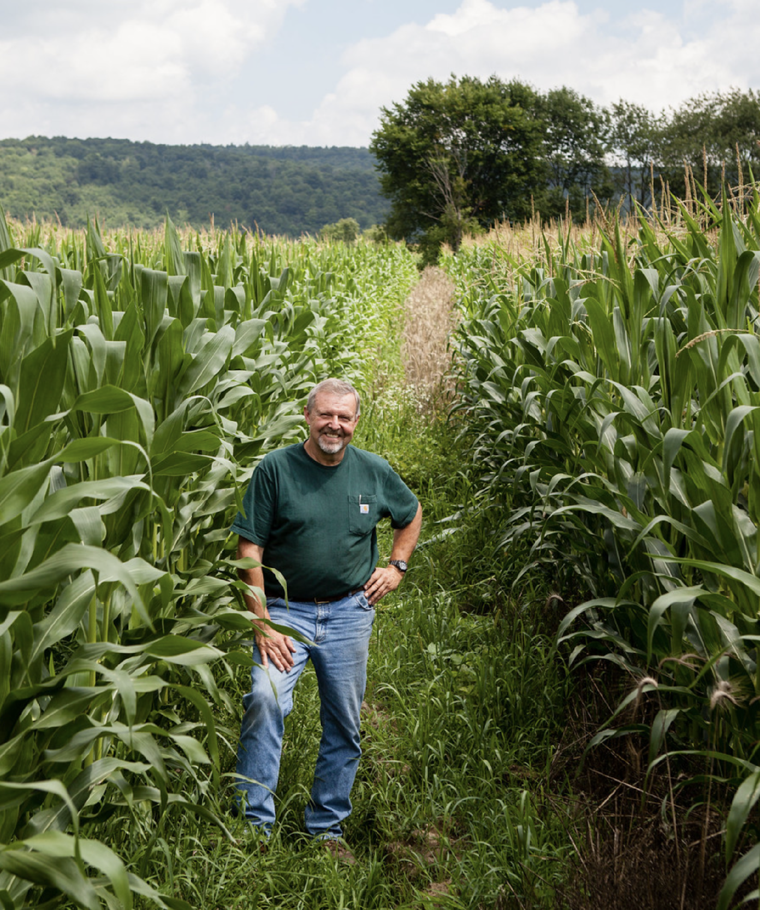
Supporting Agriculture
Now that you know more about agriculture, how do you support farmers and maximize benefits to your community?
Notes:
Photo by W. Parson/Chesapeake Bay Program

Slide 22
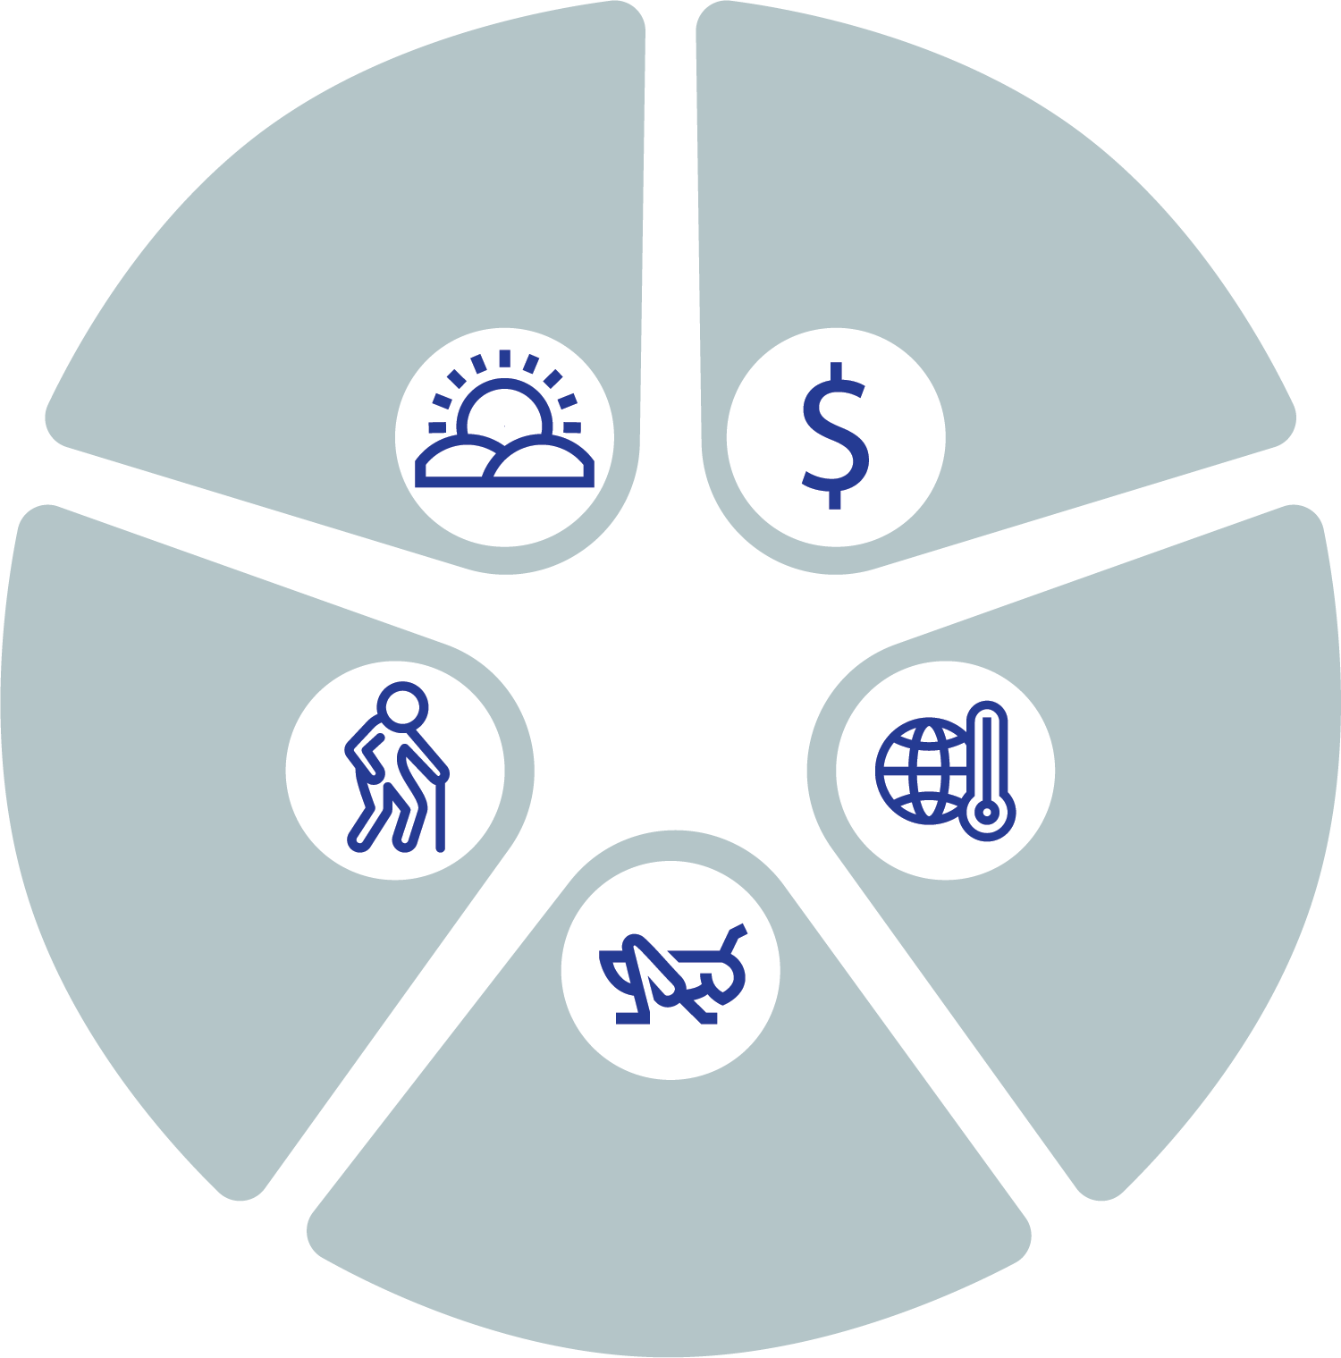
Challenges to Agriculture
There are many challenges to agriculture today, including:
Loss of farmland
Decreased economic feasibility
Drought, flooding, saltwater intrusion, changing temperatures, and more related to climate change
Invasive species and new diseases
An aging population
Land loss
Economic feasibility
Threats to Agriculture
Aging farmers
Climate change
Pests and invasives
Understanding & Supporting Agriculture
Support
Notes:
Photo by S. Ballard/Chesapeake Bay Program

Slide 23
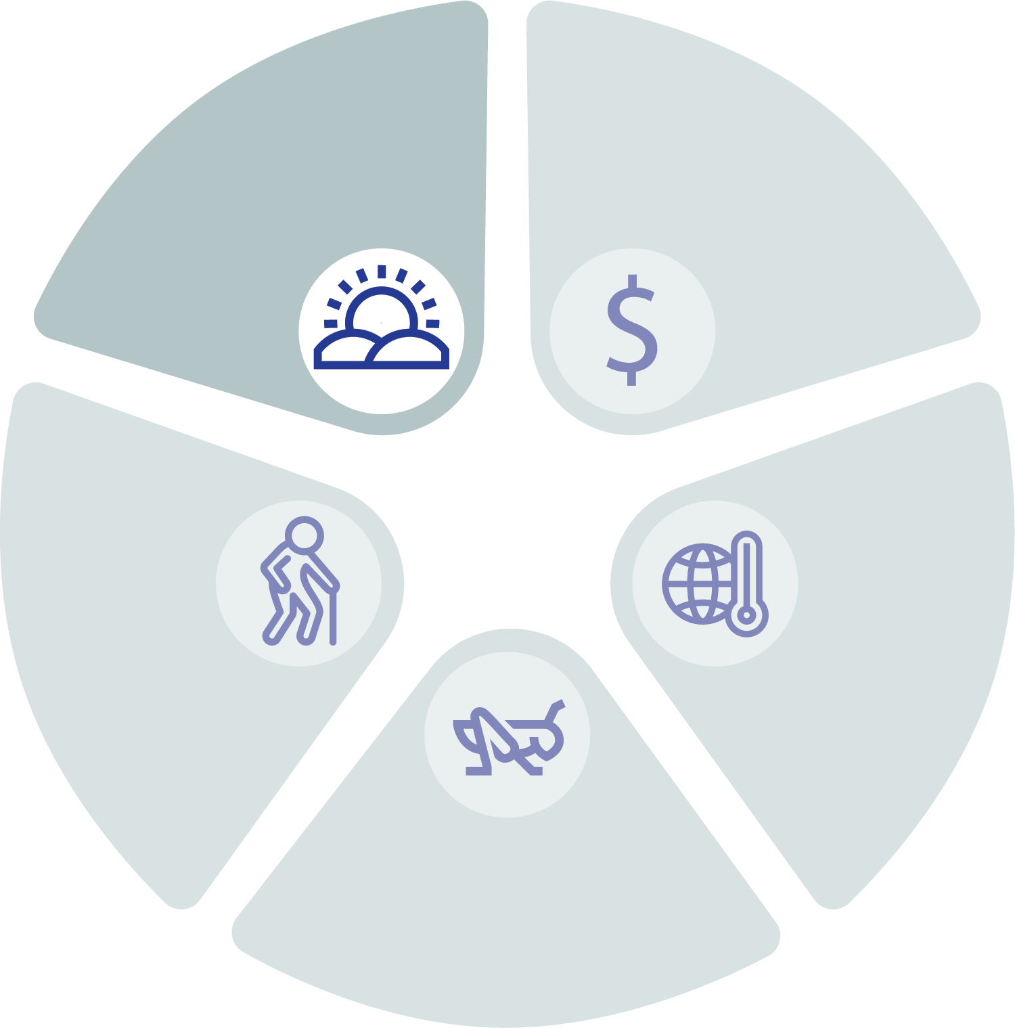
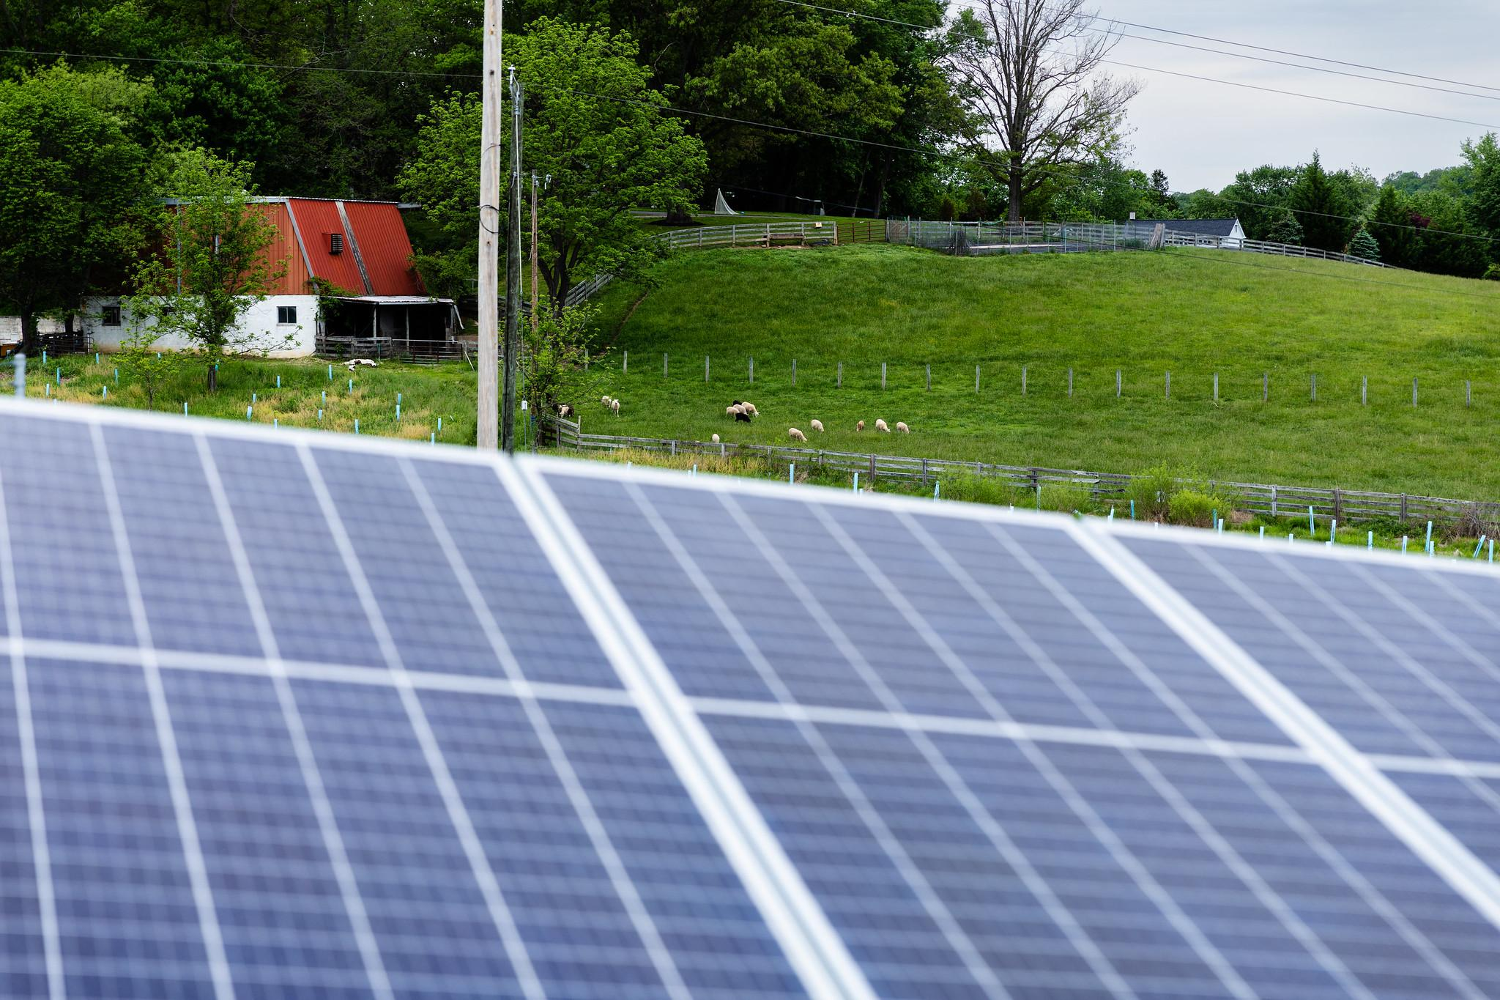
Conversion of Farmland
The Chesapeake watershed is seeing a net decrease in agricultural land.
Between 2013/2014 and 2017/2018, the watershed lost 36,500 acres of farmland. Nationally, between 2001 and 2016, 2,000 acres of farmland per day were converted to urban and highly developed land use or low-density residential land use.
Alternative energy, like solar farms, can compete with agriculture for the flat, open fields that are desirable for both uses. Cropland and pasture account for 31.9% of all land currently used for solar facilities in Virginia. Smart solar siting is required to limit competition and conversion.
Most farmers in the watershed states are 45-64 years old, followed by 65 and older.
Without younger generations getting involved or interested in farming, family farms are being sold. One way to combat this is highlighting agricultural careers in schools and public events, like county fairs. Support your local youth agricultural organizations like 4H.
Understanding & Supporting Agriculture
Support
Notes:
Photo by W. Parson/Chesapeake Bay Program
References:
https://d18lev1ok5leia.cloudfront.net/chesapeakebay/documents/landuse_landchange.pdf
https://farmlandinfo.org/wp-content/uploads/sites/2/2020/09/AFT_FUT_StateoftheStates_rev.pdf
https://scholarscompass.vcu.edu/cgi/viewcontent.cgi?article=1043&context=murp_capstone
2017 Census of Agriculture: https://www.nass.usda.gov/Publications/AgCensus/2017/index.php

Slide 24
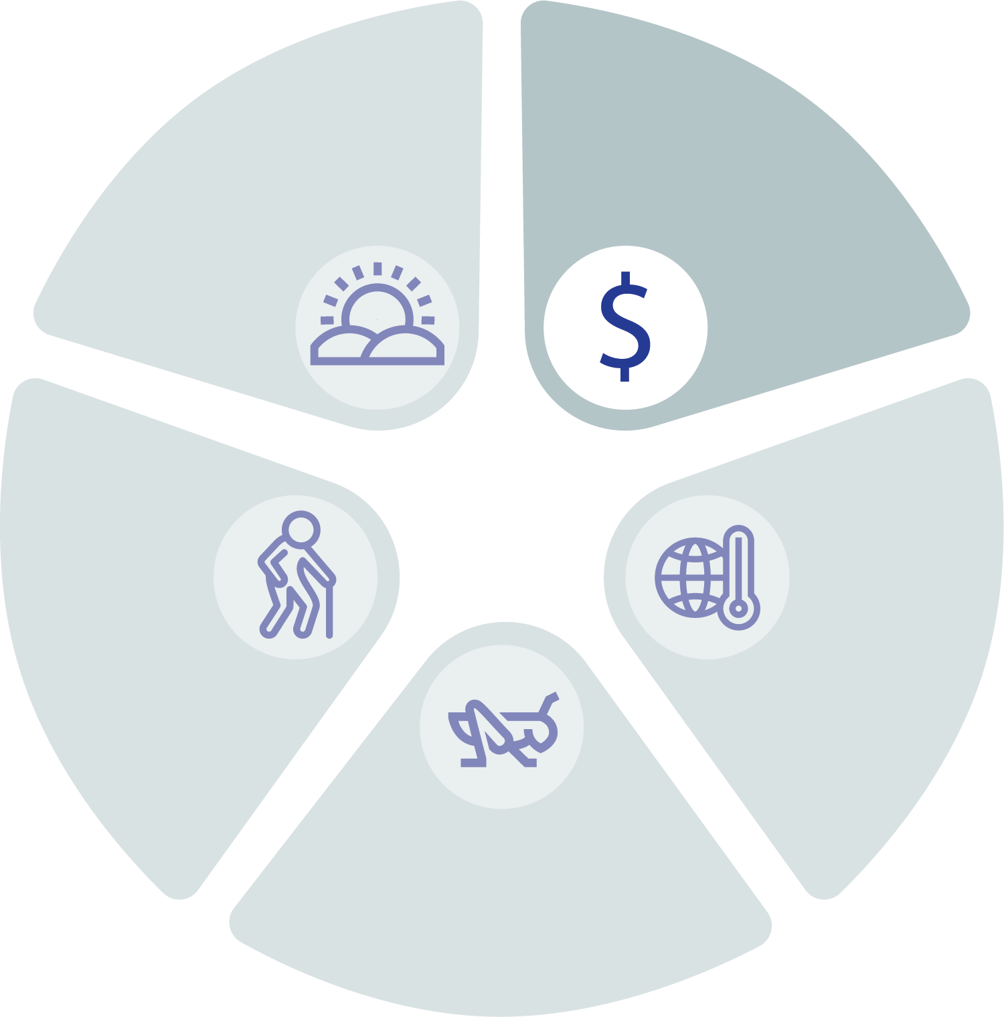
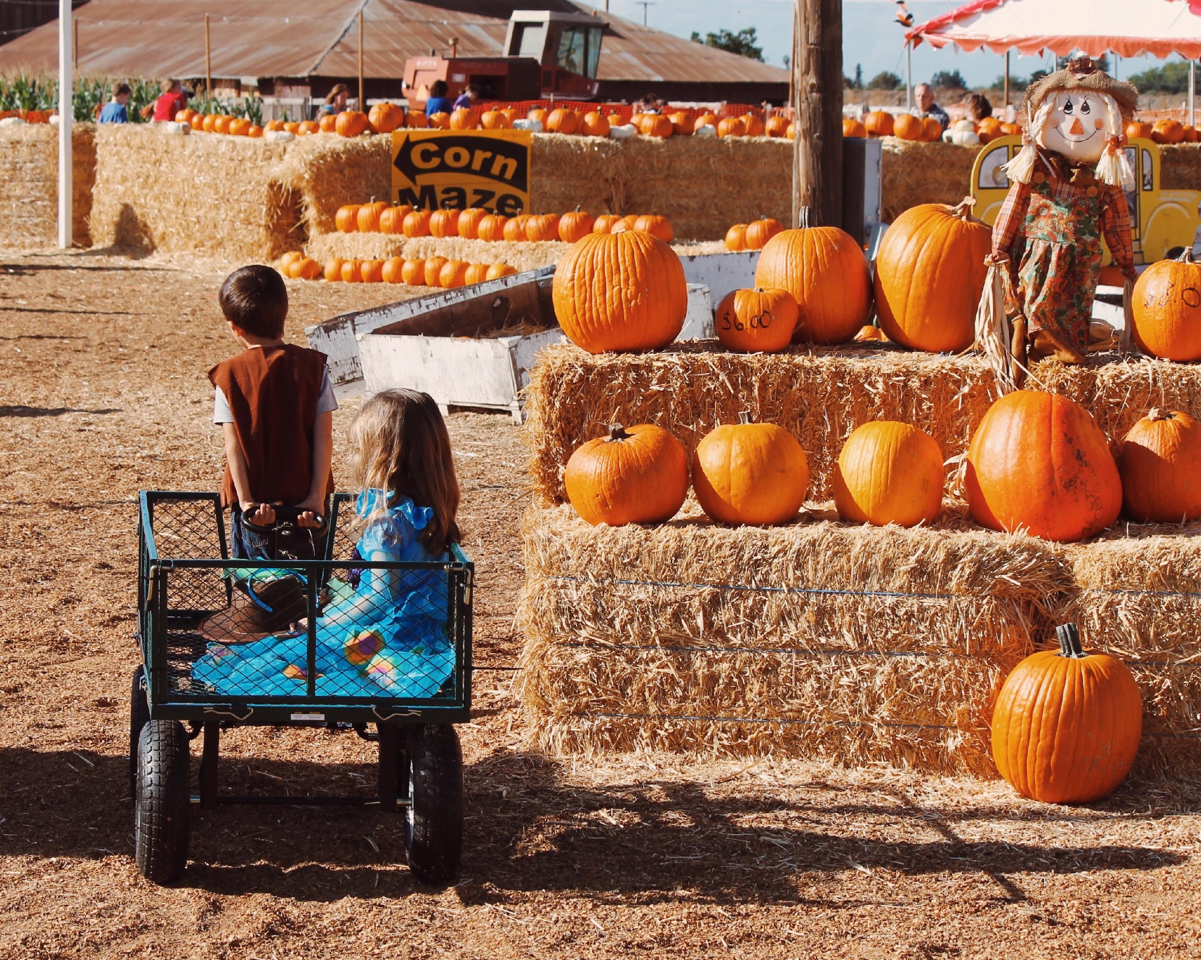
Economic Feasibility
Most farms operate on tight profit margins. Because crops and animals take time and good environmental conditions to grow, farmers must wait to see a return on investment and are beholden to the whims of nature.
In addition, many farms feel social and political pressure to farm sustainably and be ambassadors of sustainable farming to the public. Adopting BMPs requires liquid capital that the farmers may not have available. This is why cost-sharing programs and support from local, state, and federal government is so important.
Agritourism is another way that farms might bring in extra income. Supporting businesses like pick-your-own orchards or farm bed and breakfasts helps farms stay in business.
A lack of economic feasibility feeds into the loss of farmland discussed on the previous slide; if farmers aren’t profitable but can make ends meet by selling land, they may not have a choice.
Understanding & Supporting Agriculture
Support

Slide 25
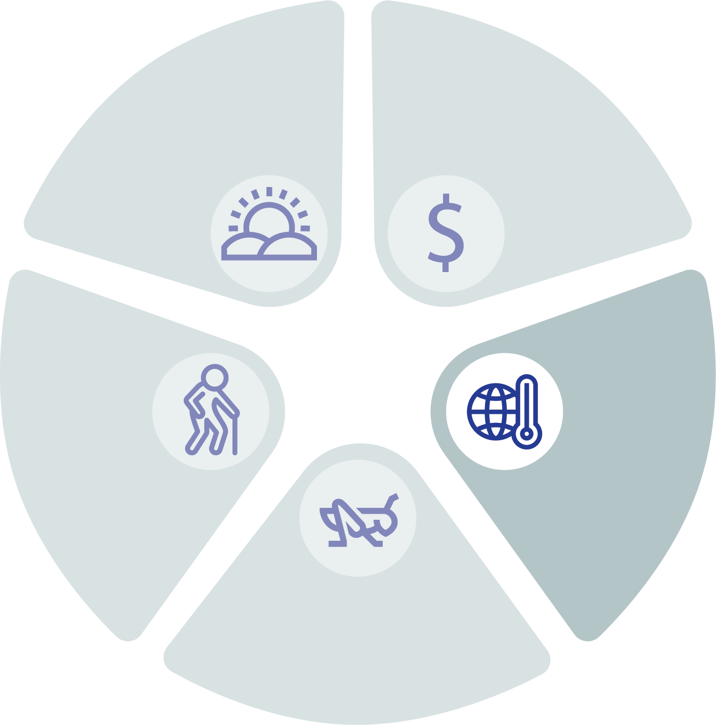
Changing Climate
Climate Connection
Farmers are facing rising temperatures, increased flooding, higher likelihoods of drought, and generally less predictable growing seasons than ever before.
It is becoming more widespread for farmers to have to worry about saltwater intrusion, or when saltwater moves inland through sea level rise and storms or underground through aquifers. Many crops are not tolerant of irrigation with salty water.
Lastly, the changing climate has impacts on other parts of the ecosystem that affect crops and livestock.
With increasing temperatures, nuisance species are likely to get a boost while crop and livestock species are negatively impacted. The list of threats includes:
Insects like the spotted lanternfly
Weeds like kudzu and privet
Fungi like potato blight
Livestock diseases like anthrax
Understanding & Supporting Agriculture
Support
Notes:
References:
https://www.climatehubs.usda.gov/hubs/northeast/topic/saltwater-intrusion-growing-threat-coastal-agriculture

Slide 26
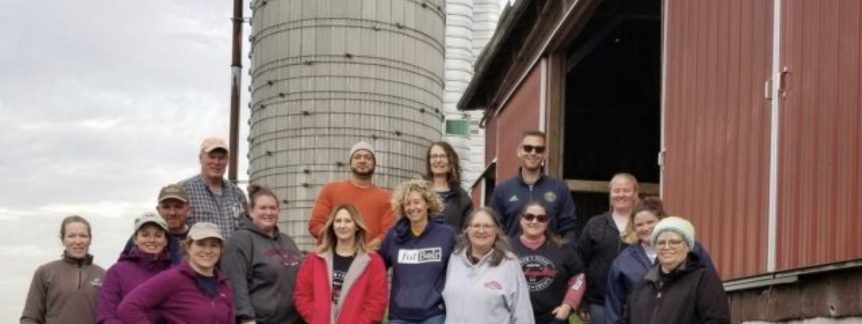
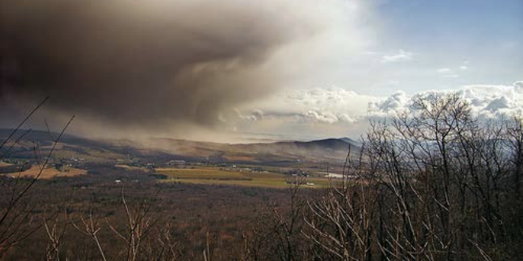
Tools
Case study: Turkey Hill Clean Water Partnership
Zoning and districting are useful tools for slowing or reversing the conversion of farmland. See the case study below.
Local leaders aren’t farmers’ only ally – partners like Soil and Water Conservation Districts (SWCDs) can help you support your community’s farms. You can also partner with extension offices, nonprofits, and industry in some cases, like the case study to the right.
There are funding resources available to your local farmers, including for resilient, climate-smart agriculture. Check out the USDA’s Partnerships for Climate-Smart Commodities.
Turkey Hill Dairy formed a partnership with the Alliance for the Chesapeake Bay and the MD and VA Milk Producers Cooperative Association. Dairy farms with conservation plans receive a premium from Turkey Hill. Funding is from the Natural Resource Conservation Service and National Fish and Wildlife Foundation.
Case study: Caernarvon Township, PA
Caernarvon Township protected their farmland through an Agricultural District through a zoning ordinance. Within the zone, only uses compatible with agriculture are allowed and future inhabitants must accept the impacts associated with agricultural business. They also partnered with neighboring jurisdictions to establish a regional comprehensive plan to protect agriculture, woodlands, and watershed resources.
Understanding & Supporting Agriculture
Support
Notes:
Photos by the Alliance for the Chesapeake Bay and Chesapeake Bay Trust

Slide 27
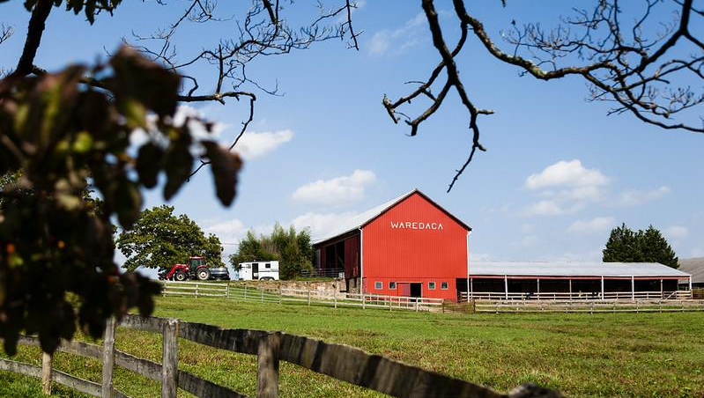
Other Support
Harford County created an agribusiness incubator, an inexpensive space for new businesses, to give farmers, artists, and food processors a place to sell directly to local consumers. The space includes a playground, pavilion and trail system and brings in hundreds of visitors monthly.
There are other ways local leaders can support local farms.
Supporting farmer’s markets in your community is a great way to expand local farmers’ tight profit margins.
Supporting the involvement of farms in local food banks and public schools also helps to add stability and keep produce local. More than 65% of school food authorities in the United States have some sort of “farm to school” program; does your community? If not, it’s a good place to start!
Case study: Harford County, MD
The “Farm to Food Bank Program” purchases produce from local farms for the Manna Food Center, which distributes fresh, nutritious food to County residents challenged by food insecurity.
Case study: Montgomery County, MD
Understanding & Supporting Agriculture
Support
Notes:
Photos by W. Parson/Chesapeake Bay Program and the National Association of Counties
References:
https://farmtoschoolcensus.fns.usda.gov/

Slide 28
What You Can Do
Connect with and act as liaison between farmers, technical service providers, nonprofits, and funders.
Consider hosting a networking breakfast or highlighting a sustainable farm in your municipal newsletters.
Champion the connection between clean water and agriculture. Appeal to your state or the federal government to support farmers.
Collaborate towards mutual wins like using agricultural BMPs to meet your community’s storm water management permitting requirements.
Learn about the Revolving Water Fund
Visit Wetlands Work to read about the benefits of wetlands and programs that help farmers restore wetlands on their properties, including funding sources.

Slide 29
To Learn More
Virginia Cooperative Extension
Find and use tools, information, and subject matter expertise to help you support local farmers.
Chesapeake Bay Commission’s Boots on the Ground Presentation
View the slides for information on agricultural technical assistance and funding.
American Farmland Trust’s Farms Under Threat
Read how to plan for and protect agricultural lands.
Chesapeake Bay Foundation’s Farm Forward Report
Read the PDF for information on the role farms can play in improving water quality, mitigating climate change, and supporting local economies.

Slide 30
Glossary
Family farms
Any farm organized as a sole proprietorship, partnership, or family corporation. Family farms exclude farms organized as nonfamily corporations or cooperatives, as well as farms with hired managers
CAFO
A Concentrated Animal Feeding Operation is an animal farm that meets certain animal size thresholds and also confines those animals for 45 days or more in any 12-month period in an area that does not produce vegetation
Organic farm
A farm that does not use synthetic fertilizers or pesticides but may still use naturally-derived fertilizers or pesticides (like biological pesticides)
Urban farm
The cultivation, processing and distribution of agricultural products in urban areas
Best management practices (BMPs)
Practical actions that reduce nitrogen, phosphorus, and sediment loads to local waterways
Nutrient management plan
A required BMP that analyzes farm practices and conditions to determine the optimal amount, form, and application process of nutrients needed to achieve optimum yields while preventing excess nutrients from impacting waterways.
Riparian forest buffer
An area of trees, shrubs, and/or other perennial plants adjacent to a stream or other waterway
Agritourism
A combination of agriculture and tourism that attracts visitors onto a farm for the purposes of entertainment or education while generating income for the farmer
Saltwater intrusion
When saltwater moves inland and endangers fresh groundwater supplies for drinking and irrigation due to sea level rise, excessive groundwater pumping, or other factors

Slide 31
Images and Graphics
Agriculture By The Numbers 1
Photo by W. Parson/Chesapeake Bay Program
Agriculture By The Numbers 2
Photo by W. Parson/Chesapeake Bay Program
Community Benefits
Photo by S. Droter/Chesapeake Bay Program
Food Production
Photo from DC Central Kitchen
Stewardship
Graphics by Green Fin Studio
Land Management
Graphics by Green Fin Studio
Supporting Agriculture
Photo by W. Parson/Chesapeake Bay Program
Conversion of Farmland
Photo by W. Parson/Chesapeake Bay Program
Tools
Photos from Alliance for the Chesapeake Bay and Chesapeake Bay Trust
Other Support
Photos by W. Parson/Chesapeake Bay Program and the National Association of Counties
Title Page
Photo by W. Parson/Chesapeake Bay Program
Table of Contents
Photo by L. Boorhem-Stephenson/Chesapeake Bay Program
Laying Foundations
Photo by M. Rath/Chesapeake Bay Program
What You’ll Learn
Photos by W. Parson and K. Rutowski/Chesapeake Bay Program
All About Ag
Photo by W. Parson/Chesapeake Bay Program
What Is Agriculture? 1
Photo by W. Parson/Chesapeake Bay Program
What Is Agriculture? 2
Photo by W. Parson/Chesapeake Bay Program
What Is Agriculture? 3
Photos by W. Parson and K. Rutowski/Chesapeake Bay Program

